Slide 1
Crypto Taxation
Best Practices & Beyond
Presented By:
Amy M. Wall, EA, MBA
Opinions expressed by Ms. Wall are solely her own and do not necessarily express the views or opinions of
TaxAct® Professional.

Slide 2
What We’ll Talk About Today
Reporting sales, trades, derivatives, staking, rewards, donations, gifts, inheritances
Mining activities
Participation in ICOs/IDOs/IEOs/ITOs
Losses and other murky tax issues
Upcoming legislation
Best Practices for your office

Slide 3
Sales and Trades
Section 1

Slide 4
Emily’s Sales and Trades
Purchases
Aug. 1, 2018: 0.50000000 BTC for $3,802
Jan. 1, 2020: 0.50000000 BTC for $3,598
Sales
June 1, 2020: 0.30000000 BTC; 1 BTC = $9,464 on that date
July 1, 2020: 0.40000000 BTC; 1 BTC = $9,146 on that date
Trade
Aug. 1, 2020: 0.10000000 BTC for Ether; 1 BTC = $11,323 on that date
What are the proceeds? What is the basis? What goes on her 8949?

Slide 5
Emily’s First Sale
8/01/2018: 0.50000000 BTC basis $3,802
6/01/2020: 0.300000000 basis $2,281
First Sale

Slide 6
Emily’s First Sale
Start with first sale event: June 1, 2020: 0.30000000 BTC;
1 BTC = $9,464 on that date
What property was sold, assuming FIFO?
Came from purchase on Aug. 1, 2018: 0.50000000 BTC for $3,802
What is its basis?
If .5 BTC sells for $3802, then 1 BTC sells for $7,604 and .3 BTC sells for $7,604 x .3 = $2,281
What are the proceeds?
If one BTC sells for $9,464, then .3 BTC sold for $9,464 x .3 = $2,839
What is reported?
$2,839 - $2,281 = $558, LT

Slide 7
Emily’s Second Sale
8/01/2018: 0.50000000 BTC basis $3,802
01/01/2020: 0.50000000 BTC basis $3,598
6/01/2020: 0.300000000 basis $2,281
07/01/2020: 0.20000000 basis $1,521
07/01/2020: 0.20000000 basis $1,439
First Sale
Second Sale

Slide 8
Emily’s Second Sale
Go to second sale event: July 1, 2020: 0.40000000 BTC;
1 BTC = $9,146 on that date
What property was sold?
Came partially from purchase on Aug. 1, 2018: 0.50000000 BTC for $3,802, .3 already accounted for, so we have .2 BTC left. That remaining .2 BTC came from Jan. 1, 2020 purchase: 0.50000000 BTC for $3,598
What is the basis of the sale?
From Aug. 1 purchase, if .5 BTC sold for $3,802, then 1 BTC sold for $7,604 and .2 BTC sold for $7604 x .2 = $1,521. From Jan. 1 purchase, if .5 BTC sold for $3,598, then 1 BTC sold for $7,196 and .2 BTC sold for $7,196 x .2 = $1,439

Slide 9
Emily’s Second Sale
What are the proceeds?
If one BTC sold for $9,146 on July 1, 2020, then .4 BTC sold for $9,146 x .4 = $3,658
What is reported?
Half LT and half ST!
LT proceeds $1,829 – basis $1,521 = $308
ST proceeds $1,829 – basis $1,439 = $390

Slide 10
Emily’s Trade
8/01/2018: 0.50000000 BTC basis $3,802
01/01/2020: 0.50000000 BTC basis $3,598
6/01/2020: 0.300000000 basis $2,281
07/01/2020: 0.20000000 basis $1,521
07/01/2020: 0.20000000 basis $1,439
08/01/2020: 0.10000000 basis $720
First Sale
Second Sale
Trade
08/01/2020: 0.20000000 basis $1,439
Still in taxpayer’s wallet!

Slide 11
Emily’s Trade
Finally, the trade:
Aug. 1, 2020: 0.10000000 BTC for Ether; 1 BTC = $11,323 on that date
What property was traded?
August 2018 purchase is fully accounted for, so this .1 BTC had to come from the Jan. 1, 2020 purchase of 0.50000000 BTC for $3,598
What is the basis?
From Jan. 1 purchase: If .5 BTC sold for $3,598, then 1 BTC sold for $7,196 and .1 BTC sold for $7,196 x .1 = $720

Slide 12
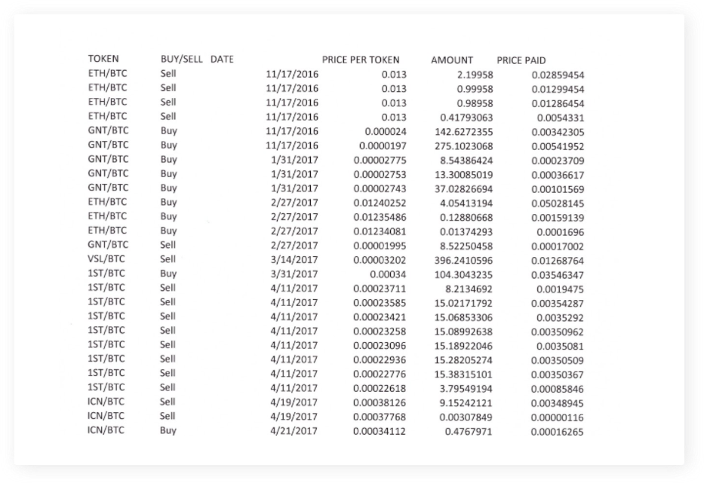
That Wasn’t So Bad…
But how would you like to do the math for about a thousand of these transactions?

Slide 13
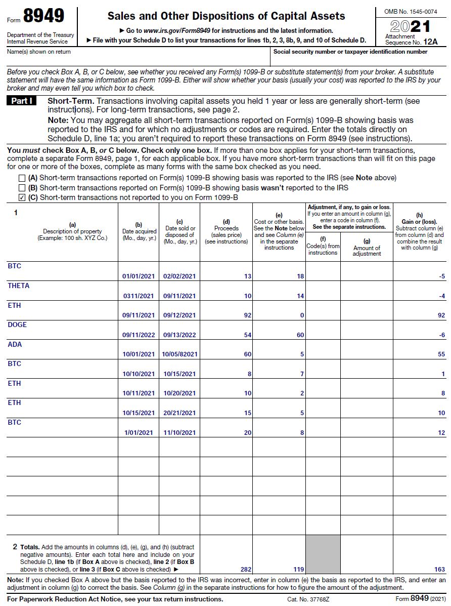
The Magic of Conversion Platforms

Slide 14
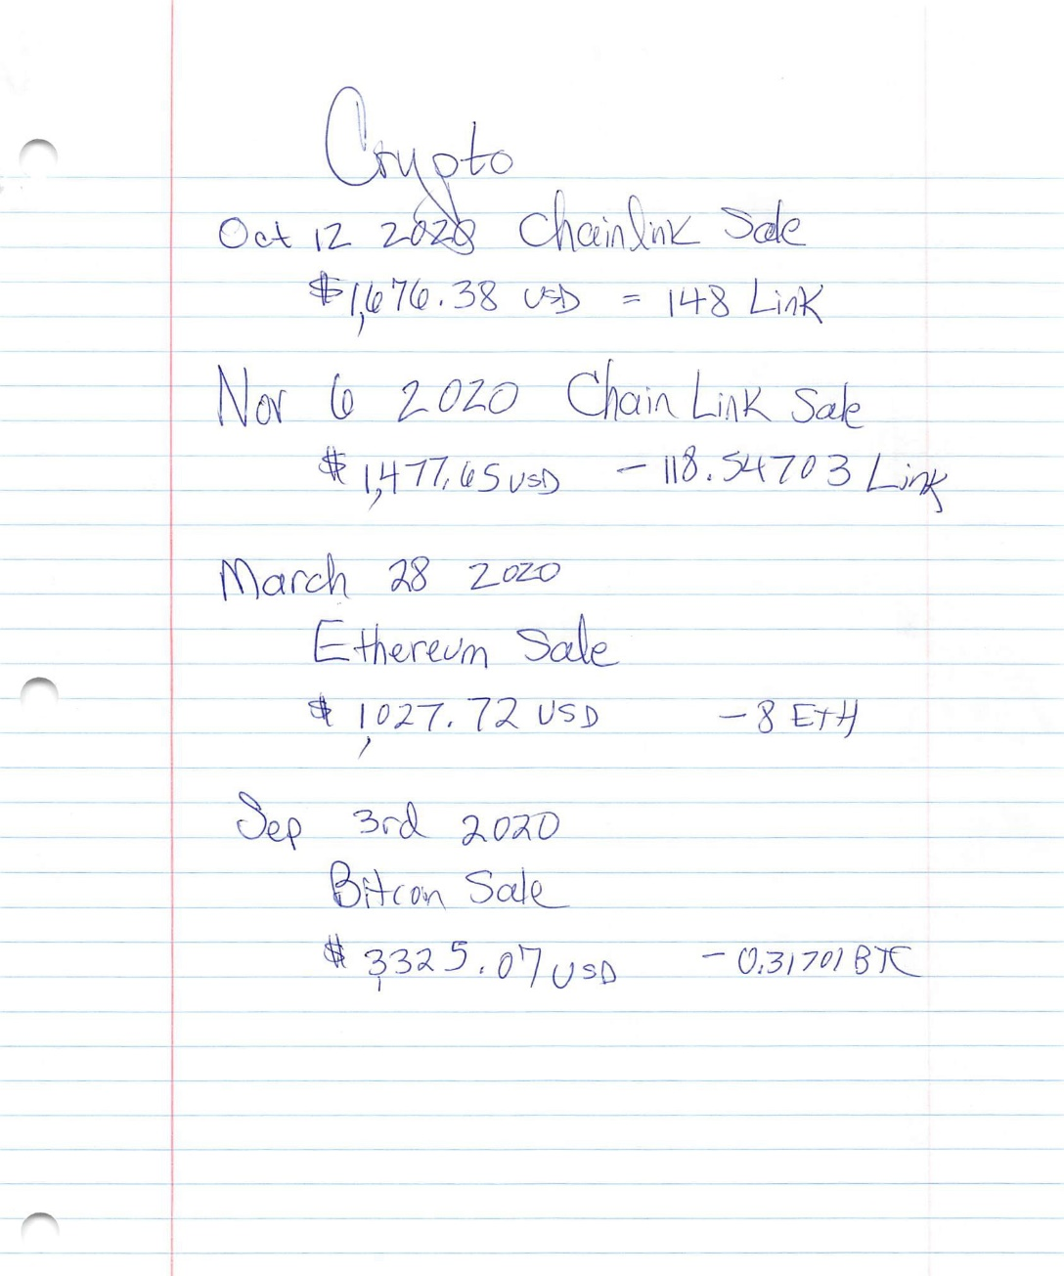
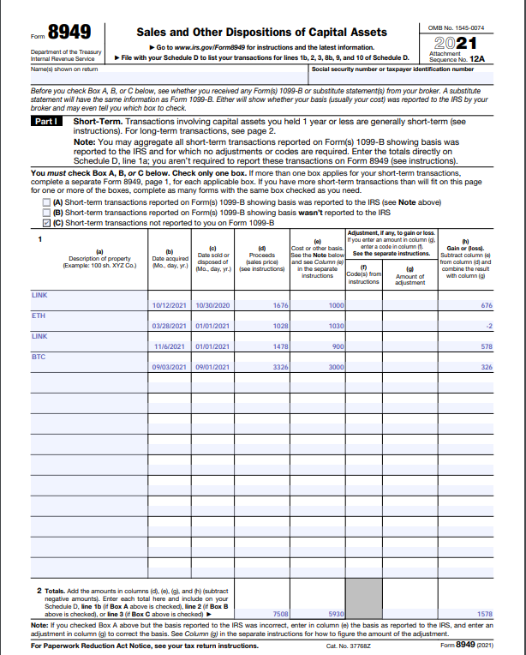
The Magic of Conversion Platforms

Slide 15
Conversion Platforms
TaxBit
TokenTax
BearTax
CryptoTrader
Cointracker
ZenLedger
Changelly
Cointracking
Cryptotax
Bitcoin.tax
Koinly
And many more
Platform issues: Software may not know the correct basis of sold/traded cryptocurrency that was received in a trade prior to 2018, received in a fork/airdrop and tax not paid, donated, given as a gift, received as a gift, inherited, etc.

Slide 16
Wash Loss
Wash loss rule:
A wash sale occurs when an investor sells or trades a security at a loss, and within 30 days before or after, buys another one that is substantially similar.
The wash-sale rule prevents taxpayers from harvesting losses without losing their position.
Crypto hasn’t been subject to the wash loss rule, because IT ISN’T A SECURITY!
For 2022, clients may have large gains from activity in the first half of the year…advise them to harvest losses and repurchase positions if they believe the market will improve.

Slide 17
When in Doubt, Throw It Out
If a client can’t prove basis and purchase date…
It’s short term zero basis!
No exceptions!
Too bad, so sad!
Do better next time!

Slide 18
Staking, Rewards, “Interest”
Section 2

Slide 19
Interest?
Just like a bank account, loan your crypto and get “interest” paid in crypto.
It isn’t technically interest!
Interest is money paid on the loan of money.
This is money paid on the loan of property BUT DON’T TREAT IT AS RENT!
Report on Schedule 1 as Other Income.

Slide 20
Staking and Liquidity Pool Rewards
Many exchanges pay some sort of rewards on currency that can be staked.
Or rewards may be paid for letting the exchange lock up your currency and thus adding to the exchange’s liquidity pool.
Whatever it is, it is probably Schedule 1 “other income”!

Slide 21
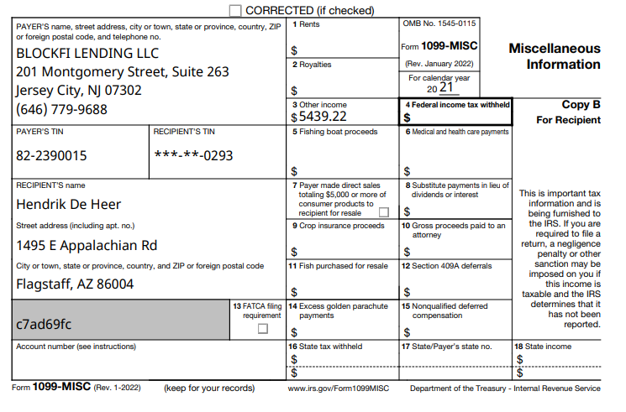
Forms to Look For
Converted to dollars for you! YAY!

Slide 22
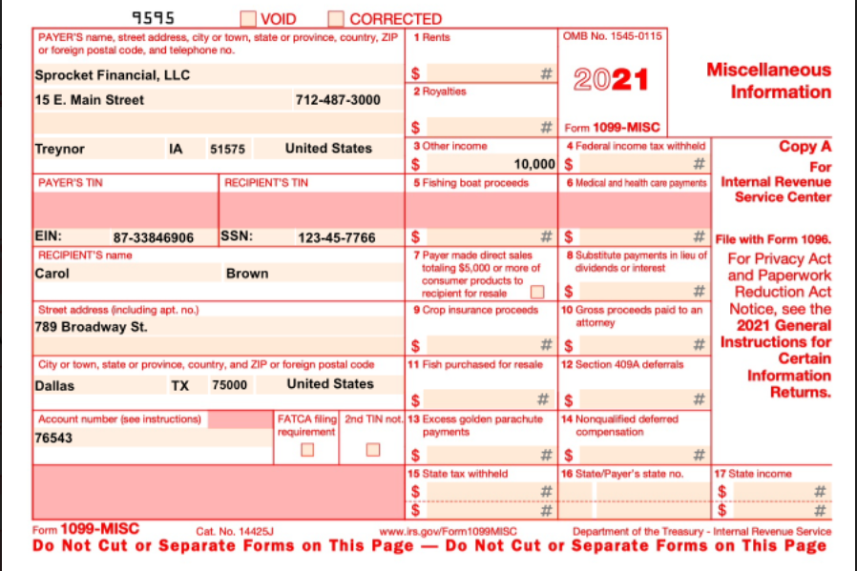
Forms to Look For
Converted to dollars for you! YAY!

Slide 23
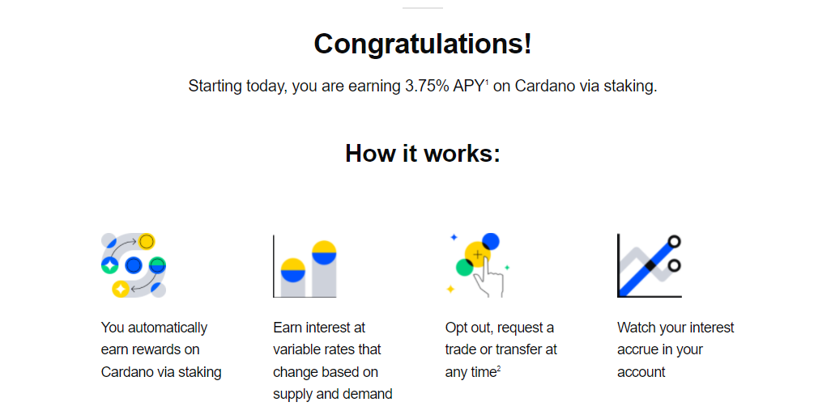
Don’t Let Terminology Throw You!
It says it’s staking…but also says it’s interest. So what is it?
It’s Schedule 1, Ordinary Income!

Slide 24
You Might Have to Help
Ethan deposited ETH at Nexo
He was paid in ETH on a quarterly basis as follows:
3/31/2022 he received 0.1000000 ETH = $141
6/30/2022 he received 0.1000000 ETH = $209
9/30/2022 he received 0.1000000 ETH = $301
12/31/2022 he received 0.1000000 ETH = $368
TOTAL $1,019
Virtual currency $1019

Slide 25
More Complex Investments
Section 3

Slide 26
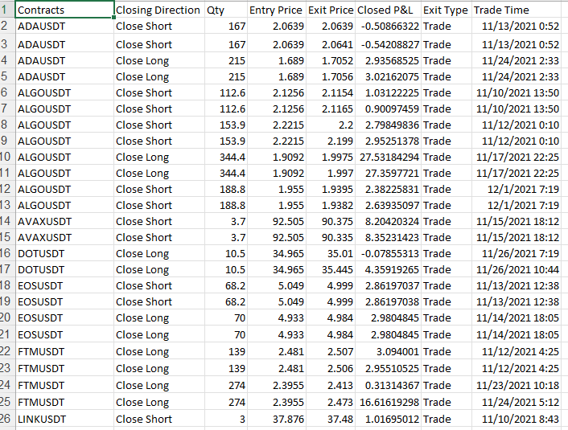
Tell Me It’s Just a Bad Dream

Slide 27
Crypto-Asset Derivatives
A crypto derivative is an agreement between a buyer and a seller for the future price of a digital asset.
The parties do not own the underlying asset.
It’s entirely a gamble on the future price of the asset.
One party believes the price of the crypto-asset will go up, the other party believes the price will go down.
The two parties sign an agreement stating that after a certain period of time, once the price has moved in any direction, one of the parties has to pay the other party the difference in price.

Slide 28
Investing in Crypto-Asset Derivatives
Investing in derivatives is different from investing in assets directly.
If you purchase one bitcoin (1 BTC) from an exchange you have ownership of that bitcoin.
But if you invest in bitcoin derivatives, you do not own the asset.
Instead, you own a contract to buy or sell that bitcoin at a set price in the future.

Slide 29
Crypto-Asset Derivative Exchanges
Cryptoasset derivative market is in the TRILLIONS
Participating Exchanges: Coinbase, Binance, OKX, BitCoke, CoinTiger, Bitget, CoinFLEX, Bybit, Huobi Global, FTX, KuCoin, BingX, Phemex, BTSE, Gate,io, MEXC, BitWell, Crypto.com Exchange, BitMEX, ZBG, Deribit, ApolloX, Delta Exchange, StormGain, Bitfinex, Kraken, AAX, etc., etc., etc.

Slide 30
Derivative Example
The price of NewCoin is currently $10,000 and Sam thinks it’ll go up – that’s called going long.
Richard thinks it’ll go down – that’s called going short.
If the price moves to $11,000 by the time the contract is settled, Richard must pay Sam $1,000.
On the other hand, if the price moves to $8,000 when the contract is settled, Sam must pay Richard $2,000.

Slide 31
Uh, Section 1256?
From Cointracker.io:
Crypto derivatives have an added layer of complexity to this already complex subject for three reasons:
The IRS taxes cryptocurrency as property.
Crypto platforms have created novel derivatives which do not resemble any traditional financial derivatives.
There is literally zero IRS guidance on cryptocurrency derivatives.

Slide 32
Uh, Section 1256?
From Cointracker.io:
If a derivative contract classifies for Section 1256 of the IRS tax code, it is subject to unique preferential tax treatment. To qualify, a derivative contract needs to meet certain criteria such as being regulated by the Commodity Futures Trading Commission (CFTC).
Currently, there are only a few cryptocurrency exchanges that meet this criteria to offer Section 1256 futures (e.g. Bakkt, CME, Erisx, LedgerX).
Other exchanges are offering non-regulated derivatives which likely do not qualify for Section 1256.

Slide 33
What About Margin Trading?
Margin trading refers to the use of borrowed funds (debt) to trade.
When trading on margin, crypto investors can leverage their buying power by trading a multiple of value of what they own.
Margin trading multiplies winnings…and losses.

Slide 34
Bob Trades on the Margin
Here’s Bob. He has one bitcoin (1 BTC) and wants to buy ether (ETH). Without margin, Bob could deposit his 1 BTC on an exchange and buy only 1 BTC worth of ETH.
But with a margin account, Bob can deposit 1 BTC and select a level of leverage of, say, 5X.
The 1 BTC would be held by the exchange as collateral, and the exchange would give Bob 5 BTC worth of “nominal money” to trade with on the exchange.

Slide 35
Bob Trades on the Margin
The nominal money can only be used to trade on the exchange within the margin account but not withdrawn from the exchange. Now Bob’s buying power is 5X (5 BTC) what it was without margin.
If Bob goes all in on ETH and the price of ETH increases by 10%, Bob makes 0.5 BTC profit (5 BTC x 10% = 0.5 BTC) instead of what he would have made without margin (1 BTC x 10% = 0.1 BTC).
This cuts both ways! Iif the price of ETH drops 10%, Bob loses 0.5 BTC instead of 0.1 BTC.

Slide 36
How Do I Report It?
Good question!
Probably all short-term gains and losses, but you might have to look at any reports your client receives to be sure.
We haven’t seen 1099s from these exchanges.
It’ll be interesting to see what we get starting in 2024!

Slide 37
Mark to Market?
From Cointracker.io:
A section 475(f) election can be very beneficial for traders. However, it is currently applicable only if you deal with securities and commodities.
Since cryptocurrencies are taxed as property per IRS Notice 2014-21, the applicability of this election for crypto traders is a grey area.
AICPA has advocated the IRS to make this election applicable to crypto traders and others have asked for more clarity on this issue.

Slide 38
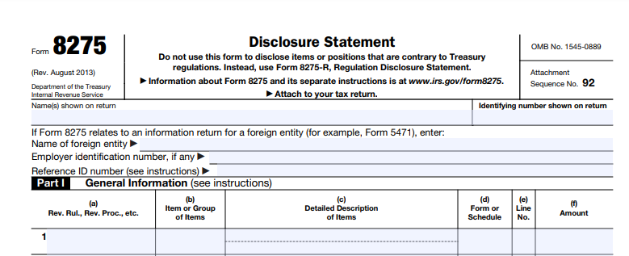
General Advice
The IRS has offered no guidance at all on these more complex investment issues.
Form 8275, Disclosure Statement, is the tax preparer’s best friend in these situations!

Slide 39
Mining & Earning Crypto
Section 4

Slide 40
Taxation of Mining
Different kinds of mining!
Proof of work is the original form of mining and is still used by Bitcoin.
Proof of stake is an alternative to proof of work requiring participants to commit tokens to the network in order to gain rewards.
Most staking these days seem to be done through an exchange rather than by individuals.
The activity may be referred to as mining, staking or validating.

Slide 41
Taxation of Mining
According to IRS Notice 2014-21, this is self-employment income if trade/business.
It isn’t reported to the IRS by anyone.
Taxpayers report mining/staking income on Schedule C for trade/business.
Expenses… not much.
Occasionally hardware is purchased with crypto.

Slide 42
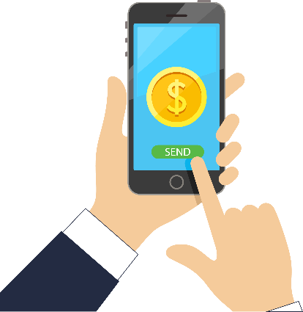
Mining Reminder
Bob stores it in his “wallet”
Bob buys Bitcoin
Bob buys a T-shirt from Cathy with Bitcoin
Jane’s computer is the first to complete the transaction; she receives a small amount of Bitcoin
Software adds the transaction to the permanent blockchain

Slide 43
Jane the Miner
Jane mines different kinds of crypto…
Her earnings in 2021 totaled $15,679
You ask about business expenses
Office in home? Unlikely.
Cell phone? Unlikely.
Increased electricity? Possibly, depending on the type of mining or staking she’s doing.
Hardware purchases? Oh, yeah. She bought a computer.

Slide 44
Jane’s Computer
YOU: “Let’s talk about the hardware purchase! Did you buy it with dollars? Or with crypto?”
Jane: “With crypto!”
YOU: “Great! What was the cost basis of that crypto?”
Jane: “Huh?”

Slide 45
Jane’s Computer
Turns out she bought the computer on March 1st with BTC that had a FMV of $10,572 the day she made the trade. These are the PROCEEDS.
Now we need to know basis. Which BTC did she sell? What were her BTC holdings as of that date? Will she use specific identification or FIFO?
Let’s say you’re able to figure out which BTC was sold and the basis of the BTC was $9,177, purchased less than a year before the trade.
Gain of $10,572 - $9,177 = $1,395 ST gain

Slide 46
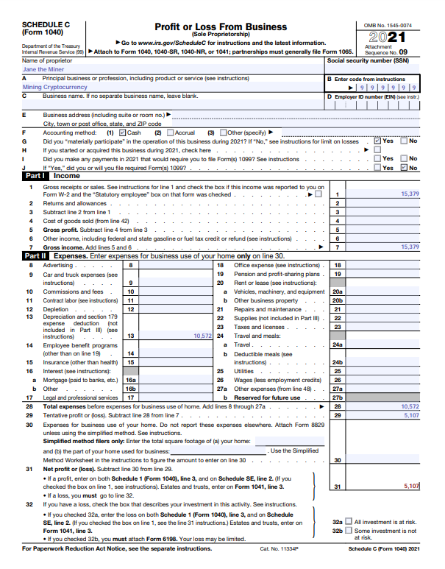
Jane’s Schedule C

Slide 47
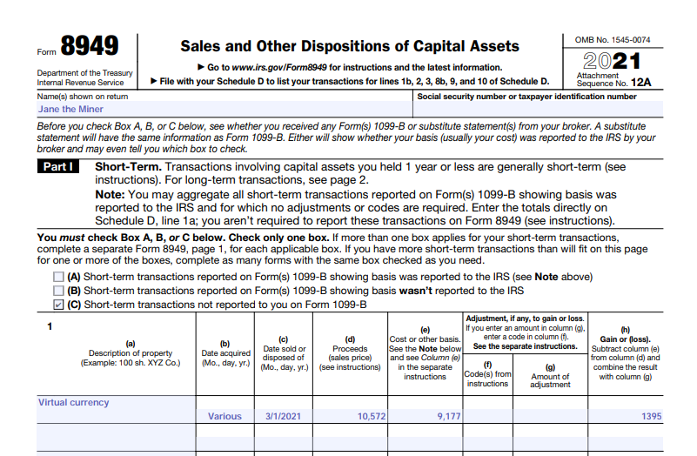
Jane’s 8949

Slide 48
Don’t Forget Forks and Airdrops
You then ask Jane about forks and airdrops.
She informs you that she received forked currency worth $550 at the time of receipt and she sold it shortly thereafter for $750.
The $550 is Schedule 1 ordinary income.

Slide 49
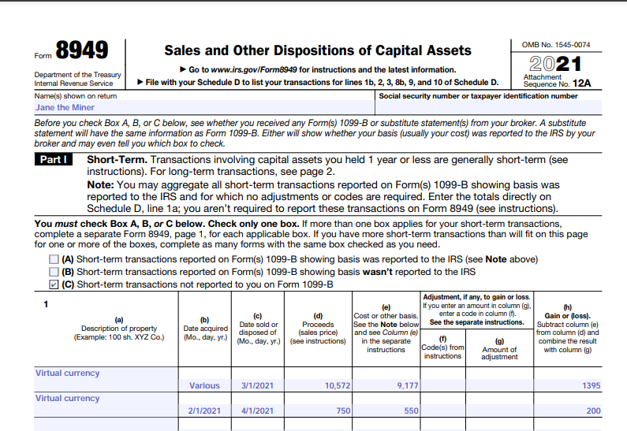
Jane’s Updated 8949

Slide 50
Earning Crypto
Earning crypto from services or products is treated the same way as mining.
Crypto received is translated into dollars.
Reported as self-employment income on Schedule C, with appropriate business code and expenses.
Or hobby income if it doesn’t qualify for a business.

Slide 51
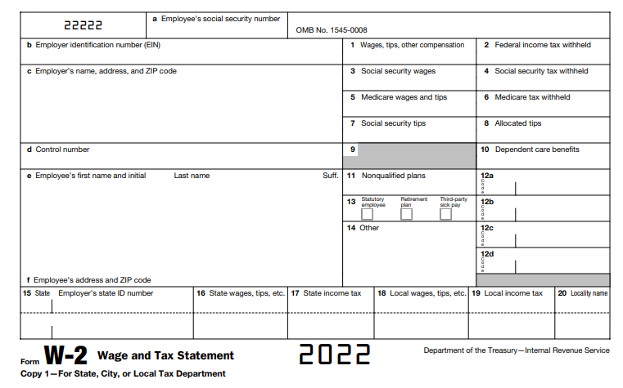
Wages Paid in Crypto?
In theory, yes.
Also in theory, the FMV would be included in the W-2 and taxes would have been withheld.
Due diligence: if a client tells you they received crypto as wages, have them call the employer to make sure it’s really in the W-2!

Slide 52
What Did You Do With the Crypto???
Anytime a client is receiving crypto, in any fashion, you always have to ask:
“What did you do with it?”

Slide 53
Donations, Gifts & Inheritances
Section 5

Slide 54
Donating Crypto
Crypto-assets can be donated to:
Save the Children
American Cancer Society
Fidelity Charitable
UNICEF
The Giving Block
Red Cross
United Way
Etc., etc., etc.

Slide 55
Appraisal?
Donations over $5000 require an appraisal!
Exceptions only for vehicles for which a written acknowledgement is received, publicly traded securities, certain types of intellectual property and certain types of inventory.
Appraisers:
Charitable Solutions: https://charitablesolutionsllc.com/virtual-currency-appraisals/
Crypto Appraisers: https://cryptoappraisers.com/

Slide 56
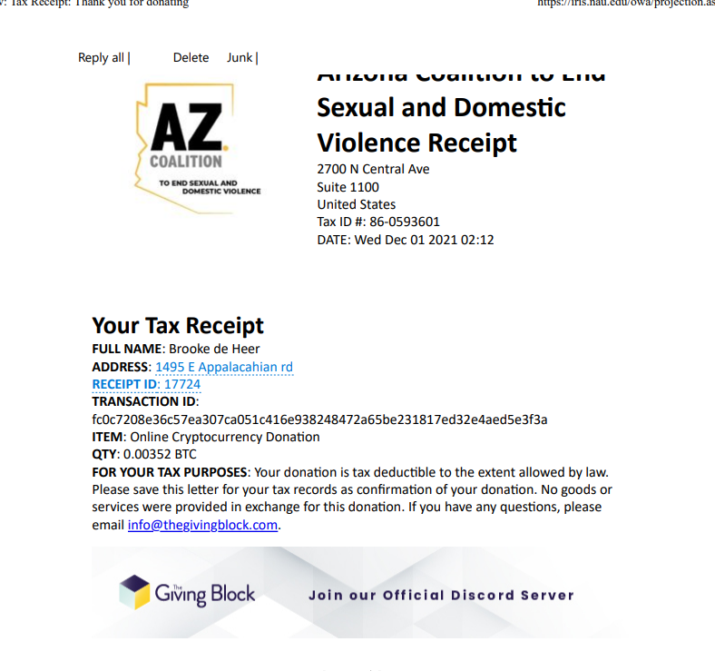
Acknowledgement Letter
Here’s a receipt…
0.00352 BTC was donated.
The recipient did not provide a dollar value.
What do we need to do?

Slide 57
Gifted? Basic Tax Law!
2022 limit $16,000 per donor, per recipient.
When sold, need to know:
FMV at date of gift
Donor’s adjusted basis
Donor’s gift tax paid
Donor’s acquisition date

Slide 58
Inherited? Basic Tax Law!
Value the inherited crypto as the FMV on date/time of death or alternate valuation date.

Slide 59
Pop Quiz!!
Which of these situations would create a tax event?
Alice loaned BTC to a friend who paid it back with interest.
Bobby gave some ETH to a friend to help with medical expenses.
Charlie donated $2,000 worth of BTC that he bought a month ago to Save the Children.
Doug received $250 of ADA as a gift and traded it for ETH.
Ethan inherited LTC and sold it a month later.
Francis gave $500 worth of LTC to a friend as a gift.

Slide 60
Initial Offerings
Section 6

Slide 61
ICOs/IDOs/IEOs/ITOs
Stands for Initial Coin Offerings, Initial DEX Offerings, Initial Exchange Offerings and Initial Token Offerings.
Same basic concepts – a new product is launched.
Different from an IPO in important ways…
IPOs are stocks issued by private companies to the public.
A participant receives a share in company ownership, with associated rights to profits.
Highly regulated process required anywhere from 90-180 days to complete regulatory process.
Typically, these products are purchased with an existing crypto… treated as a sale of one crypto and a purchase of another!

Slide 62
ICOs/IDOs/IEOs/ITOs Example
Janet reports participating in ICO introducing “Newcoin”
What currency was used to trade for Newcoin? ETH
What was FMV of traded currency at that time? $1,000
What was basis of traded currency? $600
When was traded currency purchased? One month prior

Slide 63
ICOs/IDOs/IEOs/ITOs Example
This is a sale of ETH and a purchase of Newcoin!
Proceeds = ETH’s FMV at time of sale = $1,000 = gross proceeds
Basis = $600
Short-term gain = $1,000 - $600 = $400
Form 8949, Code C, and Schedule D
Newcoin basis moving forward = $1,000

Slide 64
IRAs, HSAs, Credit & Debit Cards
Section 7

Slide 65
Crypto IRAs
Yep, that’s a thing.
These are self-directed IRAs, which allow the taxpayer to invest in weird stuff:
Real estate, precious metals, crypto.
No tracking required!
There are three components:
A custodian holds the IRA.
An exchange manages the crypto trades.
A secure storage solution protects your assets.

Slide 66
Crypto HSAs
Yep, that’s also a thing!
Again, three components…
A custodian holds the IRA.
An exchange manages the crypto trades.
A secure storage solution protects your assets.
You get to sell, trade, etc., as you like.
No tracking required!
Has to be a separate account from any other crypto account.

Slide 67
Debit Cards
Different cards work in different ways:
Crypto.com VISA Debit Card has you top up the card with their own currency, CRO.
Then it functions as a pre-paid debit card.
Rewards for various purchases are given in CRO at a time of your choosing.
Coinbase Debit Card links to your Coinbase crypto account:
Use it anywhere VISA is accepted.
Takes the money out of your crypto account when swiped.
Digital assets are automatically converted into dollars at point of sale.
Rewards are paid in BTC or XLM (Stellar Lumens).
Fee of 2.49% is charged for every purchase.

Slide 68
Credit Cards
Different cards work in different ways:
Gemini Card deposits crypto as a reward directly into your Gemini account every time you swipe the card.
BlockFi Bitcoin Rewards gives rewards in BTC.
Brex is for businesses, and you can pay your balance with crypto.
Upgrade Bitcoin Reward Card earns 105% back in BTC which you can keep or sell for a statement credit.

Slide 69
Murky Situations
Section 8

Slide 70
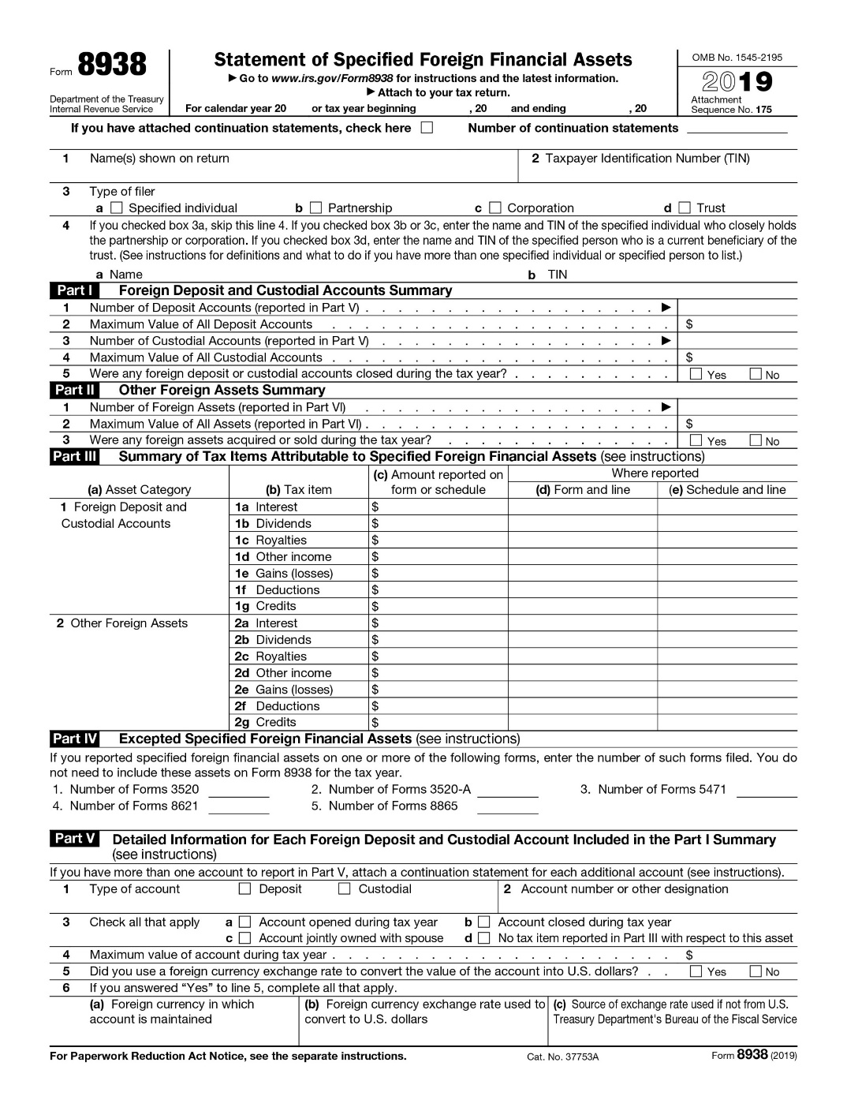
Foreign Holdings
Form 8938 is required when:
Market value of assets ≥ $50K/$100K on Dec. 31
Market value of assets ≥ $75K/$150K any date during year
Required for crypto?

Slide 71
Losses Through Theft or Scam
Tax treatment of losses other than sales and trades:
Blockchain is unbreakable, but…
Theft from phone/computer.
Exchange collapse or hack.
Scam
Loss of keys from computer problem or cold storage.
Can we take a loss on the tax return?

Slide 72
Losses – Schedule A?
Gone until 2026!
Schedule A now only applies to personal casualty and theft losses attributable to a federally declared disaster.

Slide 73
Losses – Form 8949?
Individuals use Form 8949 to report the following.
The sale or exchange of a capital asset not reported on another form or schedule.
Gains from involuntary conversions (other than from casualty or theft) of capital assets not used in your trade or business.
Nonbusiness bad debts.
Worthlessness of a security.
The election to defer capital gain invested in a qualified opportunity fund (QOF).
The disposition of interests in QOFs.

Slide 74
Losses – Form 4797?
Used for “the involuntary conversion from other than casualty or theft.”
But possibly deductible as an abandoned asset!
From the instructions for Line 10… “Deduct the loss from a qualifying abandonment of business or investment property on line 10.”

Slide 75
Abandoned Asset? Really?
In order to claim a loss due to abandonment, establish the following: (1) the loss was incurred in an activity entered into for profit;
The crypto was acquired for profit; if it’s used for everyday purchases, it may not qualify.
(2) the taxpayer has taken actions and evidence intent to constitute an abandonment;
Possibly evidenced by attempts to contact the exchange in question.
(3) the abandonment did not involve receipt of consideration;
Not a problem, because if there was consideration, I’d put it on Form 8949!
(4) the abandoned asset is not that described in I.R.C. § 1234A.
Limitations on certain transactions which may be considered sales.

Slide 76
Be Careful!
Be sure you have documentation
Taxpayer’s original basis in the crypto (you can only deduct basis).
Taxpayer’s date of purchase.
Loss of the crypto.
And hire an attorney

Slide 77
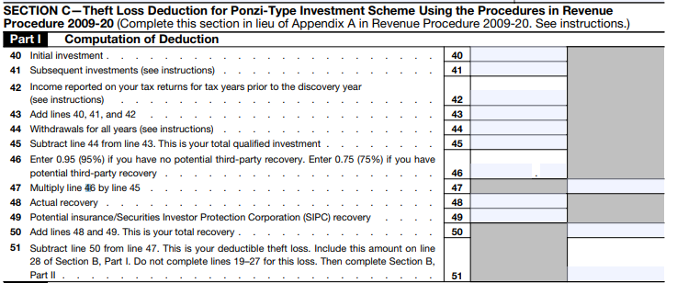
What About Form 4686, Ponzi Schemes?
Frauds and scams could qualify as Ponzi-type schemes!
Form 4686 Section C

Slide 78
More on Ponzi-Type
Ponzi safe harbor requires responsible individual to be indicted.
However, you can move forward without that safe harbor.
DOCUMENTATION IS ABSOLUTELY CRUCIAL.
ASSUME THE IRS WILL CONTACT YOU ABOUT IT.
Only basis is deductible.

Slide 79
General Advice
The IRS has offered no guidance at all on losses from crypto frauds, hacks and scams.
Again, Form 8275, Disclosure Statement, is the tax preparer’s friend! Disclose, disclose, disclose!

Slide 80
NFTs
Section 8

Slide 81
Taxation of NFTs
Reminder: an NFT is a data string representing ownership of a digital asset.
No IRS guidance at all
Best bet is to base taxation on the underlying asset.
Creation and subsequent sale of an NFT?
Probably hobby or business income for the creator.
Resale of an NFT that taxpayer purchased?
Capital gain? Collectible? Ordinary income?

Slide 82
Taxation of NFTs
The term “collectible” is defined in Section 408(m)(2) as “(A) any work of art, (B) any rug or antique, (C) any metal or gem, (D) any stamp or coin, (E) any alcoholic beverage, or (F) any other tangible property.”
NFTs aren’t tangible property.
Does this mean they aren’t collectibles? Or does it mean that all collectible are defined as tangible property?
No one knows!

Slide 83
Taxation of NFTs Example
John created a piece of digital art and minted it as an NFT.
It’s called “Cashing In.”
John’s expenses were fees, software and a computer.
He sold the NFT for $75,000 to Bob.
John probably has Schedule C income here (unless it’s truly just a hobby).
He reports the $75,000 as income and deducts fees, software, computer and any other expenses.
$
$
$
$
$
$
$
$
$
$
$
$
$

Slide 84
Taxation of NFTs Example
Bob bought the piece for $75,000.
He sells it to Alice for $90,000.
Bob has income of $15,000.
Might be ordinary gain, capital gain, or collectible!
No IRS guidance
Unless he’s in the trade or business of selling NFTs and this is inventory!
And in that case, the $15,000 is Schedule C income.
$
$
$
$
$
$
$
$
$
$
$
$
$

Slide 85
Taxation of NFTs Example
Alice bought it for $90,000 to use as a business logo.
Business asset for Alice.
Intangible asset to be amortized.
$
$
$
$
$
$
$
$
$
$
$
$
$

Slide 86
General Advice on NFTs
NFTs are pretty much always purchased with cryptocurrencies.
Buying an NFT with crypto is a trade of one property for another aka a SALE of that crypto!
There are also fees paid to the exchange, often ETH.
Paying that fee is a SALE of that ETH!
No IRS guidance in terms of whether digital assets can be characterized as collectibles.

Slide 87
Upcoming Legislation
Section 9

Slide 88
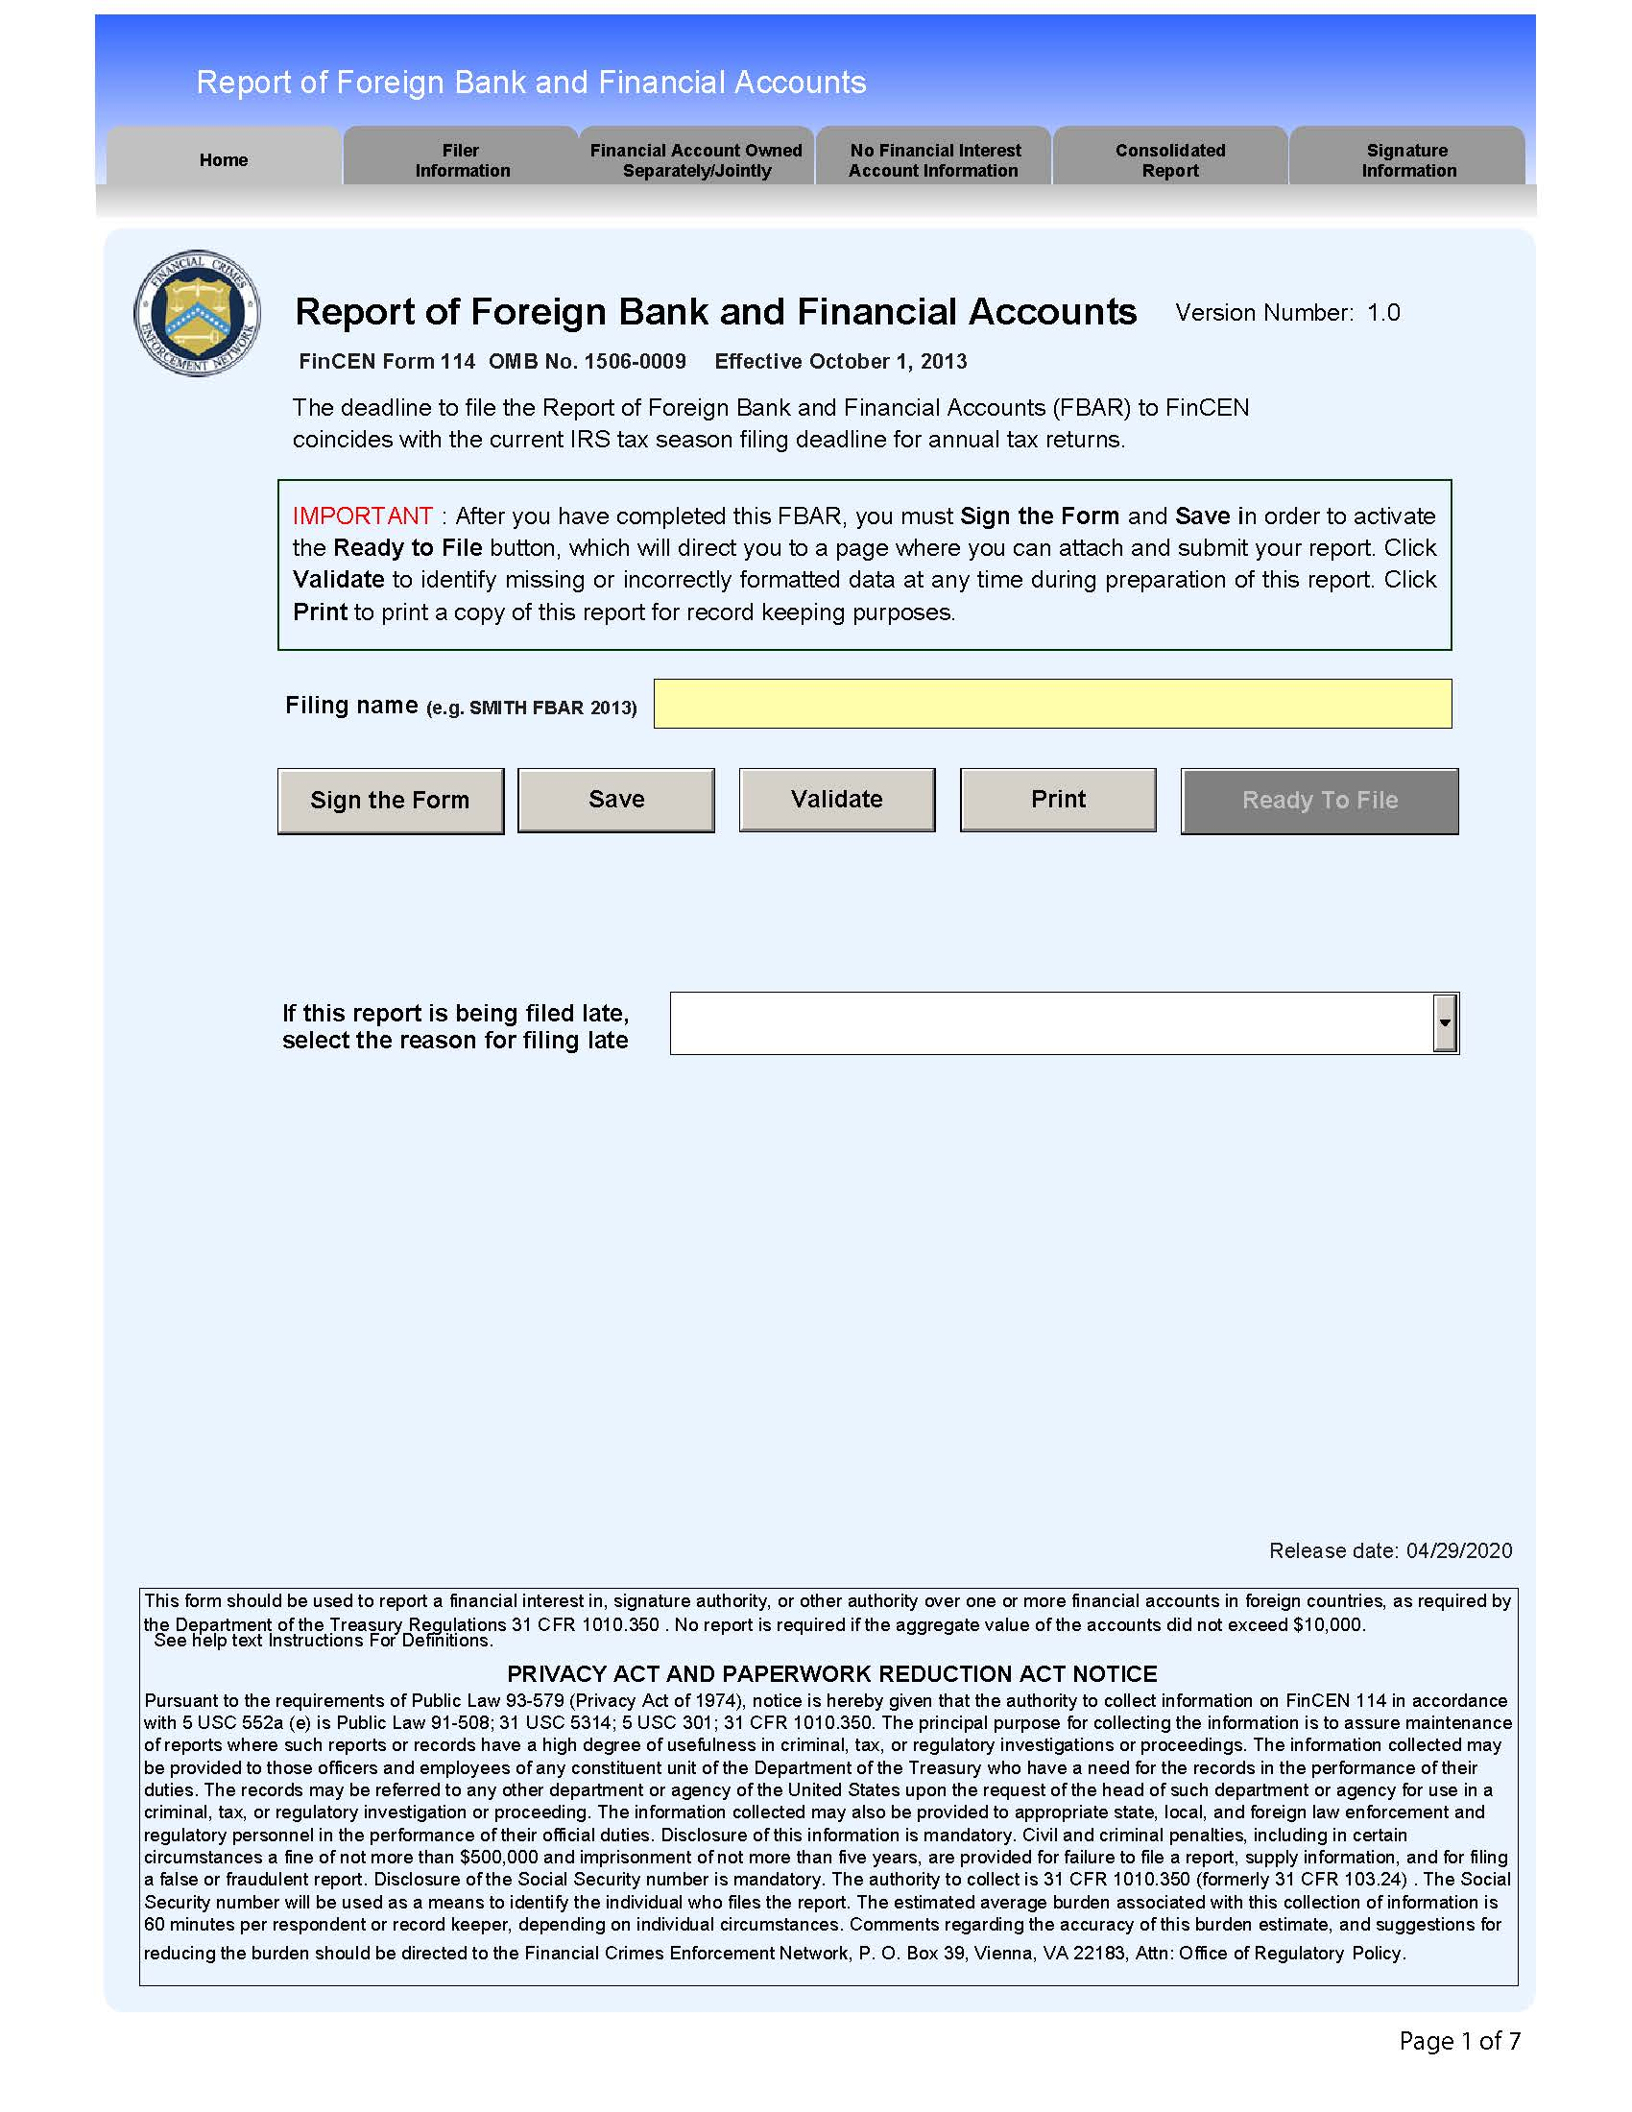
Foreign Holdings
FinCEN Notice 2020-2:
Currently, the Report of Foreign Bank and Financial Accounts (FBAR) regulations do not define a foreign account holding virtual currency as a type of reportable account… However, FinCEN intends to propose to amend the regulations implementing the Bank Secrecy Act (BSA) regarding reports of foreign financial accounts (FBAR) to include virtual currency as a type of reportable account under 31 CFR 1010.350.

Slide 89
Responsible Financial Innovation Act
June 2021, U.S. Senators Kirsten Gillibrand (D-NY), member of the Senate Agriculture Committee, and Cynthia Lummis (R-WY), member of the Senate Banking Committee, introduced the Responsible Financial Innovation Act, legislation that will create a complete regulatory framework for digital assets.
Creates a clear standard for determining which digital assets are commodities and which are securities.
Creates clear definition for digital assets.
Assigns regulatory authority over digital asset spot markets to the CFTC.
Defines and creates requirements for stable coins what will protect consumers and markets and promote faster payments.
Creates an advisory committee to develop guiding principles, empower regulatory agencies and advise lawmakers on fast-developing technology.

Slide 90
Responsible Financial Innovation Act
Responsible Financial Innovation Act
Imposes disclosure requirements on digital asset service providers to ensure that consumers understand the product and can make informed decisions when engaging with digital assets.
Requires a study on digital asset energy consumption.
Directs the CFTC and the SEC to study and report on the development of a self-regulatory organization (SRO) and develop a proposal for its creation.
Directs the CFTC and SEC to consult with Treasury and the National Institute of Standards and Technology to develop comprehensive, principles-based guidance relating to cybersecurity for digital asset intermediaries.

Slide 91
Responsible Financial Innovation Act
Responsible Financial Innovation Act
Provides a regulatory sandbox for state and federal regulators to collaborate on innovative financial technologies.
Creates a workable structure for the taxation of digital assets by creating a de minimis exemption so that people can make purchases with virtual currency without having to account for and report income.
Directs the Government Accountability Office (GAO) to conduct an analysis of the potential opportunities and risks associated with investing retirement savings in digital assets and to report its findings to Congress, Treasury, and the Department of Labor.
Directs the Office of Management and Budget, along with the Cybersecurity and Infrastructure Security Agency, the Director of National Intelligence, and the Defense Department, to conduct an information security study around the digital yuan, China’s central bank digital currency.

Slide 92
Virtual Tax Fairness Act
July 2022, U.S. Senate Banking Committee Ranking Member Pat Toomey (R-Pa.) and U.S. Senator Kyrsten Sinema (D-Ariz.) introduced bill H.R. 6582:
This bill excludes from gross income, for income tax purposes, up to $200 of gain from the disposition of virtual currency in a personal transaction. The bill defines virtual currency as a digital representation of value that is used as a medium of exchange and is not otherwise currency.

Slide 93
Best Practices
Section 10

Slide 94
Best Practice #1 - Engagement Letter
On your standard engagement letter:
“At any time during 2022, did you: (a) received (as a reward, aware, or payment for property or services); or (b) sell, exchange, gift, or otherwise dispose of a digital asset (or a financial interest in a digital asset)?”
Sound familiar?
YES
NO

Slide 95
Best Practice #2 - Questionnaire
I earned cryptocurrency through mining or by working for others.
I sold, traded or spent cryptocurrency.
I gave or loaned cryptocurrency.
I inherited or received cryptocurrency as a gift, an inheritance, or in some other manner.
I lost cryptocurrency in some manner other than a sale.
I received forked/airdropped cryptocurrency.
I held cryptocurrency in a foreign exchange.
I purchased assets in an initial coin/initial exchange/initial DeFi/initial token or similar offering.
I received interest, dividends, node rewards or similar type of income from cryptocurrency activities.
I participated in cryptocurrency, NFTs, or other types of blockchain activities in a manner not mentioned above.

Slide 96
Best Practice #3 - Crypto Engagement Letter
Special engagement letter for cryptocurrency clients
Tax laws that apply to virtual currency are subject to change and/or reinterpretation.
The client understands that [TAXES I AM] will prepare the tax return using information that was provided by the client and under virtual currency tax law as it is now understood.
[TAXES I AM] is not responsible for the taxes, penalties or interest that may result from withheld information or from changes/reinterpretations of virtual currency tax laws.

Slide 97
Best Practice #4 - Avoid High-Risk Situations
High risk positions
Basis with no documentation
Loss due to theft/hack/exchange failure
Bad debt with no documentation
Handwritten records
Protect your license and reputation!! (Even if it means you lose a client)

Slide 98
Best Practice #5 - Client Documentation
Always let the client:
Provide as much information as possible.
Utilize online conversion platforms as required.
Manually correct perceived errors.

Slide 99
Best Practice #6 - Stay Educated!
Educate clients
Taxable transactions
Earning/spending
Selling/trading
Forks/airdrops
Inheriting/gifting
Donating
Educate yourself
Ask questions of clients
Check for new regulations

Slide 100
THE END!

