Slide 1
Introduction to
Cryptocurrency
Presented By:
Amy M. Wall, EA, MBA
Opinions expressed by Ms. Wall are solely her own and do not necessarily express the views or opinions of
TaxAct® Professional.

Slide 2
What We’ll Talk About Today
Centralized vs Decentralized Finance
Cryptoverse Concepts
IRS Guidance
IRS Compliance Efforts
Answering the “Crypto Question”

Slide 3
De-Fi vs Ce-Fi
Section 1

Slide 4
What We’ve Got: Ce-Fi
Centralized Finance
CeFi (centralized finance) refers to current system with its traditional gatekeepers.
CeFi transactions are cumbersome, time-consuming and may serve to make centralized institutions stronger, often at the expense of taxpayers.
Money is held by corporations whose primary goal is their own success.
Third parties are required to move money between parties.
Transactions are slow and costly.
Traveling can affect a person’s ability to access funds.
Unbanked millions
Fraud and forgery
Incompetent government

Slide 5
What Might Be Better?
De-Fi
DeFi hopes to take power away from traditional gatekeepers by uniting buyers/sellers, lenders/borrowers, etc., directly without the intermediary.
Anyone with a computer and Wi-Fi can participate.
Fees are reduced and, in some cases, eliminated.
But what’s required? Some sort of computer-based currency that isn’t linked to a government…

Slide 6
Financing the Revolution!
Bitcoin!

Slide 7
It’s Been in Development a Long Time…
1982 – David Chaum invents digital cash, utilizing cryptography.
1990s – the Crypto Wars
US and allied governments attempt to limit access to cryptography on the grounds of protecting national security.
1997 – Adam Back creates Hashcash, a proof-of-work system.
1998 – Wei Dai proposes “B-money” e-cash system.
2005 – Nick Szabo proposes “BitGold” utilizing software blocks.
2009 – Satoshi Nakamoto devises first blockchain database.

Slide 8
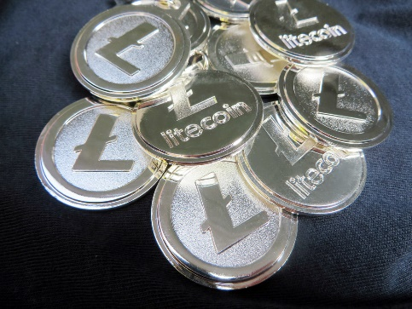
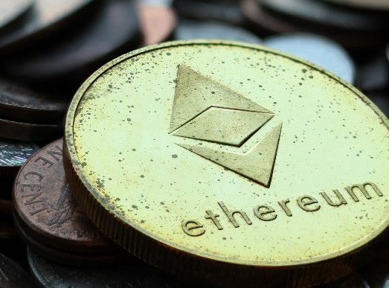
New Currencies Emerge
Litecoin created in October 2011
Ripple released in 2012
Dogecoin introduced in 2013
Tether aka RealCoin created in 2014
Ethereum went live in 2015
Cardano launched in 2017
And on and on and on…

Slide 9
Bubble? Disruptive Technology?
Or maybe a bit of both?
A “bubble” occurs when a price for something exceeds its fundamental value by a large margin.
Bubble’s 5 stages: displacement, boom, euphoria, profit-taking, panic (sounds familiar…).
A “disruptive technology” is an innovation that changes the world. Examples: artificial intelligence, internet, e-commerce, virtual reality, blockchain (also sounds familiar…).
Blockchain is here to stay, as is some form of blockchain currency… but will any of the existing currencies survive?

Slide 10
It’s the Wild, Wild West
Section 2

Slide 11
Anonymous Purchases
Silk Road
Online black market (darknet)
“Dread Pirate Roberts” (aka Ross Ulbricht)
Founded 2011
Sold illegal substances taking Bitcoin payment
2013, FBI took down Silk Road
FBI momentarily 2nd largest BTC holder: 29,657 BTC
Auctioned off online

Slide 12
“Rug Pull”
April 2021, Thodex based in Turkey unexpectedly went off-line.
The founder, Faruk Fatih Ozer, apparently flew to Albania along with $2B in investor’s funds.
There’s an international warrant out for his arrest.
Meanwhile, thousands of users are unable to access their accounts.

Slide 13
The Bizarre Story of QuadrigaCX
Early 2022, the Ontario Securities Commission concluded its investigation into the Canadian exchange Quadrigacx.
Founder Gerald Cotten used millions of dollars in customer assets for his own purposes.
He supposedly died in India December 9, 2018, at the age of 30
Circumstances were unusual and name on death certificate was misspelled.
The law firm hired to represent the users affected by the shutdown has requested an exhumation and autopsy of the body!!
Robertson and Cotten

Slide 14
Scammers & Thieves
2011: Mt. Gox hack 850,000 BTC, $500M at that time
2015: Bitstamp hack $5.3M
2016: Dao hack $70M
2017: Tether hack $30.9 M and ETH hack $31M
2018: Coincheck hack $530M
2019: GateHub hack $9.5M
2020: Kucoin hack $281M
2021: Total hacked $2B

Slide 15
Scammers & Thieves
2022 so far:
January – Crypto.com $35M & Qubit Qbridge hack, $80M
February – Wormhole $325M & IRA Financial Trust $37M
March – Cashio $52M & Axie Infinity $625M
April – Beanstalk $182M & Fei Protocol $80M
June – Harmony Bridge $100M
CHAINALYSIS PUTS 2022 HACKS AT $1.9B JAN – JULY!

Slide 16
Pop Quiz!!
Which is true of the DeFi movement?
It relies on fiat currency.
Removing costly intermediaries is a goal.
It requires face-to-face contact.
It requires sophisticated cryptographic programming for security.
Users will still always need banks.
Government does not control or regulate it.

Slide 17
Crypto Concepts
Section 3

Slide 18
Digital, Virtual, Crypto
The terms “digital currency,” “virtual currency,” and “cryptocurrency” are used interchangeably for general purposes.
IRS Notice 2014-21 defines virtual currency as “a digital representation of value that functions as a medium of exchange, a unit of account, and/or a store of value.”
Infrastructure Investment and Jobs Act defines digital assets for reporting purposes as “any digital representation of value which is recorded on a cryptographically secured distributed ledger or any similar technology…”
They all mean the same thing when it comes to taxes!

Slide 19
Distributed & Decentralized
Cryptocurrencies are “distributed” and “decentralized.”
Distributed
Anyone on the network can look at the books.
All transactions are recorded across the entire network.
Data cannot be changed without the collusion of the entire network.
Decentralized
No central authority.

Slide 20
Owning Crypto
It’s not physical…
I can’t see it…
I can’t hold it…
So how can I own it?
Cryptocurrency is owned by possession of the KEYS.
1DSsgJdB2AnWaFNgSbv4MZC2m71116JafG

Slide 21
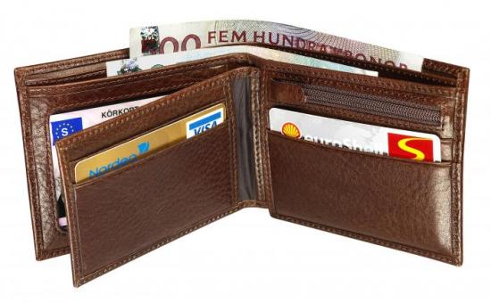
Where Do I Keep My Keys?
Hot wallets (online)
Desktop – utilizes an app
Web – stored on a website
Mobile – utilizes a phone app
Cold wallets (not online)
Paper – keys are stored on paper
Hardware – an offline physical device
Brain – keys are memorized

Slide 22
The Block
A block is a storage site where information is held and encrypted.
The blocks are identified by long numbers that include encrypted transaction information from previous blocks.
New transaction information is added to the block.
The information within the block must be verified by the network before new blocks can be created.

Slide 23
The Blockchain
The blockchain is a series of data blocks.
Transactions are recorded and stored throughout the entire network.
The data cannot be altered without network collusion.
Provides a level of certainty and trust previously unavailable.

Slide 24
Airdrops
Distribution of currencies/tokens to various wallets.
Typically, promotional and of little value.
Recipient may be unaware.
Often sent to early users of a new platform, service, etc.
There are websites people can sign up for to receive airdrops.
Why do I care? (They’re taxable.)

Slide 25
Forks
Soft fork – software update with no impact on the coin holder.
Hard fork – software update that results in a new currency that may be distributed to a coin holder.
Can be significant amounts money.
Bitcoin Cash – result of hard fork August 2017
Bitcoin Cash forked into Bitcoin Cash ABC and Bitcoin Cash Node.
Bitcoin Satoshi Vision – result of hard fork in November 2018.
Why do I care? (They’re taxable)

Slide 26
Faucets
A crypto faucet is an app or a website that gives taxpayers small amounts of cryptocurrencies as a reward for completing easy tasks.
Watching product videos, viewing or clicking on advertisement, completing a Captcha, solving a puzzle, playing a game.
The name “faucet‘’ refers to the size of the rewards…like small drops of water dripping from a leaky faucet.
Reward is typically 1 Satoshi = $0.0004261

Slide 27
Faucets
The first faucet was created in 2010 by Gavin Andresen, who believed in the future of Bitcoin.
His faucet paid out 5 BTC in exchange for clicking on images.
Try not to kick yourself for not getting into it back then.
There are also LTC faucets, ETH faucets, DOGE faucets, etc.

Slide 28
Receiving Forks & Airdrops
Hot wallets receive them automatically.
Cold wallets have to go through a process to receive them.
Recipient may not be aware of receipt!

Slide 29
Smart Contracts
Computer program that executes commands when certain conditions are met.
Used in trading, investing, lending, borrowing, gaming, healthcare, real estate.
Advantages: autonomous, secured, interruption free, trustless, cost-effective, fast, accurate.

Slide 30
Smart Contract Example
Life insurance policy.
Policy terms encoded into the smart contract.
Notarized death certificate is the input trigger.
Payment immediately released.
No humans involved!

Slide 31
NFTs = Nonfungible Token
Fungible = BTC, dollar bills
Fungible goods have no distinguishing characteristics and may be sold in bulk.
Often divisible into smaller units.
Nonfungible = a piece of land, a diamond
A jpg file can be replicated many times, but the token itself, the right to sell it and license it, cannot be.
Nondivisible – a process called fractionalizing divides the ownership, not the asset.

Slide 32
OK…But What Is It?
NFTs are units of data representing ownership of a digital asset.
Art, memes, songs, videos, even virtual fashion!
They’re not cryptocurrencies but are part of the DeFi movement.
They’re an alternate way of establishing ownership.
It is likely NFTs will eventually replace title documents of all kinds.
NFTs may become identity documents in place of physical passports.

Slide 33
And I Care Because…?
NFTs are sold, traded, purchased, collected.
Typically bought and sold with cryptocurrency.
Taxable events abound!

Slide 34
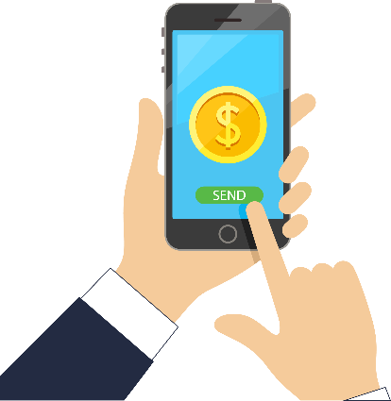
Mining
Bob stores it in his “wallet”
Bob buys Bitcoin
Bob buys a T-shirt from Cathy with Bitcoin
Jane’s computer is the first to complete the transaction; she receives a small amount of Bitcoin
Software adds the transaction to the permanent blockchain

Slide 35
More on Mining
A network of computers called crypto miners compete to solve the problem first.
The computer (miner) that solves the problem first earns the right to post the transaction to the ledger and gets a financial reward, which is typically paid in cryptocurrency.
Mining rewards are taxable income.

Slide 36
More on Mining
Proof-of-work mining was the first kind of mining
Takes a lot of electricity
Highly secure
Has been proven at scale
Fastest computer wins
Proof-of-stake
Faster transactions
Less electricity
Person with most staked coins wins

Slide 37
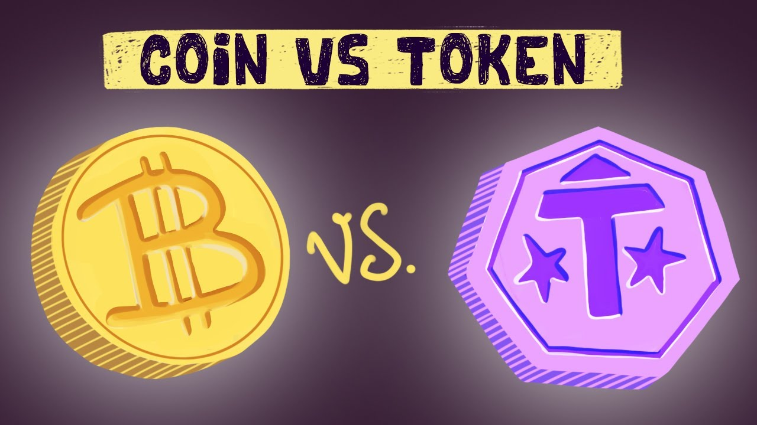
Tokens vs Currencies
Crypto coins are the native asset of a blockchain.
Tokens ride on someone else’s blockchain.
Differences are technical.
Tax preparers don’t care!
They’re all taxed the same way.

Slide 38
Stablecoins
Pegged to the US dollar:
Tether (USDT)
USD Coin (USDC)
Binance USD (BUSD)
Dai (DAI)
TerraUSD (UST)
TrueUSD (TUSD)
Pegged to commodities:
Palladium Coin
Digix Gold (DGX)
Perth Mint Gold Token (PMGT)
Tether Gold
SilverCoin
SilverLink (LKNS)

Slide 39
CBDC
China might be the first to fully launch a CBDC.
Taiwan close behind
India should launch soon
European Commission expects a digital euro in 2023.
Russia, Thailand, Malaysia, South Korea, United Arab Emirates, Saudi Arabia, Canada, Australia, Brazil expected to follow suit.

Slide 40
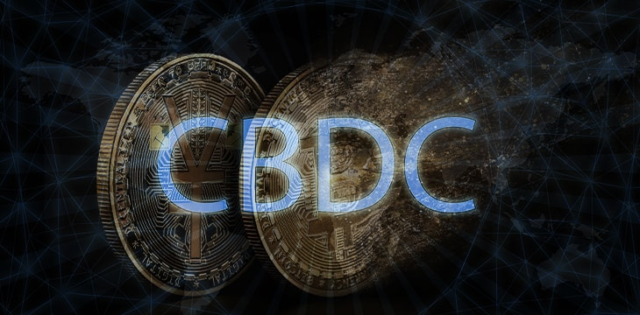
CBDC
The US is considering offering its own CBDC.
Fed Reserve chair Jerome Powell: “You wouldn’t need stablecoins; you wouldn’t need cryptocurrencies, if you had a digital US currency. I think that’s one of the strongest arguments in its favor.”
Probably several years out, if ever.

Slide 41
Pop Quiz!!
Match the word with the definition!
1. Stablecoin
a. Holding crypto online
b. A way of owning nonphysical assets
2. Mining
c. A promotional distribution of crypto
3. Smart Contract
d. A program that executes commands when conditions are met
e. Solving math problems to earn crypto
4. NFT
f. A software update resulting in two separate currencies
5. Fork
g. A coin whose value is tied to another asset

Slide 42
Pop Quiz!!
Match the word with the definition!
1. Cold hardware wallet
a. Utilizes an online app
b. Keys written down
2. Hot desktop wallet
c. Utilizes a phone app
3. Hot mobile wallet
d. Stored on a website
4. Cold paper wallet
e. Stored on an offline physical device
5. Hot web wallet
f. Keys are memorized

Slide 43
IRS Guidance
Section 4

Slide 44
IRS Rules and Regs
Notice 2014-21
TC&JA in 2018
Regulation 2019-24
Online FAQs in 2019
Chief Counsel Guidance 2020 & 2021

Slide 45
IRS Notice 2014-21 Summary
For federal tax purposes, virtual currency is treated as property.
General tax principles applicable to property transactions apply to transactions using virtual currency.
$200 de minimis foreign currency gain doesn’t apply.
Virtual currency received as payment is reportable income.
Value of that income is FMV on date (but not time) of receipt.
IRS will accept exchange rate in determining FMV of property received.

Slide 46
IRS Notice 2014-21 Summary
Taxable gain or loss occurs when exchanged for other property.
Gains/losses treated according to how taxpayer holds the assets.
Virtual currency received via “mining” is income, valued at FMV date (but not time) of receipt.
Self-employment income if rises to level of trade or business.
Virtual currency received by independent contractor is subject to FICA.
Wages received in virtual currency is subject to all same reporting requirements.

Slide 47
IRS Notice 2014-21 Summary
Information reporting is identical to all reporting requirements of payments of property.
Form 1099 requirements apply to virtual currency.
Backup withholding applies to virtual currency payments.
Third-party settlers required to file Form 1099-K if usual requirements are met.
The usual penalties will apply to earlier returns! (Even though we hadn’t decided what you should do until now.)

Slide 48
OUCH!
Crypto is property.
In general, payments of crypto = payments of property.
All reporting requirements apply.
Harshest possible interpretation of this new type of asset.
Huge blow to the De-Fi world!

Slide 49
Pop Quiz!!
Who has a taxable event according to IRS Notice 2014-21?
Alice bought crypto and stored it in a virtual wallet.
Bob traded crypto for a t-shirt.
Charlie mined crypto but didn’t sell any of it.
Donna worked for an overseas company who paid her in crypto.
Edgar sold some crypto, but gain was less than $200.

Slide 50
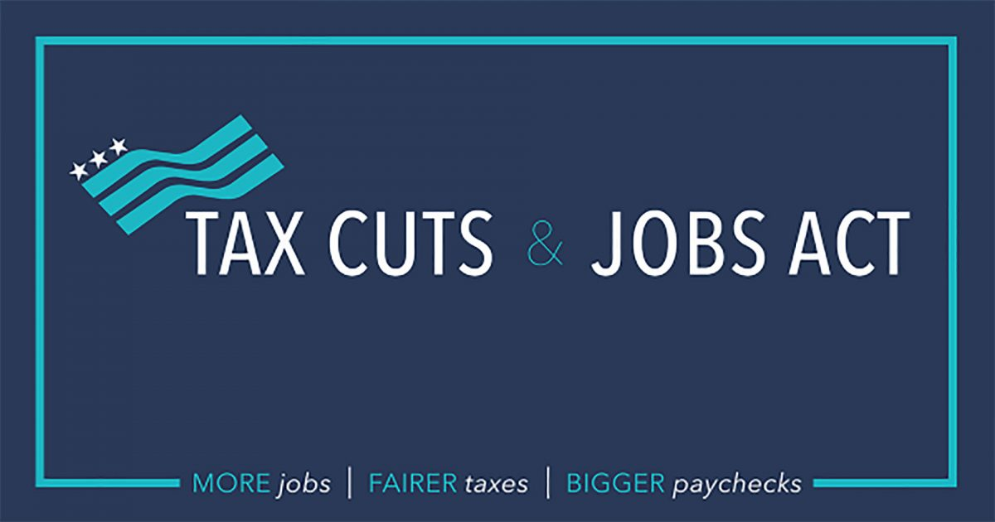
The IRS Goes Dark
2015? Nothing….
2016? Nothing…
2017? Nothing…
2018? Tax Cuts & Jobs Act!

Slide 51
TC&JA Talked About Crypto?
Indirectly, yes!
Beginning in tax year 2018, LKE is only for real estate.
Before that, the Cryptoverse simply assumed LKE for all cryptos and tokens.

Slide 52
2019 Was a Big Year for Guidance!
Finally… Revenue Ruling 2019-24 released in October of 2019.
It addressed one topic and one topic only, and that was reporting income from forks and airdrops.

Slide 53
Reminder
A fork is a change in the blockchain software; hard fork can result in new currency being distributed.
An airdrop is typically a marketing stunt resulting in new currency “airdropped” into online wallets.
Revenue Ruling 2019-24!
Forks – when is taxable income received and how is it taxed?
Airdrops – when is taxable income received and how is it taxed?

Slide 54
Revenue Ruling 2019-24
Fork or airdrop and no new property was received?
No taxable income
Fork or airdrop and new property was received?
Taxable ordinary income valued at FMV on date/time of ability to dispose.
Report on Schedule 1, ordinary income.
Tax treatment identical for forks and airdrops.

Slide 55
Pop Quiz!!
How much is going to be reported on Schedule 1?
John received forked currency valued at $100 on the day of receipt; the next day he sold that currency for $500.
Kate received an airdrop worth nothing on the day of receipt; the next day the currency was worth $100 but she didn’t sell it.
Larry received forked currency worth $50; he sold it the next day for $40.
Molly received an airdrop worth nothing.
Nancy received forked currency worth $1,000 and she gave it to her son.

Slide 56
2019 Online FAQs
First published in Dec. 2019
Updated periodically
Mostly a repeat of earlier guidance
Did we learn anything new?

Slide 57
New Guidance from FAQs
Here’s what we learned:
FAQ #5 and #5(a): If all you did was buy virtual currency, you should answer NO to the crypto question.
FAQ #8: Basis of virtual currency includes fees, commissions and other acquisition costs.
FAQs #12 & #20: FMV is valued as of the date and time received, not just date.
FAQ #35: Donations of virtual currency are treated as appreciated property.

Slide 58
New Guidance from FAQs
And…
FAQ #38: Transferring crypto from one account to another, both owned by the same taxpayer, is not a taxable event.
FAQ #39 and FAQ #40: Inventory options are specific identification or FIFO.
FAQ #44: Ordinary income from virtual currency is reported on Schedule 1.

Slide 59
But Is This Reliable Guidance?
On one hand… “FAQs that have not been published in the Bulletin will not be relied on, used, or cited as precedents by Service personnel in the disposition of cases.”
On the other hand,…“Taxpayers who show that they relied in good faith on an FAQ and that their reliance was reasonable based on all the facts and circumstances will not be subject to a penalty that provides a reasonable cause standard for relief, including a negligence penalty or other accuracy-related penalty, to the extent that reliance results in an underpayment of tax.”
https://www.irs.gov/newsroom/general-overview-of-taxpayer-reliance-on-guidance-published-in-the-internal-revenue-bulletin-and-faqs

Slide 60
Pop Quiz!!
True or false?
Jay is permitted to use FIFO as an inventory method.
Kevin can add exchange fees to basis.
Lisa donated some appreciated crypto to a charity but can only deduct the amount of her basis.
Molly received about $5K in forked currency; she held the original currency for more than a year, so she can report this $5K as long-term gain on Form 8949.
Nancy transferred crypto from one of her accounts to another; there is a taxable gain or loss depending on the basis of the transferred currency and its current FMV.

Slide 61
2021 Chief Counsel Memo
On March 22, 2021, Chief Counsel released guidance on the bitcoin cash (BCH) hard fork of 2017.
On August 1, 2017 at 9:16am, the Bitcoin blockchain split into Bitcoin and Bitcoin cash.
Situation: Taxpayer A received BCH at the time of the fork and had dominion and control in the 2017 tax year; A has income equal to the FMV as of the date and time of the fork.
Situation: Taxpayer B did not have dominion and control until 2018; B has ordinary income in 2018 as of the FMV of the BCH on January 1, 2018, at 1pm.
(We already figured this out, thanks anyway.)

Slide 62
2021 Chief Counsel Memo
On June 8, 2021, Chief Counsel released guidance on like-kind exchange of cryptocurrencies prior to 2018, CCA 202124008.
Conclusion: If completed prior to Jan. 1, 2018, an exchange of (i) Bitcoin for Ether, (ii) Bitcoin for Litecoin, or (iii) Ether for Litecoin does not qualify as a like-kind exchange under §1031 of the Code.
And why? Because of differences in nature and character.
(No one cares anymore, but thanks anyway.)

Slide 63
2020 Chief Counsel Memo
On June 29, 2020, Chief Counsel released guidance on the taxation of virtual currency received in the crowdsourcing labor market, CCA. 202035011
Conclusion: A taxpayer who receives convertible virtual currency in exchange for performing a microtask through a crowdsourcing platform has received consideration in exchange for performing a service, and the convertible virtual currency received is taxable as ordinary income.
(Kind of figured that.)

Slide 64
Compliance Efforts
Section 5

Slide 65
The Early Days…
2013 Congress’ US Government Accountability Office kicked things off with a 27-page report: GAO-13-516.
Virtual Economies and Currencies
Big focus on earning taxable income.
MMORPGs (Massively Multiplayer Online Role-Playing Games)
Oh, yeah, and cryptocurrency!

Slide 66
The Early Days…
2013 Taxpayer Advocate Service report to Congress.
Emphasized digital currency prominence (Bitcoin).
Asked IRS to answer questions regarding:
Triggering gains and losses.
Ordinary income or capital gains.
Information reporting, withholding, backup withholding, record-keeping requirements.
FBAR or Form 8938 requirements.

Slide 67
The IRS Might Have a Problem
In 2016, Coinbase claims to have served 5.9 million customers and exchange $6B worth of Bitcoin.
But IRS says only 800-900 tax returns report transactions related to Bitcoin 2013-2015.
Something’s wrong…
Could it be that people are deliberately not reporting income???

Slide 68
IRS vs. Coinbase
November 2016 John Doe Summons served on Coinbase.
IRS wants all Coinbase’s info on customers 2013-2015.
Coinbase users filed action to prevent.
IRS blinked first, modified request to users with transactions $20K or more.

Slide 69
IRS vs. Coinbase
November 2017 Federal court orders Coinbase to comply.
14,000 users affected out of 6 million customers.
Information on those 14,000 customers released to the IRS.
IRS used this information to target taxpayers.

Slide 70
IRS’ Top Five of 2018
2018 “Top Five” compliance campaigns
Restoration of sequestered AMT credit carryforward
S corporation distributions
Virtual currency
Repatriation via foreign triangular reorganizations
Section 965 transition tax

Slide 71
IRS Puts That Coinbase Info to Use
July 26, 2019 - IRS announced over 10,000 letters sent.
Names probably came from Coinbase John Doe.
May have failed to report, or properly report.
Letter 6173
Letter 6174
Letter 6174-A
“You might have screwed up your virtual currency reporting. Or not. Hard to know.”

Slide 72
2021 John Does
US District Court for the District of Massachusetts authorized a “John Doe” summons to allow the IRS to collect information concerning taxpayer/customers of Circle and Kraken (both crypto exchanges/payment platforms) with crypto transactions of $20K or more from 2016 to 2020.
Acting Assistant Attorney General David A. Hubbert of the Justice Department's Tax Division stated: "Gathering the information in the summons approved today is an important step to ensure cryptocurrency owners are following the tax laws. Those who transact with cryptocurrency must meet their tax obligations like any other taxpayer."

Slide 73
Operation Hidden Treasure
Office of Fraud Enforcement added a dedicated team of IRS Criminal Investigation professionals who are trained in cryptocurrency and virtual currency tracking.
The unit works with sophisticated vendors to analyze blockchain and de-anonymize transactions in order to find taxpayers who omit cryptocurrency income from their tax returns!

Slide 74
Infrastructure Investment & Jobs Act
Cryptocurrency exchanges and brokers will be required to report crypto transactions on Form 1099 beginning with transactions on 1/1/2023…
Brokers are gearing up.

Slide 75
Infrastructure Investment & Jobs Act
USC §6045 was:
(c) Definitions For purposes of this section—
(1) Broker The term “broker” includes—
(A) a dealer,
(B) a barter exchange, and
(C) any other person who (for a consideration) regularly acts as a middleman with respect to property or services.
USC §6045 is:
(c) Definitions For purposes of this section—
(1) Broker The term “broker” includes—
(A) a dealer,
(B) a barter exchange, and
(C) any person who (for consideration) regularly acts as a middleman with respect to property or services
(D) any person who (for consideration) is responsible for regularly providing any service effectuating transfers of digital assets on behalf of another person.

Slide 76
Infrastructure Investment & Jobs Act
§60501 was:
(d) Cash includes foreign currency and certain monetary instruments
For purposes of this section, the term “cash” includes—
(1) foreign currency, and
(2) to the extent provided in regulations prescribed by the Secretary, any monetary instrument (whether or not in bearer form) with a face amount of not more than $10,000.
§60501 is:
(d) Cash includes foreign currency and certain monetary instruments
For purposes of this section, the term “cash” includes—
(1) foreign currency,
(2) to the extent provided in regulations prescribed by the Secretary, any monetary instrument (whether or not in bearer form) with a face amount of not more than $10,000, and (3) any digital asset (as defined in section 60405 (g) (3) (D)).
Starts 1/1/2024

Slide 77
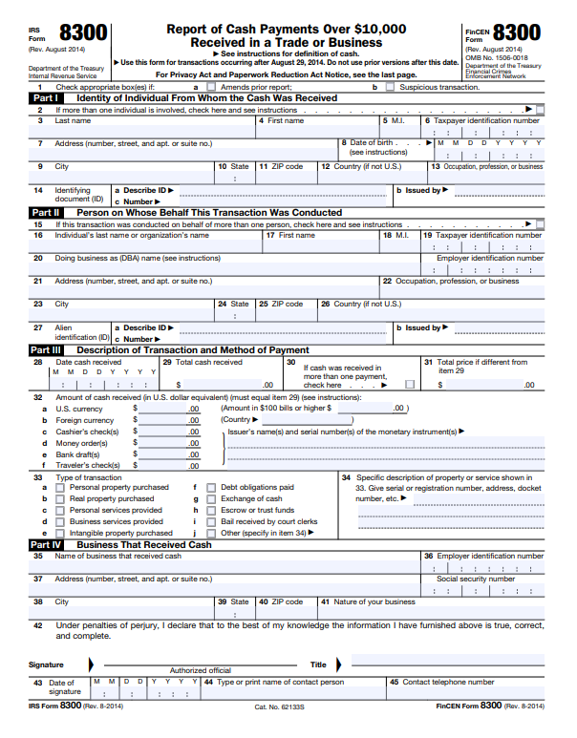
Infrastructure Investment & Jobs Act

Slide 78
Infrastructure Investment & Jobs Act
USC §6045 (A) now includes:
d) Return Requirement for Certain Transfers of Digital Assets Not Otherwise Subject to Reporting.–
Any broker, with respect to any transfer (which is not part of a sale or exchange executed by such broker) during a calendar year of a covered security which is a digital asset from an account maintained by such broker to an account which is not maintained by, or an address not associated with, a person that such broker knows or has reason to know is also a broker, shall make a return for such calendar year, in such form as determined by the Secretary, showing the information otherwise required to be furnished with respect to transfers subject to subsection (a).

Slide 79
Infrastructure Investment & Jobs Act
And then adds this note!
Rule of Construction -- Nothing in this section or the amendments made by this section shall be construed to create any inference, for any period prior to the effective date of such amendments, with respect to…
(1) whether any person is a broker under section 6045(c)(1) of the Internal Revenue Code of 1986, or
(2) whether any digital asset is property which is a specified security under section 6045(g)(3)(B) of such Code.
SO…WHAT’S A BROKER??? And is an NFT a digital asset??
A lot of uncertainty is introduced.

Slide 80
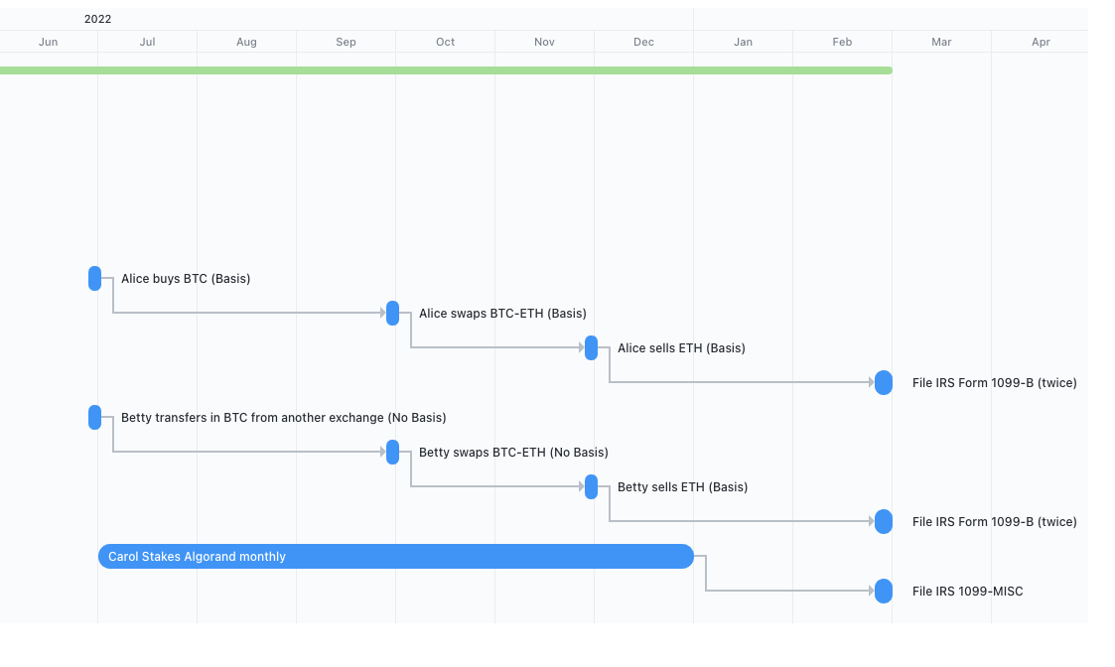
Reporting on 1099-B (or something like it)

Slide 81
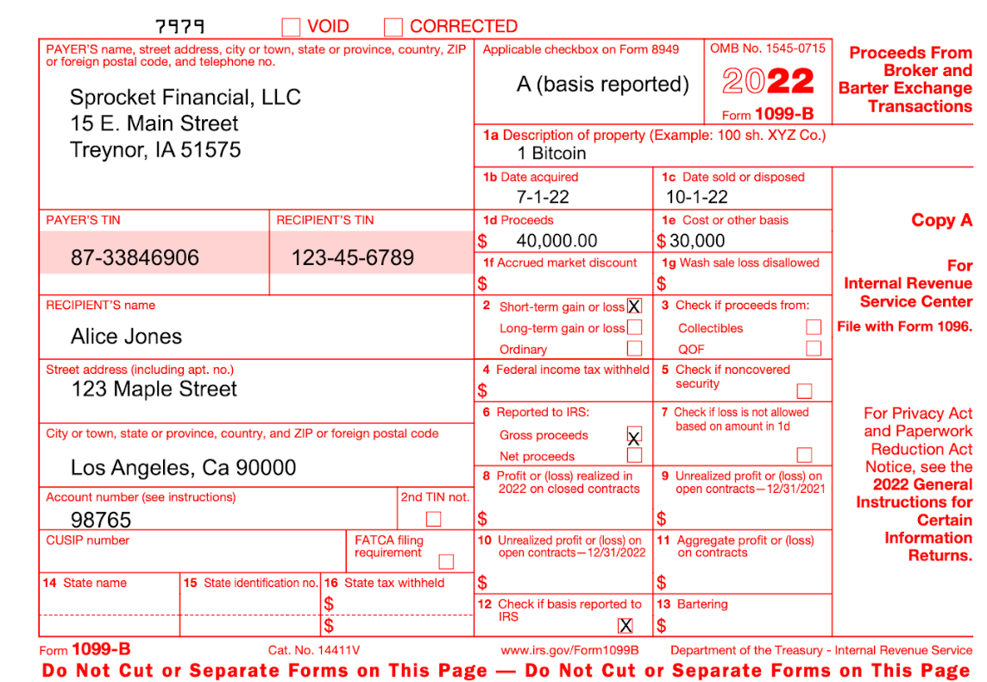
Reporting on 1099-B (or something like it)
1099-B for trade of Alice’s BTC for ETH, reported as a sale of BTC.

Slide 82
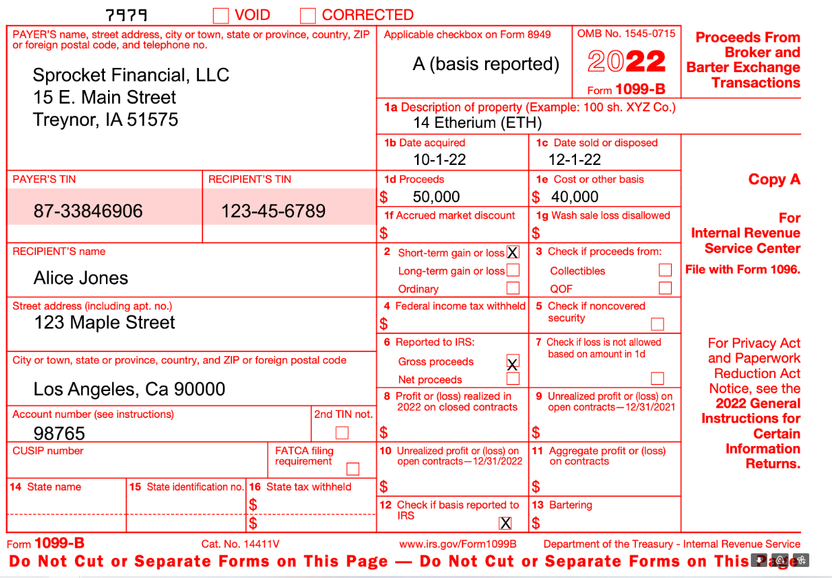
Reporting on 1099-B (or something like it)
1099-B for sale of Alice’s ETH.

Slide 83
Reporting on 1099-B (or something like it)

Slide 84
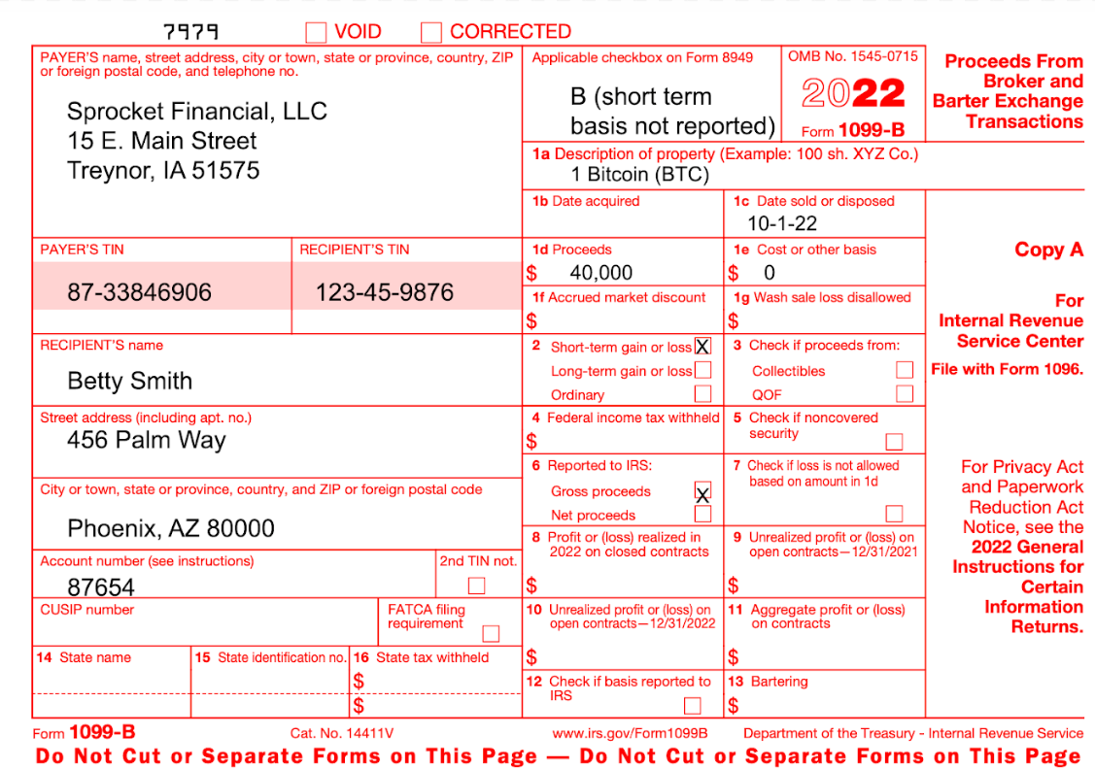
Reporting on 1099-B (or something like it)
1099-B for Betty’s trade of BTC for ETH, reported as a SALE of BTC.

Slide 85
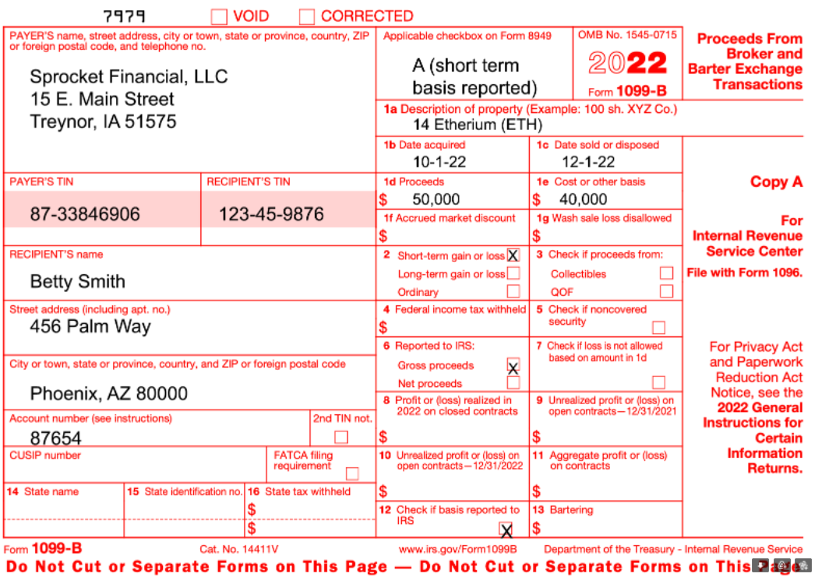
Reporting on 1099-B (or something like it)
1099-B for the sale of Betty’s ETH.

Slide 86
2022 Form 14457
You can plead guilty on Form 14457…
But you might want to speak to an attorney first!

Slide 87
The Crypto Question
Section 6

Slide 88
The Birth of the Crypto Question
2019 crypto question on Schedule 1
“At any time during 2019, did you receive, sell, send, exchange or otherwise acquire any financial interest in any virtual currency?”

Slide 89
The 2020 Crypto Question
2020 crypto question on the 1040
“At any time during 2020, did you receive, sell, send, exchange or otherwise acquire any financial interest in any virtual currency?”

Slide 90
The 2021 Crypto Question
2021 crypto question
“At any time during 2021, did you receive, sell, send, exchange or otherwise dispose of any financial interest in any virtual currency?”

Slide 91
The 2022 Crypto Question Draft Version
2022 crypto question
“At any time during 2022, did you: (a) received (as a reward, aware, or payment for property or services); or (b) sell, exchange, gift, or otherwise dispose of a digital asset (or a financial interest in a digital asset)?”

Slide 92
The 2022 Crypto Question Suggestion by AICPA
2022 proposed crypto question
"At any time during 2022, did you have a taxable event involving virtual currency? See instructions."

Slide 93
When to Check Yes
A transaction involving virtual currency includes, but is not limited to:
The receipt of virtual currency as payment for goods or services provided;
The receipt or transfer of virtual currency for free (without providing any consideration) that does not qualify as a bona fide gift;
The receipt of new virtual currency as a result of mining and staking activities.

Slide 94
When to Check Yes
A transaction involving virtual currency includes, but is not limited to:
The receipt of virtual currency as a result of a hard fork;
An exchange of virtual currency for property, goods, or services;
An exchange/trade of virtual currency for another virtual currency;
A sale of virtual currency; and
Any other disposition of a financial interest in virtual currency.

Slide 95
When to Check No
A transaction involving virtual currency does not include the holding of virtual currency in a wallet or account, or
The transfer of virtual currency from one wallet or account you own or control to another that you own or control.
If your only transactions involving virtual currency during 2021 were purchases of virtual currency for real currency, including the use of real currency electronic platforms such as PayPal and Venmo, you are not required to check the “Yes” box next to the virtual currency question.

Slide 96
When to Check No
Note that owning stock in a company that owns crypto (Greyscale Bitcoin Trust, Coinbase, etc.) does not mean you own crypto!
(Owning stock in General Motors doesn’t mean you own a car.)

Slide 97
Pop Quiz!!
Who should check YES on the crypto question?
Alice purchased crypto through Paypal.
Barb sold Robin Hood stock.
Crystal received crypto as a gift from her brother.
Darren received an airdrop.
Edgar moved his crypto from one wallet to another.
Francine received crypto in exchange for building a website.
Georgiana traded ETH for LTC.

Slide 98
Stay With Us for Part II
Let’s apply what we’ve learned!
Reporting of sales, trades, staking, rewards, donations, gifts, inheritances, ICOs/IDOs/IEOs/ITOs
Reporting of mining activities
Deducting losses and other murky tax situations
Upcoming legislation
Best Practices for your office

