Slide 1
How to Grow Your Practice
With Tax Planning In 3 Easy Steps

Slide 2
Do any of these feelings resonate with you?
Growing Pains…
Fed Up You're tired of not being compensated for all the help you’re giving clients year-round.
Cautious You want to increase fees but don’t want to jeopardize any of your client relationships.
Want Better You want all your client relationships to be like your “best” clients (enjoyable, productive, profitable).
Don’t have the right message You're not sure what to say to clients so they understand why they should pay more than they’re already paying…
Need a Plan You want a plan for how to increase your margins and cash flow this year.
SmartPath.co LLC

Slide 3
Planning = Stability
You’re not alone…
Increasing Tax Planning for Clients Is the #1 Strategy to guarantee your firm is profitable in the future.
SmartPath.co LLC

Slide 4
Why is Tax Planning so important?
> It allows you to: automatically increase your margins.
> If you have higher margins for every engagement:
- Pay yourself more
- Hire the right staff
- Invest in marketing & tech
- Build a firm you love
SmartPath.co LLC

Slide 5
Why is Tax Planning so important?
> It deepens your relationship with clients:
> When you have a deeper relationship with clients:
You separate yourself from bots, A.I., and DIY options.
- You position yourself as the trusted advisor
- You stand out from the competition
- The right clients want to pay for your help
SmartPath.co LLC

Slide 6
What you’ll learn in this workshop
We're going to you ONE simple framework.
You can use to increase your tax planning engagements.
Significantly boost your margins throughout the year.
SmartPath.co LLC

Slide 7
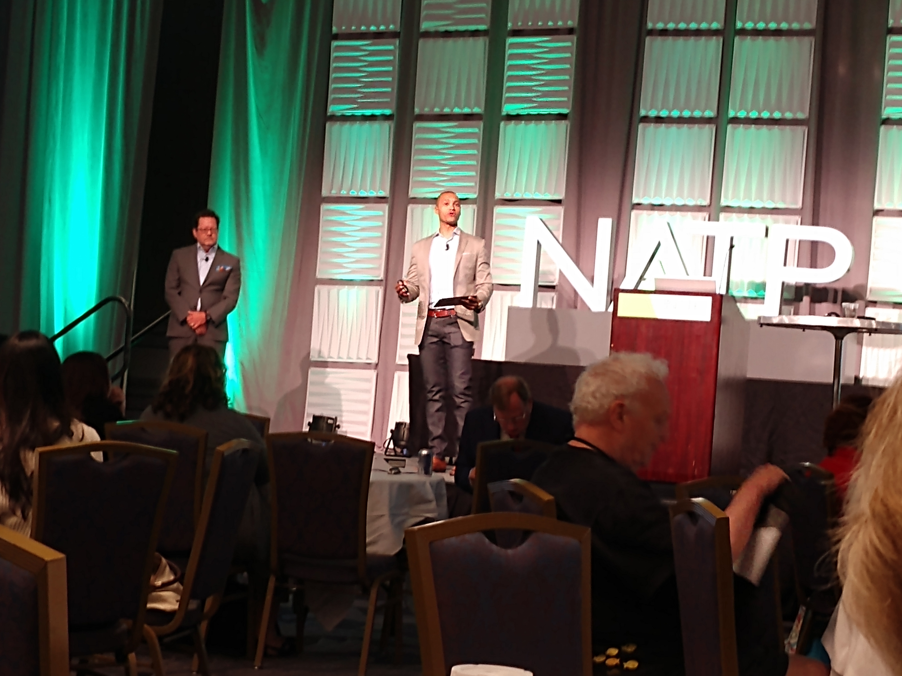
We know small tax firms.
William Hamilton
I’m an approved speaker with the NATP, AICPA and CPAAcademy.org.
I spend 1,000's hours a year working directly with small tax firm owners across the US helping them increase their margins.
Over the last 14 years SmartPath.co has helped over 1,300+ firms across all 50 states increase their margins with new and existing clients on avg 2.8x.
Founder
SmartPath.co
SmartPath.co LLC

Slide 8
The Smart Tax Planning Framework
The proven Framework to Structure Your Tax Planning + Increase Your Margins
TM
Identify
Planning Opportunities
1
2
Engage
Get fairly paid for your help
3
Execute
Gather data, analyze, & implement savings steps
SmartPath.co LLC

Slide 9
The Smart Tax Planning Framework
TM
1
Identify Opportunities
SmartPath.co LLC

Slide 10
Have you ever thought about buying a certain car?
Once you decided on that specific car you started seeing them everywhere?
We first create the space in our brains to start identifying planning opportunities with clients.
Once you do, you’ll start seeing planning opportunities everywhere.
1
> Identify
Opportunities
SmartPath.co LLC

Slide 11
Why is this the first step?
Once you see opportunities in the work you’re already doing with clients.
You’ll know exactly which ones you want to act on.
You’ll see how to grow revenue faster by simply acting on the opportunities that naturally happen in every tax practice.
1
> Identify
Opportunities
SmartPath.co LLC

Slide 12
We like to think about planning opportunities in three key categories:
1
> Identify
Opportunities
A. Post Tax Filing
B. Major Life Event
C. Faster Progress
SmartPath.co LLC

Slide 13
A. Post Tax Filing
1
> Identify
Opportunities
You complete the tax prep for the year.
The result is either “good” or “bad.”
If it’s good = there’s an opportunity to plan how to maintain the result in the future.
If it’s bad = there’s an opportunity to plan how to create a better result in the next filing.
SmartPath.co LLC

Slide 14
B. Major Life Event
1
> Identify
Opportunities
On avg. every year 10-25% of your clients will:
Get married
Inherit money
Get divorced
Have or adopt a child
Buy a home
Retire
Sell a property
Lose or gain income
Change jobs
Need to pay for education
Start a business
Need to pay for healthcare
ALL of these are potential tax planning opportunities.
SmartPath.co LLC

Slide 15
C. Faster Progress
The complexity in client’s business and financial lives has ballooned.
1
“1040” client 20 years ago
“1040” Today
> Identify
Opportunities
1 or 2 W2’s
1 Mortgage Interest
1 brokerage statement (Investment income from the company 401k)
1 or 2 W2’s
Mortgage Interest from primary
Mortgage Interest from rental
Schedule C with income and deductions from AirBnB
Multiple Investment Statements (Robinhood, Traditional Brokerage, Crypto)
Side Income from a “Gig” (Uber or DoorDash)
Helping a client make faster progress on any of the complexities in their life creates tax planning opportunities.
10x this list for a business client
SmartPath.co LLC

Slide 16
What happens if you don’t identify planning opportunities for clients?
You end up giving away countless hours of free work answering “quick questions” instead of defining a proactive planning process.
You could put off charging for your planning services because you think you need to “hard-sell” clients and don’t want to have awkward conversations.
You could lose planning clients to other firms who act on the planning opportunities in the client’s life.
1
> Identify
Opportunities
SmartPath.co LLC

Slide 17
When you do this the right way
Easily find planning opportunities you can bill for, and clients will be happy to pay your fee.
You will never have to “hard sell” any client on complicated tax plans, you can just act on the natural opportunities that arise.
You can significantly increase your revenue in a short time by simply going deeper and addressing opportunities with more clients.
1
> Define
Progress + Impact
SmartPath.co LLC

Slide 18
How to do it A. Post Tax Filing>
1
Start sending a post-filing email to clients you enjoy working with.
“Bad” result = “Hey, I hate that this happened. I want to make sure it doesn’t happen again. The only way for us to do that is to take time throughout the year to execute some planning…let’s schedule a call to discuss next steps.”
“Good” result = “Hey, your tax picture looked great this. Every year tax law can change and the only way for us to ensure you keep paying the least amount of tax possible is to take time this year to execute some planning…let’s schedule a call to discuss next steps.”
> Identify
Opportunities
The goal of the call should be to discuss your options for adding paid tax planning services to their engagement. (we’ll cover how to do that the next step of the framework)
SmartPath.co LLC

Slide 19
How to do it B. Major Life Event>
1
Send an email to book a Discovery Call.
Let’s see how this impacts your taxes… “Hey, since you shared [define life event], I put aside some time so we can discuss how this might impact your future tax filings. I’d like to spend a few minutes and map this out together…let’s schedule a call to discuss the next steps.
> Identify
Opportunities
The goal of the call should be to discuss your options for adding paid tax planning services to their engagement. (we’ll cover how to do that the next step of the framework)
SmartPath.co LLC

Slide 20
How to do it C. Faster Progress>
1
Send an email to book a Discovery Call.
Let’s map out the next 12 months… “Hey, the economy is wacky right now and tax law is continuing to morph rapidly. I know you have a bunch happening this year, I want to make sure we set aside some time to see how we can help…let’s jump on a call to discuss next steps.
> Identify
Opportunities
The goal of the call should be to discuss your options for adding paid tax planning services to their engagement. (we’ll cover how to do that the next step of the framework)
SmartPath.co LLC

Slide 21
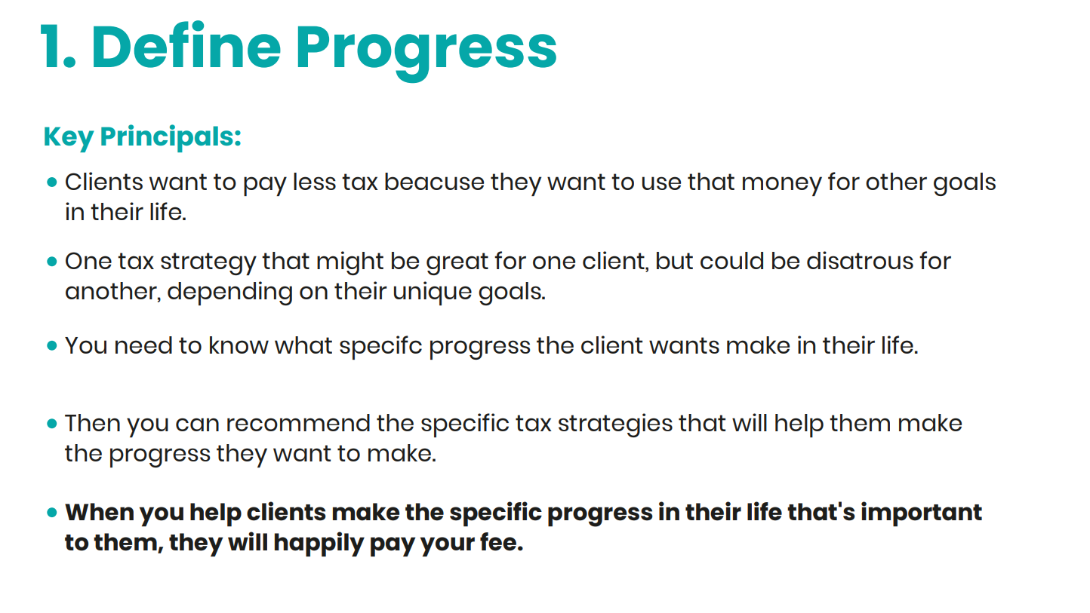
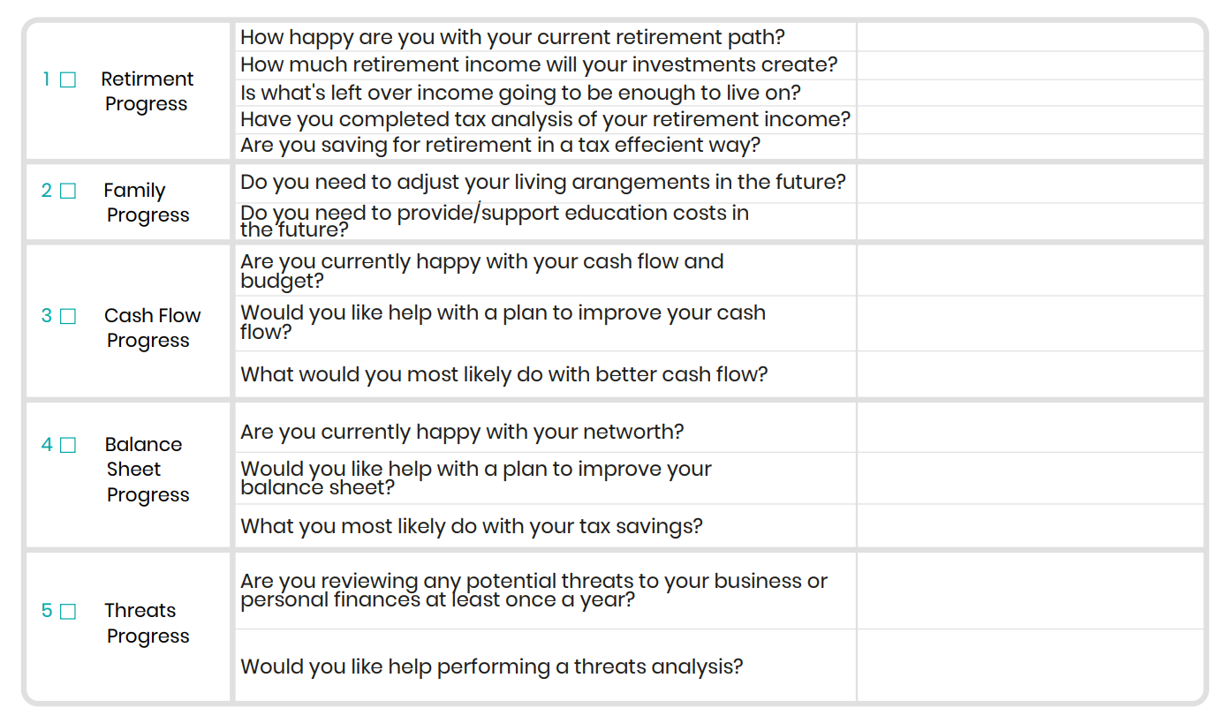
Free Download
The Smart Tax Planning Worksheet
TM
Use this worksheet to help you define progress manually with a client.
SmartPath.co LLC

Slide 22
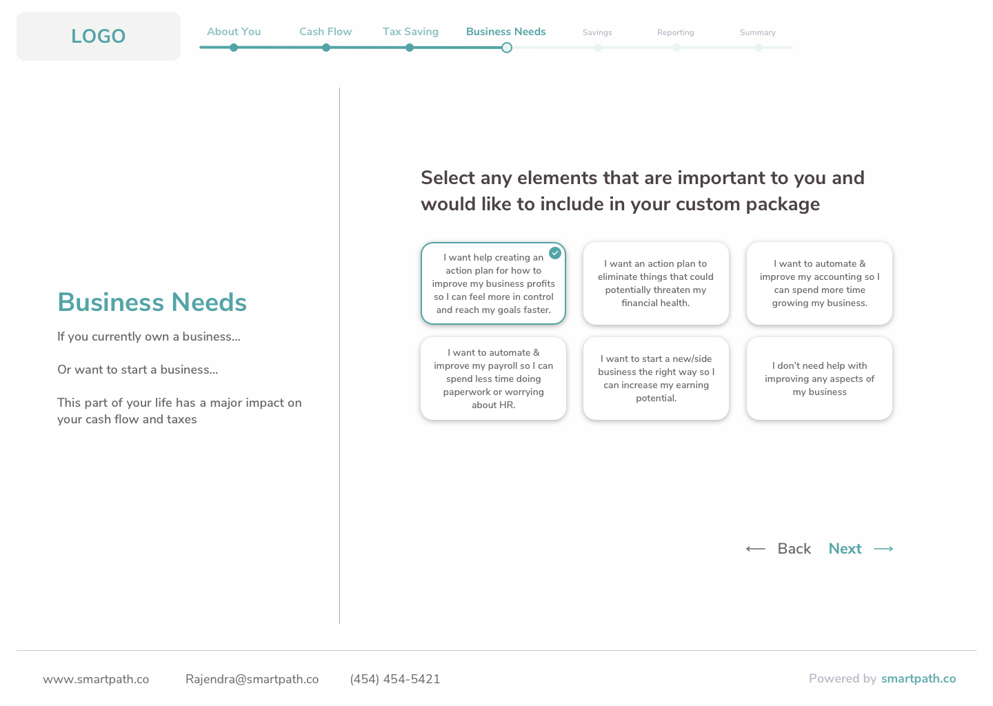
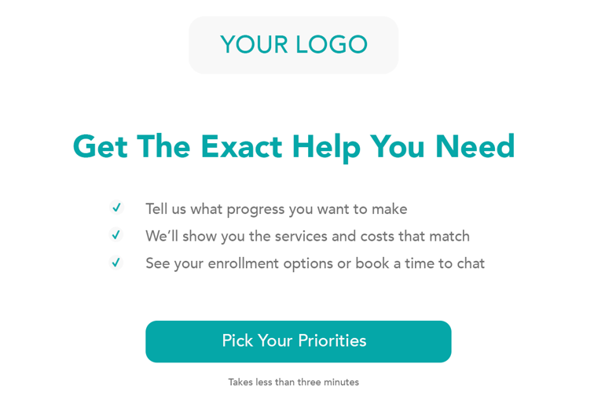
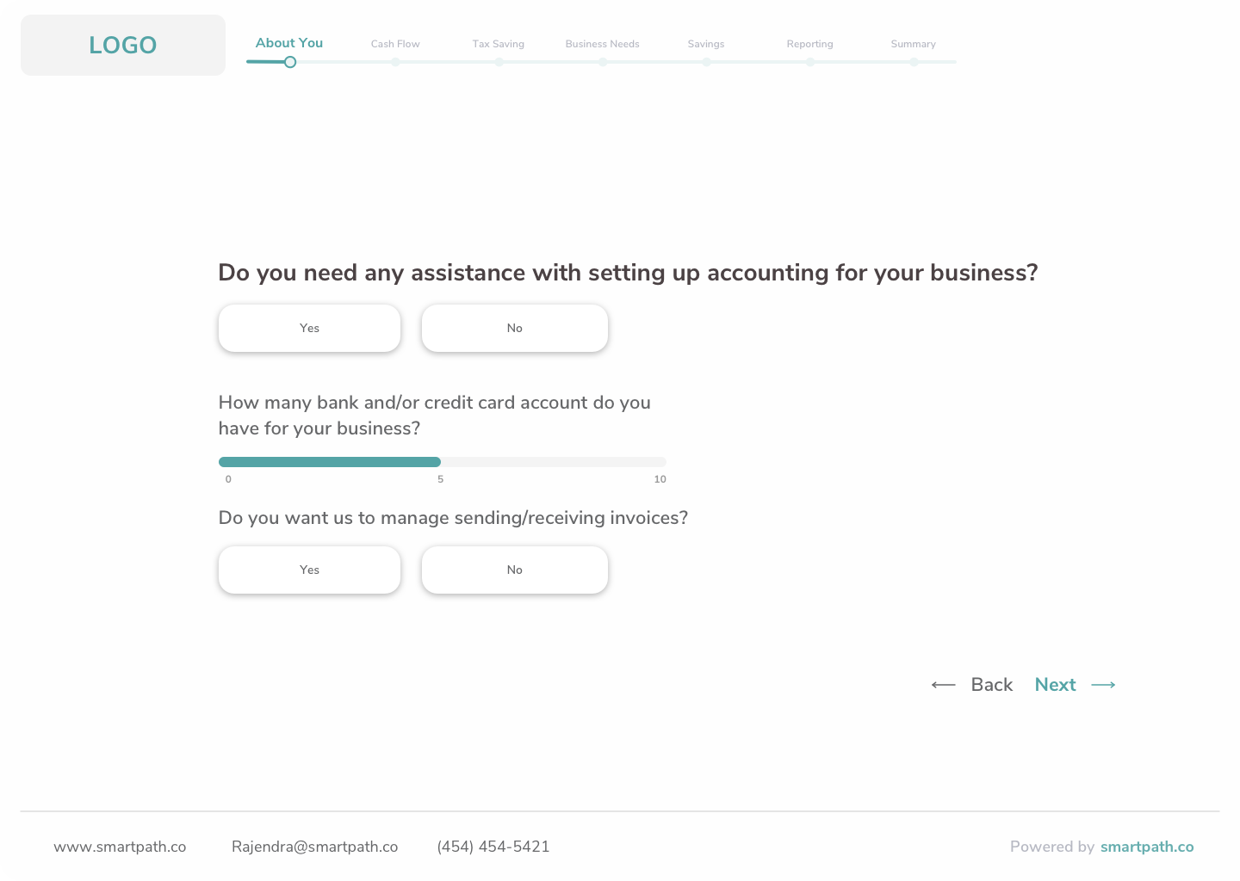
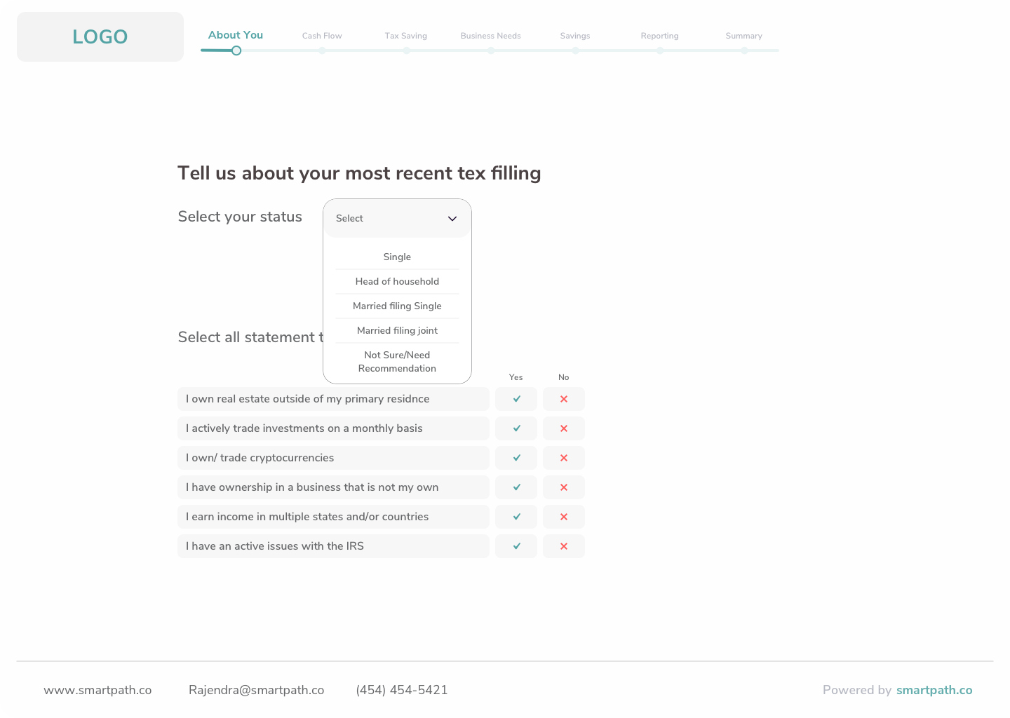
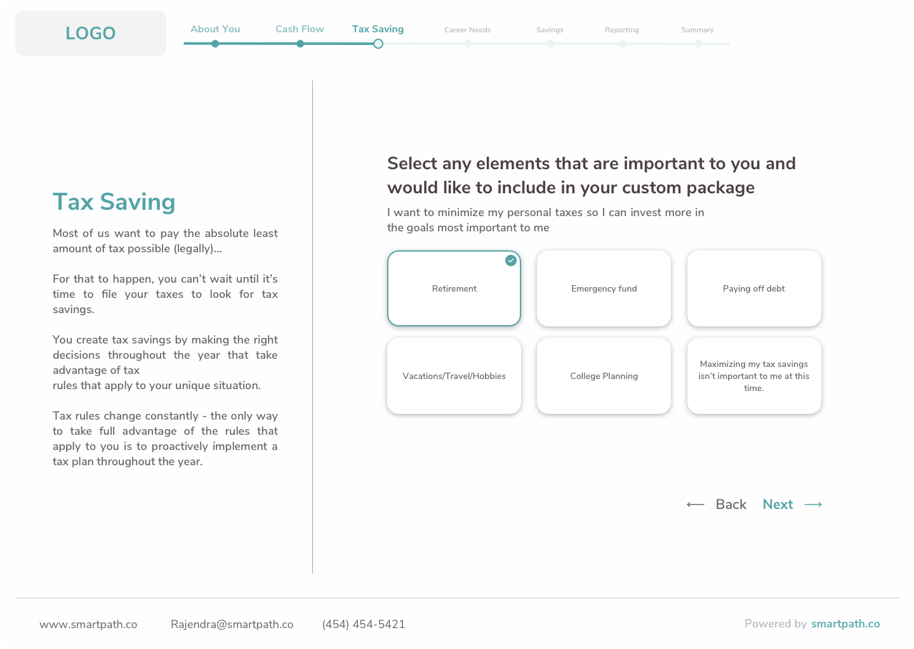
If you want to automate this step
Use the Magic Pricing Link Engage Software
TM
SmartPath.co LLC

Slide 23
Case Study
Michael McGovern, EA | Garnerville NY
513% average client fee increase
Multi-generational firm with 1,000+ clients.
Once he stopped charging by the form and started Client Progress Analysis: Average fee went up by over 5x.
70% clients are individuals, 30% are businesses.
Minimum individual fee is: $199/month - ($2,388/year)
SmartPath.co LLC

Slide 24
The Smart Tax Planning Framework
TM
2
Engage Get Fairly Paid for Your Help
SmartPath.co LLC

Slide 25
What happens if you don’t do progress and impact analysis for clients?
You get stuck with 2% annual fee increases because you don’t have the clear “WHY” behind adjusting a client fee…
“We’re going to adjust your engagement this year so we can help you make more progress on the things you care about.”
Clients will push back on fee increases because the new engagement isn’t matched to what they specifically want.
Quoting a fee is stressful because you don’t know if the client will value the services you put in your proposal.
1
> Define
Progress + Impact
SmartPath.co LLC

Slide 26
Why is this the next step?
Once you know the progress a client wants…
You have real opportunities for planning…
You can accurately calculate what their price should be for your help.
2
> Engage
Get fairly paid for your help
SmartPath.co LLC

Slide 27
The Good News
You don’t have to guess!
You don’t have to limit your calculation to the forms in their return.
Or limit your price to what the firm down the street is charging.
Or feel like you must charge $10k+ up front for a complicated plan.
2
> Engage
Get fairly paid for your help
SmartPath.co LLC

Slide 28
Why is this step critical?
It’s natural to worry that your “new price” is right.
2
> Engage
Get fairly paid for your help
Quoting a new fee for a client can be stressful.
The reality is, by clearly defining the planning opportunities in Step 1, the “right” price will automatically reveal itself.
The right price will compensate you for all your work, year-round, so you can generate profit margin for every client.
SmartPath.co LLC

Slide 29
Fee schedules haven’t kept up today’s client needs
Traditional Fee Schedule
Modern Engagement
2
Prep & Filing 1040
Prep & Filing Schedule C
Prep & Filing State
> Engage
Get fairly paid for your help
Tax Planning Save more toward retirement
QBO Setup & Training Get insights into your rental property costs
Cash Flow Analysis See if you should buy another property or buy more inventory for their side gig.
Expert Tax Prep & Filing
Year-Round Support
$450 One-Time +
$150 Excel “Bookkeeping” ($50/hr. x 3 hours)
Total = $600 Year
Total = $109/month ($1,308/year)
87% increase
SmartPath.co LLC

Slide 30
Different clients value different things
Paying less tax to buy investment properties.
Grow their business revenue to hire more staff or expand locations.
Finding more savings to build retirement.
Having a better budget to get out debt.
2
> Engage
Get fairly paid for your help
Whatever the client values can always point to strategies for how you can help them plan for their taxes/accounting/payroll etc.
SmartPath.co LLC

Slide 31
Top 5 Categories of Client Value
Category 1 : Setup Help
Helping someone set up their QuickBooks or S-Corp
Category 2 : Expert Historic Work
“Compliance” - Tax Prep or Accounting Reconciliation
Category 3: Done-For-You Management
Accounting, managing payroll, or helping with an active IRS Issue.
Category 4: Tax Reduction Planning
Year-Round Tax Planning or Reasonable Comp Analysis
Category 5: Better Results Planning
Helping with budgeting cash flow, recommendations for how and when to depreciate an asset, consulting on a business sale, debt structuring, etc.
2
> Engage
Get fairly paid for your help
SmartPath.co LLC

Slide 32
Top 5 Categories of Client Value
2
> Engage
Get fairly paid for your help
Most tax & accounting engagements only calculate help with 1 or 2 of these categories:
Your new price should include options for help with ALL 5 categories.
This new Price will align with what your ideal clients want, are willing to pay for.
This is a critical steps that will significantly increase your margins (most firms miss).
SmartPath.co LLC

Slide 33
The cool thing is, your best clients already want to make progress in their lives.
They will naturally be attracted to 5 major categories of value you can offer them.
SmartPath.co LLC

Slide 34
What happens if you don’t calculate your price based on the 5 categories of Client Value?
You’ll give away too much free work.
2
> Engage
Get fairly paid for your help
You get stuck pricing per form. Each form can be very different based on the client.
You won’t have a way to get paid for “Quick Questions”.
If don’t give them a price point that allows you to partner together year-round, they will default to trying to get it “for free”.
Clients will churn when they find a better option.
When a firm offers them an engagement that helps them make more progress, when they have the time and energy to switch, they will.
SmartPath.co LLC

Slide 35
When you do this the right way
When you tie your pricing to the 5 Value Categories, you can perfectly match any client with an engagement they’re happy to pay for.
Clients will stop pushing back on your fees.
Because they will see and feel exactly how paying your fee will lead to the results they care about.
You can INCREASE your average price high enough, you can DRECREASE the number of clients you work with.
2
> Engage
Get fairly paid for your help
SmartPath.co LLC

Slide 36
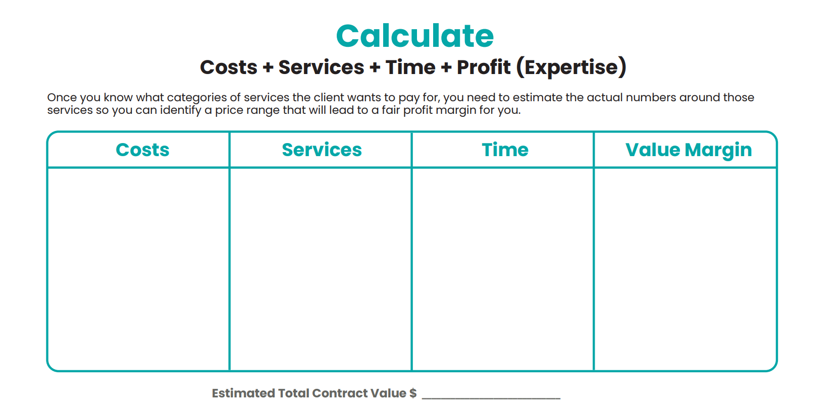
Free Download
The Perfect Pricing Template
TM
PricingTemplate.SmartPath.co
SmartPath.co LLC

Slide 37
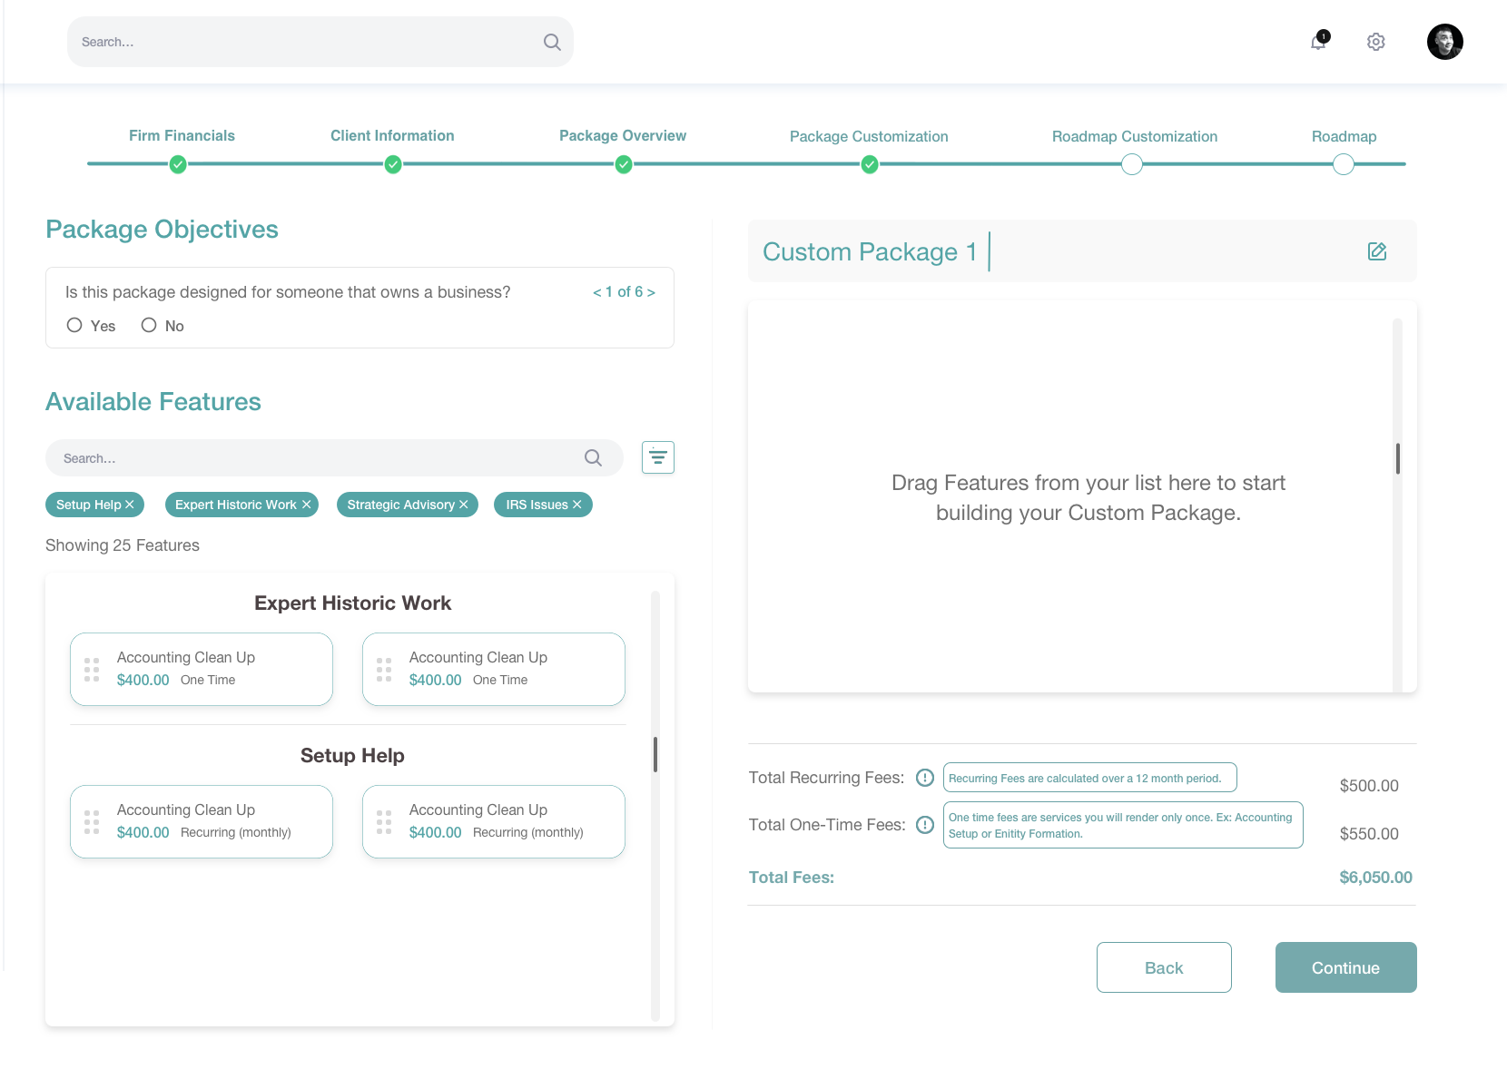
If you want to automate this step
Use the Client Services Calculator Engage Software
TM
2
> Engage
Get fairly paid for your help
SmartPath.co LLC

Slide 38
Case Study
Nicole Odeh, EA | Coatsville PA
$96k net new revenue in the first 6 months
She has an Established Practice.
We started calculating the total value of a year-round engagement for clients.
We helped her systematically pick 20-30 clients she wanted to price at fair margin for tax planning opportunities.
All other strategies and tactics were de-prioritized into the “later” pile.
SmartPath.co LLC

Slide 39
The Smart Tax Planning Framework
TM
3
Execute Gather data, analyze, implement savings steps
SmartPath.co LLC

Slide 40
Why is this critical?
Once someone pays for planning services, you need a simple and repeatable process any preparer in your firm can use to identify potential tax saving.
Most trained tax professionals can tax plan, but they don’t have a documented process to make it scalable.
3
> Execute
SmartPath.co LLC

Slide 41
What happens if you don’t give the client options?
It will feel like you’re forcing them into a “take it or leave it” engagement.
That may make them defensive, and they may “leave it”.
You position yourself as a sales-person instead of trusted advisor.
This is stressful for everybody.
3
> Customize
SmartPath.co LLC

Slide 42
When you do this the right way
If you give them up to three options and show them which one you recommend, it keeps you on the “same team”.
They can pick the best option for themselves, and you don’t have to hard-sell them.
One of the options can be close to their previous engagement, so they have a way to keep things close to the same (if every option gives you enough margin).
A high % of clients will say “yes” to at least one option so you can generate significant revenue in days, not years.
3
> Customize
SmartPath.co LLC

Slide 43
How to do it
Tax strategies can be complicated.
If you follow a simple process, you can make it manageable for any one in your practice.
3
> Execute
Step 1
Step 2
Step 3
Define Client Progress
Gather Data
Create Your Results
SmartPath.co LLC

Slide 44
How to do it
Step 2
Gather Data
3
> Execute
SmartPath.co LLC

Slide 45
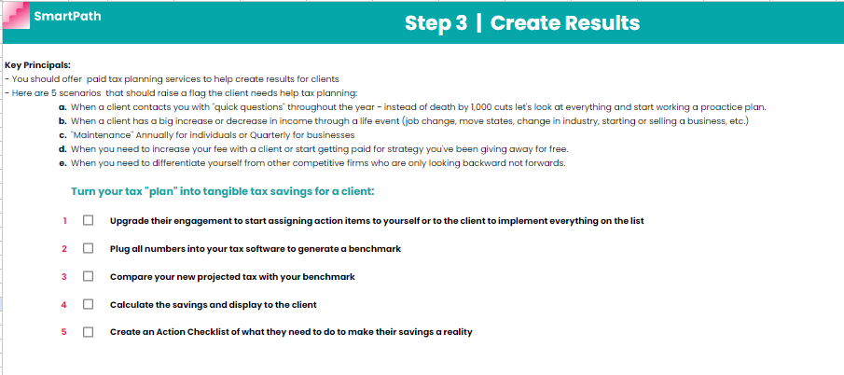
How to do it
Step 3
Create Your
Results
3
> Execute
SmartPath.co LLC

Slide 46
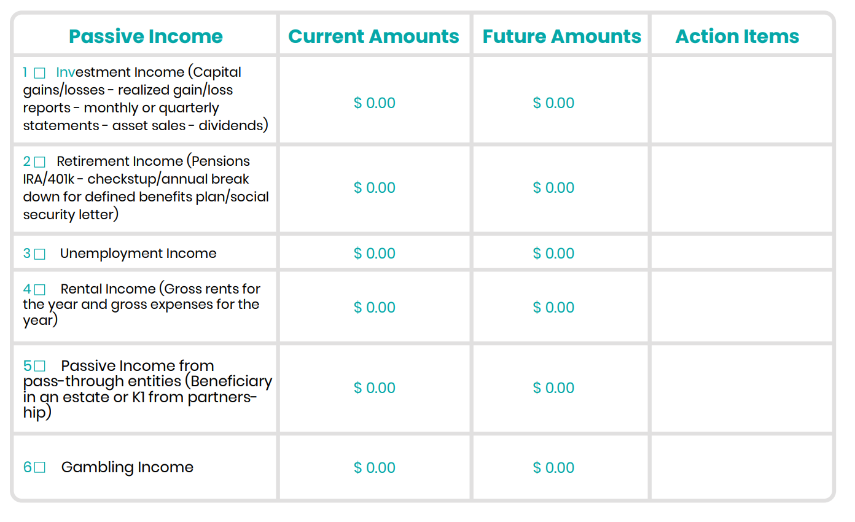
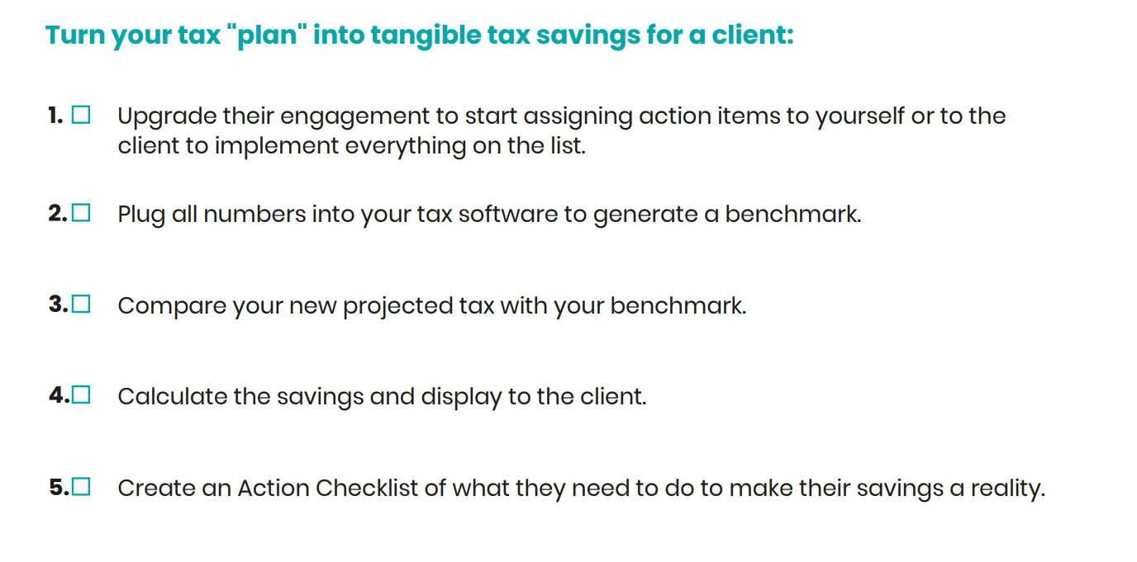
Free Download
The Smart Tax Planning Worksheet
TM
TaxPlanning.SmartPath.co
SmartPath.co LLC

Slide 47
Case Study
Christine Johnson, CPA | Eagleville TN
$9,884 in new monthly recurring revenue in the first 90 days
Small firm – 350 Clients.
Stopped giving away tax planning for free tax advice.
Offered two different pricing options: - Tax Prep + Year-end Tax Plan - Proactive Year-Round Planning
Added $118,608 in new annual revenue in 90 days. $9,884 x (12 months)
SmartPath.co LLC

Slide 48
Access Your Free Worksheet >> taxplanning.smartpath.co
Email | will@smartpath.co
Web | www.SmartPath.co

