Slide 1
What’s New for TY23 + Software Demo

Slide 2
TY22 at a Glance
LAUNCHED
eSignature Integration
TheTaxBook Partnership (Discounted Rate for Customers who purchase an annual license with TheTaxBook)
Refund Transfer Incentives
ProtectionPlus Firm-Level Offering
UPDATED
Forms Entry Experience
INCREASED
E-File and Forms Coverage
Support Hours / Staff
Events / Trainings / Webinars

Slide 3
We Have Heard Your Feedback And Taken it to Heart.
“Continue to provide a great product at a market best price.”
“Add relevant features for the tax practice of today and the future.”
“Care about me and my business by prioritizing support.”
“Continuously improve the software’s flow and how easy it is to use.”

Slide 4
New Offerings

Slide 5
New Offers Coming for TY23
As we move into this next tax season, we are working to revise some of our special offerings:
1040 “20” Bundle ($545 $699)
1040 Pay-Per-Return Edition
All States
eSignature
Multi-User
Cloud Storage
Document Manager
20 Pre-Paid Returns
After 20 Returns: Cost Per Individual Return - $22.50
1040 Plus Business “50” Bundle ($795 $1,845.50)
1040 Pay-Per-Return Edition
All Federal Editions & All States
eSignature
Multi-User
Cloud Storage
Document Manager
50 Pre-Paid Returns
After 50 Returns: Cost Per Business Return - $29.95, Cost Per Individual Return - $22.50
Learn More:
https://www.taxact.com/professional/products/low-volumebundles

Slide 6
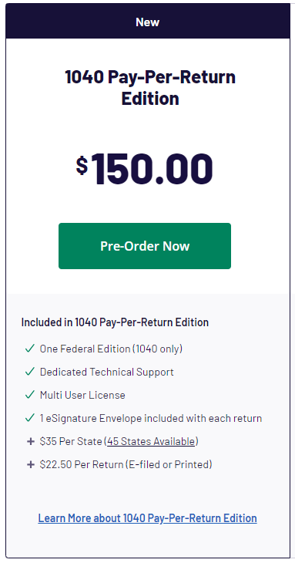
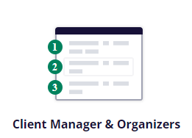
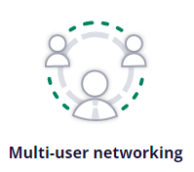
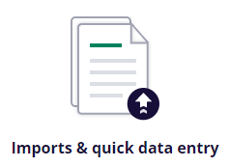
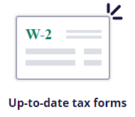
Pay-per-Return
We are excited to announce that the Pay-Per-Return edition will now include (1) eSignature envelope, with KBA, on each return.
Learn More: https://www.taxact.com/professional/products/federal-taxes

Slide 7
Product Updates

Slide 8
Expanded Forms and E-File Coverage
Like every year, we continually add updated forms and expand our e-file coverage.
Confirmed Additions:
FL 1065 E-File
FL 1120X E-File
Fed Form 8936-A
1040, 1041, 1065, 1120S, 1120
Fed Form 8992
1040, 1065, 1120S, 1120
Fed Form 970
1040, 1065, 1120S, 1120
Fed Form 8993
1120
Fed Form 4255
1040, 1041, 1065, 1120S, 1120

Slide 9
Enhanced eSignature Integration Powered by DocuSign
Learn More: https://www.taxact.com/professional/efiling/esignature
Upload/add other documents for signature to an envelope during the e-file steps.
eSignature will also be available for the most-used business forms.
1065
1120
1120-S
1041 (Estates)*
990 (Non-Profits)*

Slide 10
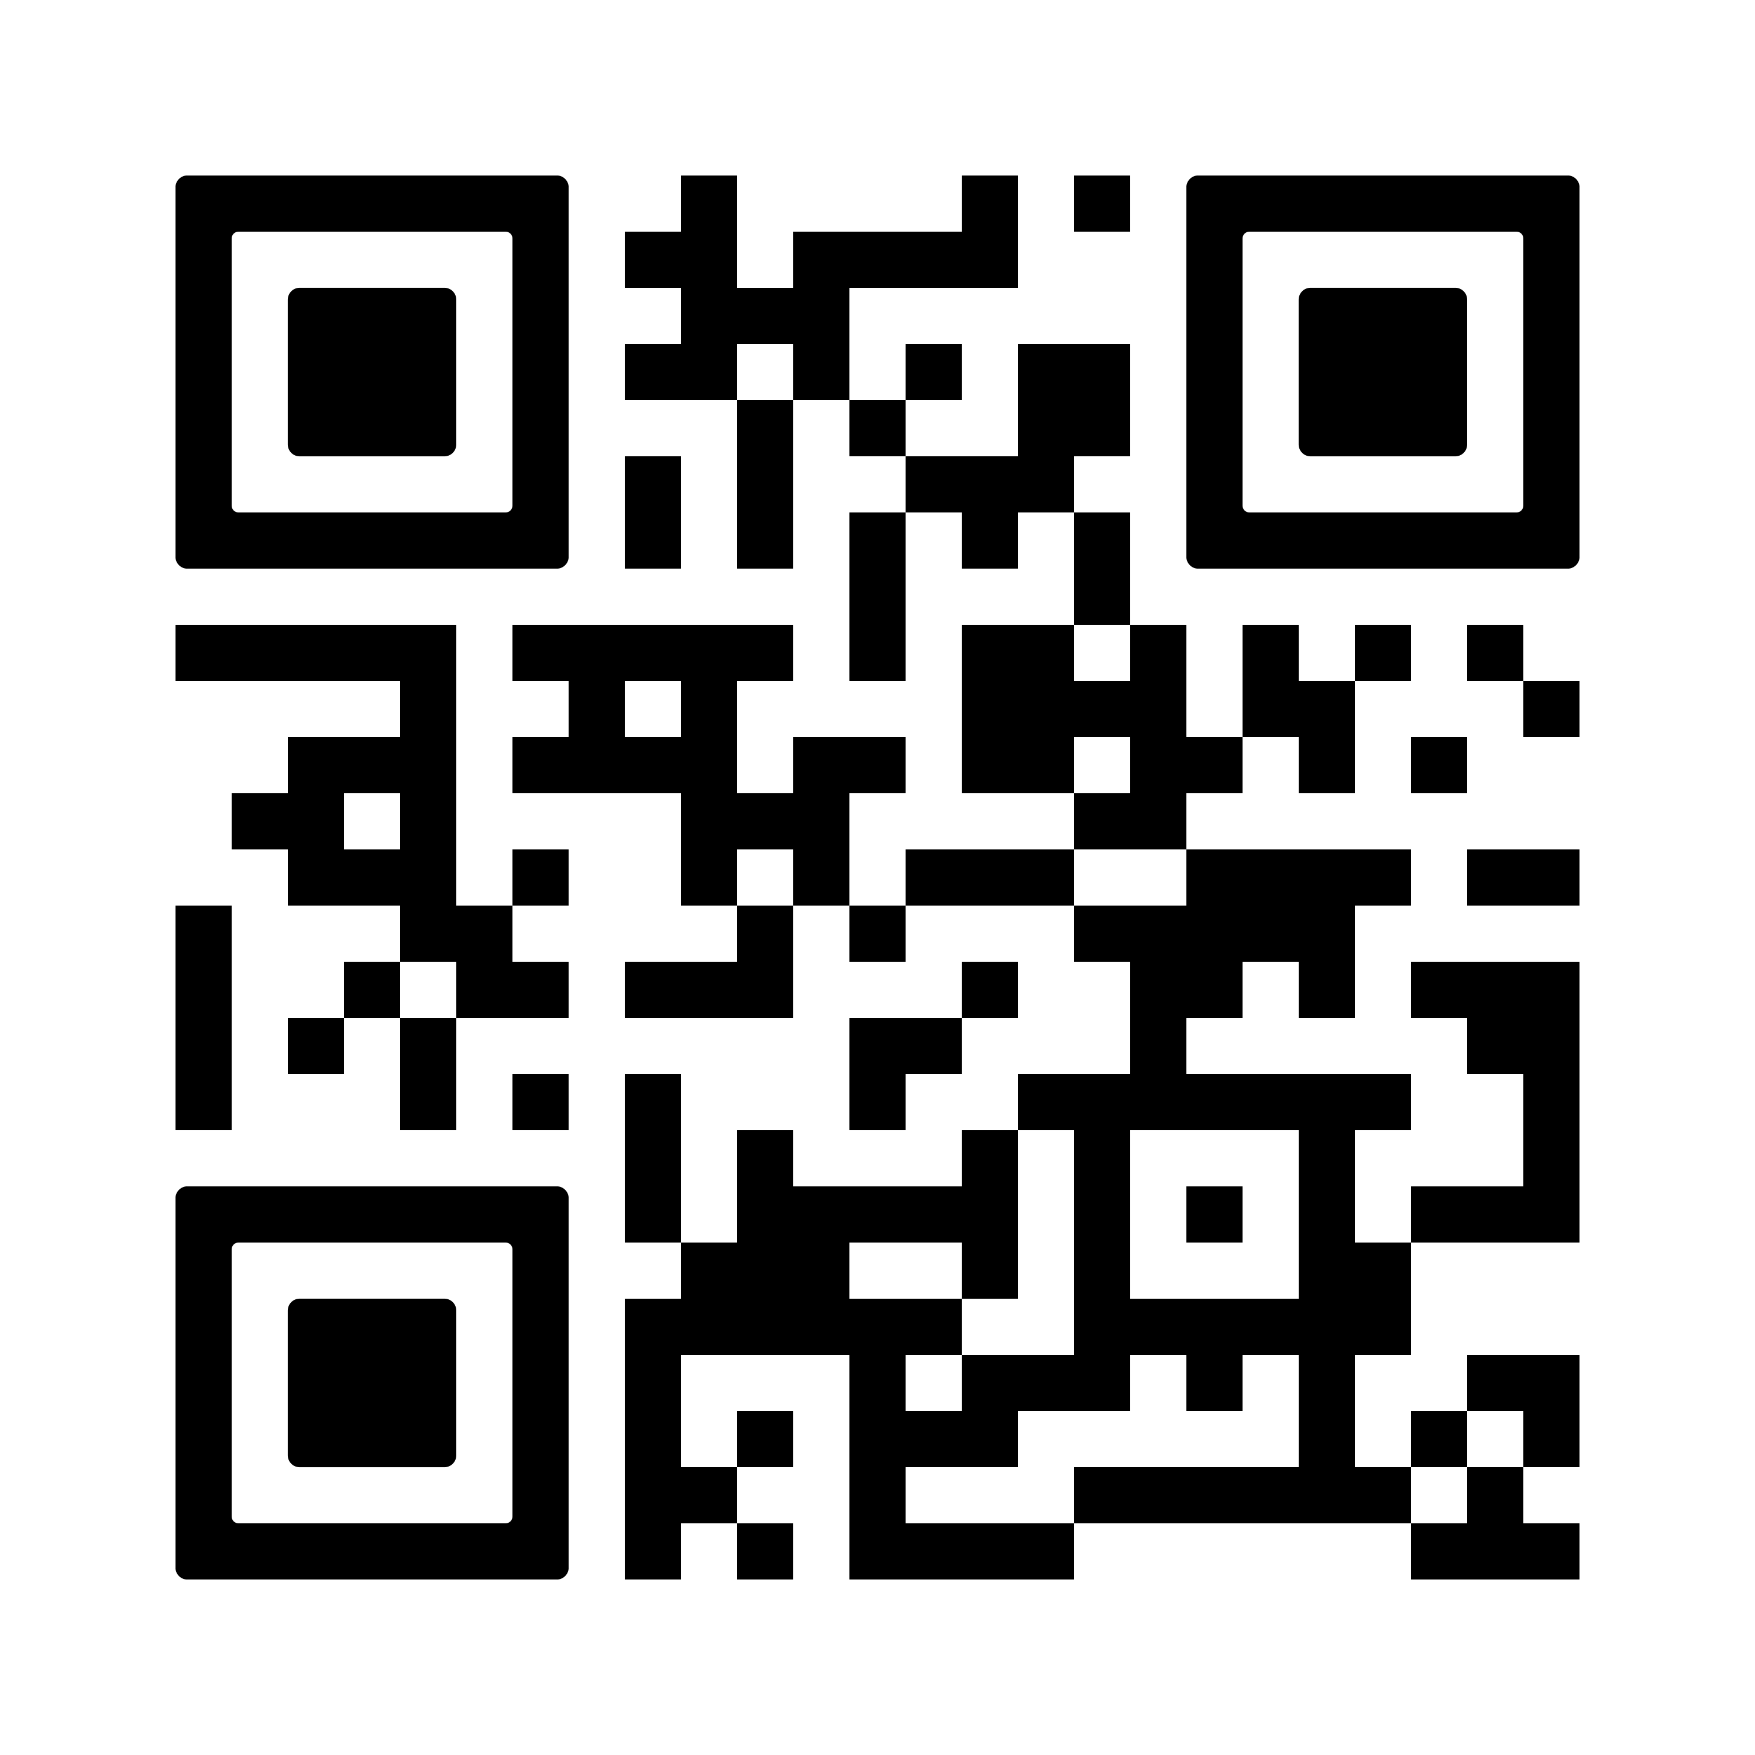
Client-Facing Documents Will Be Available in English and Spanish
TaxAct Professionals will receive complimentary access to client-facing templates, built to help our pros better serve their customers – regardless of the language they speak.
Available Now: https://proadvance.taxact.com/free-downloadable-client-facing-tax-documents-english-spanish/
Available Documents (English and Spanish Versions):
Engagement letter
New customer tax questionnaire
Returning customer tax questionnaire
Non-resident tax questionnaire

Slide 11
Training and Events

Slide 12
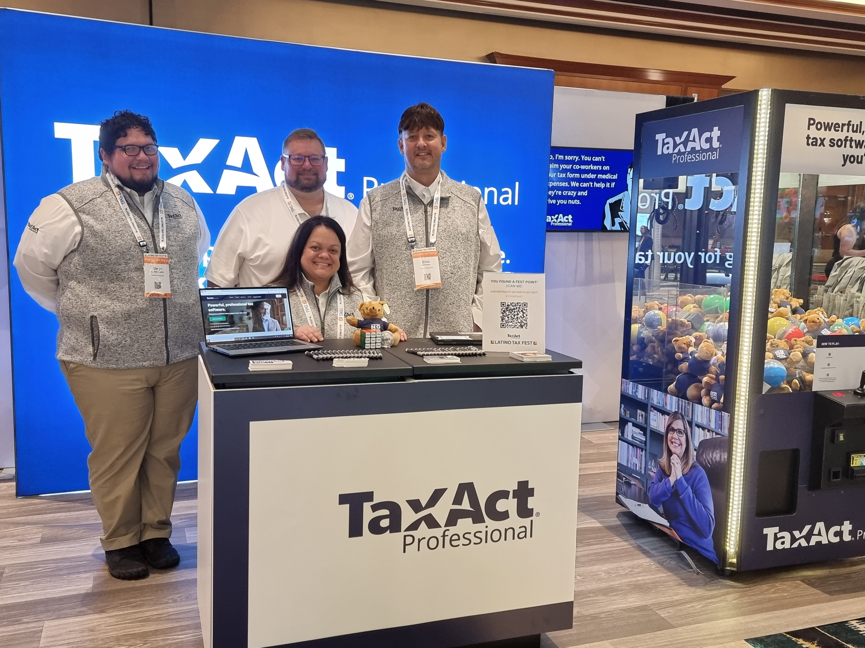
Training and Events
Free Webinars
What’s New Product Demos
Filing Schedule C for Microbusinesses (October)
Onboarding Webinars for New Users
Bank Product Webinars
And More…
On-Demand Training
ProAdvance Blog Content
YouTube Channel
Event Name | Location | Date(s)
IRS Tax Forum | San Diego, CA | August 22nd – 24th
IRS Tax Forum | Orlando, FL | August 29th – 31st

Slide 13
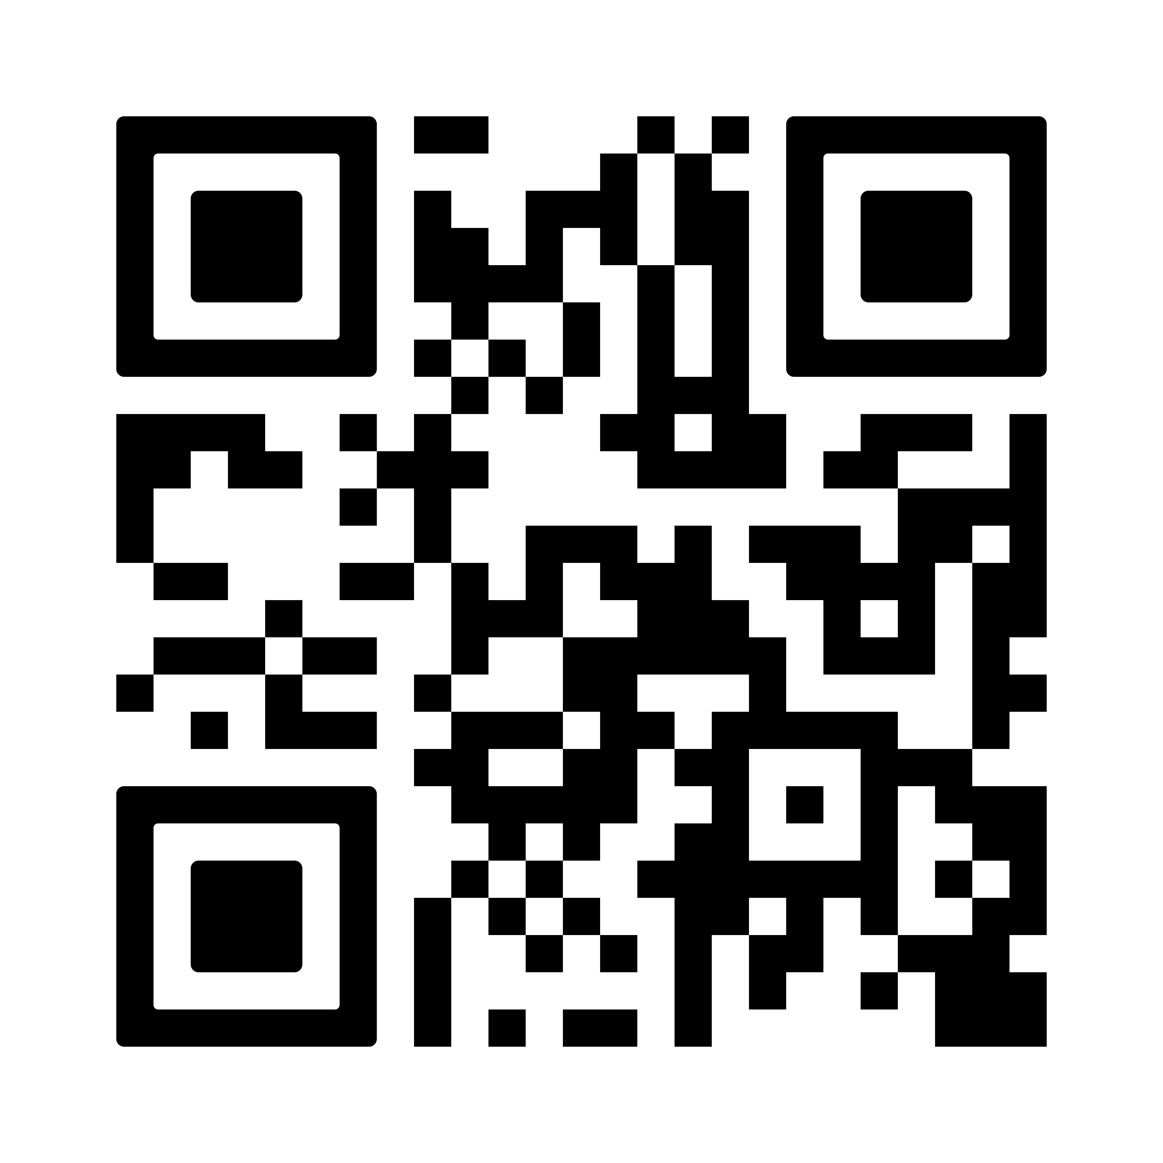
Upcoming Education Forum Will Be Hosted in December of 2023
Register to Attend: https://events.hubilo.com/taxact-professional-education-forum-december-2023/register
Location:
Streamed Live from Savannah, GA (Virtual Event Only)
Date:
Thursday, December 7th, 2023
Time:
1:00pm – 3:00pm EST
Agenda:
What’s New for TY23 + Software Demo
1099-B Reporting Income from Securities
1099-B Reporting Bond Income

