Slide 1



Slide 2

EIC Eligibility &
Due Diligence

Slide 3

Sioux City, Iowa

Slide 4
Quote of the Session
“Ethical behavior is doing the right thing when no one else is watching – even when doing the wrong this is legal” -- Aldo Leopold --

Slide 5
Objectives
Doing the right thing when no one else is watching, even when doing the wrong thing is legal.
Knowing the difference between what you have the right to do and what is RIGHT to do

Slide 6
Agenda
EIC rules for everyone
EIC rules if you have a qualifying child
EIC rules if you do not have a qualifying child
EIC rules for military
EIC rules for clergy

Slide 7
Agenda
Due Diligence
Paid preparer compliance
Basic questionnaire checklist
Training questions addressing common issues
IRS resources

Slide 8
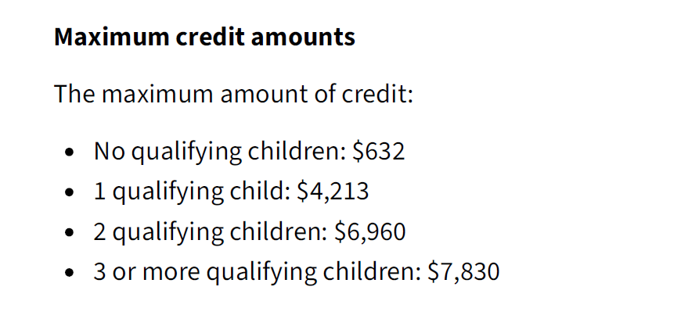
Earned Income Tax Credit
Tax Year 2024

Slide 9

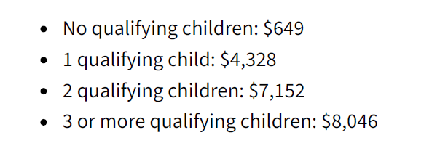
Earned Income Tax Credit
Tax Year 2025

Slide 10
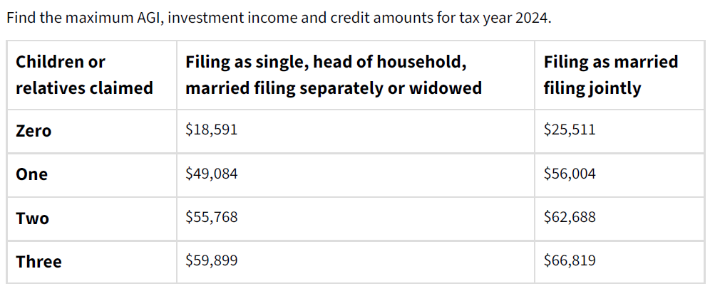

EIC Rules for Everyone Rule 1
Adjusted gross income (AGI) Limits
Tax Year 2024, Line 11 Form 1040

Slide 11
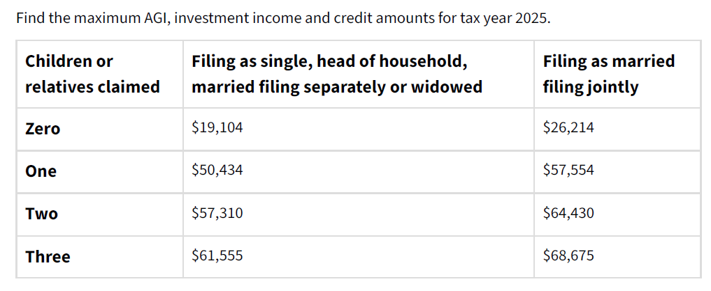
EIC Rules for Everyone Rule 1
Adjusted gross income (AGI) Limits
Tax Year 2025

Slide 12

EIC Rules for Everyone Rule 2
Taxpayer must have a valid Social Security Number (SSN)

Slide 13

EIC Rules for Everyone Rule 3
If taxpayer is separated from spouse and not filing a joint return, taxpayer must meet certain rules

Slide 14

EIC Rules for Everyone Rule 4
Taxpayer must be a U.S. citizen or resident all year

Slide 15

EIC Rules for Everyone Rule 5
Taxpayer cannot file Form 2555

Slide 16

EIC Rules for Everyone Rule 6
Taxpayer investment must be $11,600 (2024), $11,950 or less

Slide 17

EIC Rules for Everyone Rule 7
You must have earned income

Slide 18
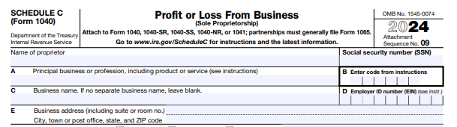
EIC Rules for Everyone Rule 7
Schedule C due diligence
To meet due diligence requirements, a paid preparer should determine if a client is really conducting a trade or business

Slide 19

EIC Rules for Everyone Rule 7
Schedule C due diligence
Ask probing questions such as:
If necessary or customary for the trade, does the client have a business license, business cards, a business location, sales tax permit, advertisements, or other expected business structures or processes?

Slide 20

EIC Rules for Everyone Rule 7
Schedule C due diligence
Remember:
Self-employed clients filing a Schedule C or Schedule F must report the correct gross income and deduct all allowable business expenses on their respective tax returns

Slide 21

EIC Rules for Taxpayers That Have Qualifying Child Rule 8
Taxpayer’s child must meet the ‘Relationship’, ‘Age’, ‘Residency’ and ‘Joint Return’ tests

Slide 22

EIC Rules for Taxpayers That Have Qualifying Child Rule 8
Qualifying children for EIC must meet the following tests:
Relationship
Age
Residency
Joint return
Support

Slide 23
Qualifying Child Requirement for EIC
Relationship | Age | Residency | Joint Return
The child must be your client's: son, daughter, adopted child, stepchild, eligible foster child or a descendant of any of them or brother, sister, step-brother or sister, half brother or sister, or a descendant of any of them | The child must be younger than your client or your client's spouse if filing a joint return and under the age of 19 at the end of the year or a full-time student under the age of 24 at the end of the year The child can be any age if permanently and totally disabled at any time during the year | The child must have: lived with your client or your client's spouse, if filing a joint return, for more than half the year* in the United States *Exceptions exist for temporary absence due to special circumstances and birth or death of a child. See Pub. 596, Earned Income Credit for more information | The child must: not file a joint return or file a joint return only to claim a refund of withholding or estimated tax paid and neither the child nor the child's spouse had a filing requirement

Slide 24

EIC Rules for Taxpayers That Have Qualifying Child Rule 9
Taxpayer’s qualifying child cannot be used by more than one person to claim EIC
Remember, only the custodial parent is eligible to claim the EIC

Slide 25

EIC Rules for Taxpayers That Have Qualifying Child Rule 10
Taxpayers cannot be a qualifying child of another taxpayer

Slide 26
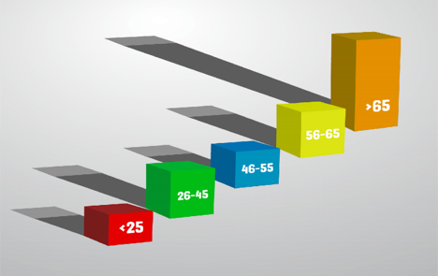
EIC Rules for Taxpayers That Do Not Have Qualifying Child Rule 11
Taxpayer must meet the age requirements
Taxpayer must be at least age 25 but under age 65 at the end of tax year.
If taxpayer is married filing joint return, either taxpayer of spouse must meet the test, however, both do not have to meet it

Slide 27

EIC Rules for Taxpayers That Do Not Have Qualifying Child Rule 12
Taxpayer cannot be the dependent of another person

Slide 28

EIC Rules for Taxpayers That Do Not Have Qualifying Child Rule 13
Taxpayer cannot be a qualifying child of another taxpayer

Slide 29
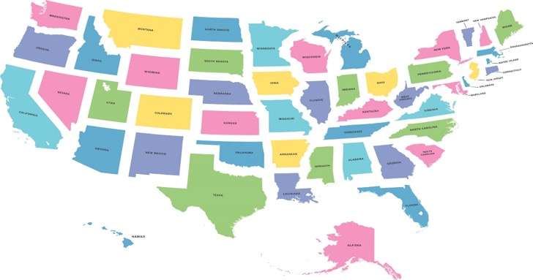
EIC Rules for Taxpayers That Do Not Have Qualifying Child Rule 14
Taxpayer must have lived in the U.S. more than half of the year

Slide 30

EIC Rules for Military
Military has two additional rules
Get ‘nontaxable military pay’ such as
combat pay
housing allowance
subsistence allowance
Were stationed outside the United States
Extended active duty

Slide 31

EIC Rules for Clergy or Minister
Clergy or Minister Rules
If you are a clergy member or minister, you must
Include the rental value of the home you live in, or the housing allowance, if it was provided to you by the church
Include income you get for working as a minister if you are an employee

Slide 32

Question
What does Due Diligence mean to you?

Slide 33

Due Diligence Must Dos
Know the law
Ask all the right questions
Complete and submit Form 8867
Apply your knowledge
Get all the facts
Compute the credits based on the facts
Documents as you go and keep records

Slide 34
Due Diligence Question # 1
Tax Preparers’ Most Frequently Asked Questions Received By The IRS
What Documents should a paid preparers ask for when interviewing a client for a tax return claiming certain tax benefits, credits, and Head of Household filing status?

Slide 35
Due Diligence Answer # 1
Answer
Due diligence does not necessarily require you to request documentation. However, you must make reasonable inquiries if the client gives you information that appears incorrect, incomplete, or inconsistent.
In some cases, a reasonable inquiry may entail asking for documentation.

Slide 36
Due Diligence Question # 2
Tax Preparers’ Most Frequently Asked Questions Received By The IRS
I have known my client for years, so do I still need to perform Due Diligence

Slide 37
Due Diligence Answer # 2
Answer
Yes. You must make reasonable inquiries to determine the client’s eligibility for the tax benefit and must document the client’s responses.
Even if you believe that your already know the answers to your inquiries, you must ensure that your information is current, as some facts such as the residency of qualifying persons my have changed.

Slide 38
Tax Practitioners Exercising Due Diligence Summary
Careful attention and painstaking
Interviewing Clients
Gather the facts, do Not assume!
Prior Knowledge
Document, Document, Document

Slide 39
Tax Practitioners Exercising Due Diligence Summary
Make Reasonable inquiries
Do clients documents make sense
Document date, time and who you interviewed

Slide 40
Tax Practitioners Exercising Due Diligence Summary
Avoid Errors
Ensure clients receive the correct credits
Ensure clients file correct filing status
Protect clients and your self from penalties

Slide 41
Tax Practitioners Due Diligence Requirements
Completions and submission of Form 8867
Completion of applicable credit worksheet(s) and computation of the credit(s)
Knowledge
Record retention

Slide 42
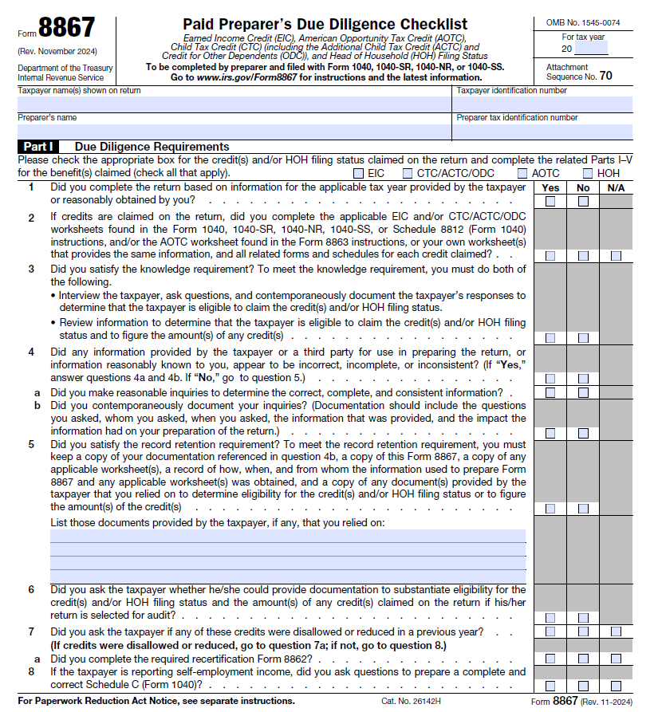
Form 8867

Slide 43
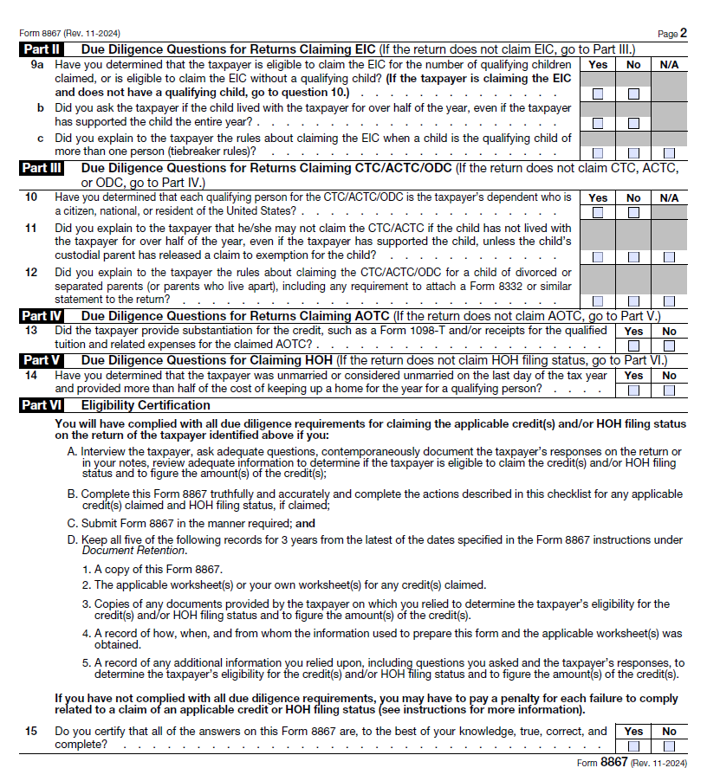
Form 8867

Slide 44

Due Diligence Requirement # 1
Complete and submit Form 8867
Paid Preparer’s Due Diligence Checklist

Slide 45

Due Diligence Requirement # 2
Complete Worksheet(s) and compute the credits(s)

Slide 46

Due Diligence Requirement # 3
Knowledge

Slide 47

Due Diligence Requirement # 4
Keeping Records

Slide 48

Due Diligence Note of Interest
Having your client sign any due diligence documents, forms, worksheets, etc., Does Not relieve you of due diligence requirements

Slide 49
Interviewing Tips
Probing questions are necessary to meet the due diligence knowledge requirement
Evaluate information provided by client
Ask questions in layman terms
Do not lead the ‘witness’
Document, document, document

Slide 50

Best Practices
Every year ask all applicable questions to complete Form 8867 and applicable worksheet(s)
Phrase questions in non-technical terms your client will understand
Ask enough questions to correctly
determine filing status
Does client have qualifying child(ren)
EIC related

Slide 51
Best Practices
Apply a reasonableness standard to information received from your client and ask follow-up questions about any inconsistencies
Ask as many questions as you need in order to be satisfied with your due diligence requirements

Slide 52
We Cannot Rely on Software Alone to Fulfill Due Diligence Responsibilities
Software is not a substitute for your tax law knowledge and common sense
Be sure you complete and review all the required worksheets for the credits claimed
Remember software programs may not catch all the special rules and exceptions; for example, the option to classify nontaxable combat pay as earned income for the EIC
Review the computation of any credit claimed for completeness so your clients do not miss out on credits to which they are entitled

Slide 53
These Best Due Diligence Practices Can Assist
Apply common sense to information client provides
Does the whole picture make sense
Ask additional questions about any incorrect, inconsistent or incomplete information client provides
Consider using IRS forms to assist;
886-H-EIC

Slide 54
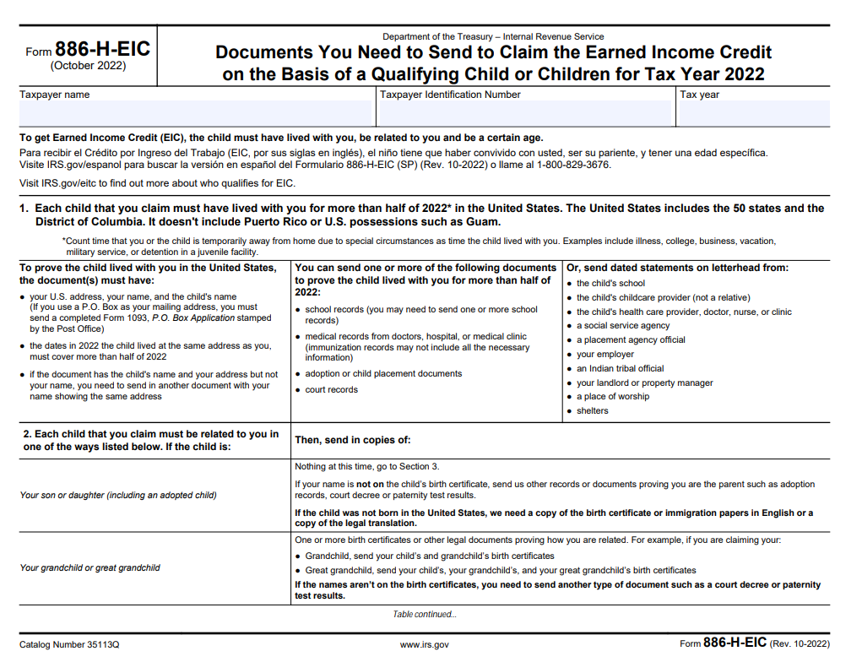
Form 886-H-EIC

Slide 55
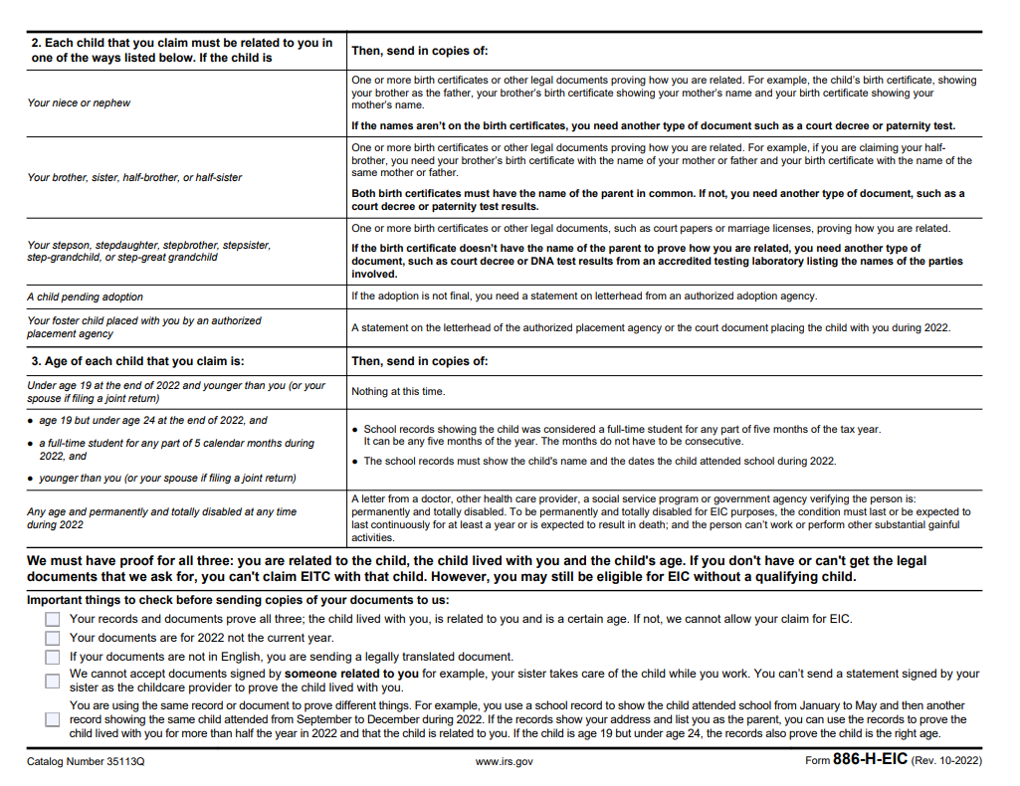
Form 88-H-EIC

Slide 56
These Best Due Diligence Practices Can Assist
Income reporting questions
Document all additional inquires
Education yourself and your office

Slide 57
Record Retention Requirements
Retain documents provided to determine facts
Be aware of record retention time frames
Maintain copy of original documents provided by client
Keep all client records containing personally identifiable information in a secure environment to safeguard client privacy
Always backup electronic records

Slide 58
Other Best Practices
Create an interview sheet based on questions asked in your tax software and ask additional questions as needed
Use computer software, Form 8867 and 886-H-EIC to develop your checklist
Not one size fits all

Slide 59
Paid Preparer Compliance
The IRS and your clients expect you to know the tax law and prepare accurate returns. As a paid preparer, you must meet the due diligence requirements to avoid consequences

Slide 60
Paid Preparer Compliance
A $635 penalty (returns filed in 2025) assessed against you for each failure to meet the EIC, CTC/ACTC/ODC, AOTC or HOH filing status due diligence requirements on a client's return. If you fail to meet due diligence with respect to more than one credit or HOH filing status on a return, there can be a penalty assessed for each failure (up to four per return)
Referral to the Office of Professional Responsibility

Slide 61
Paid Preparer Compliance
Referral to the criminal investigation division
Suspension or expulsion of your firm from participation in IRS e-file
An injunction barring you from preparing tax returns for others

Slide 62
Paid Preparer Compliance
Employers of paid preparers must also meet due diligence requirements to avoid consequences
IRS can assess a penalty of $635 (returns filed in 2025) against an employer or employing firm for each time an employee fails to meet the due diligence requirements

Slide 63
Due Diligence Questionnaire Example

Slide 64
Due Diligence Questionnaire Example

Slide 65
Due Diligence Questionnaire Example

Slide 66
Due Diligence Questionnaire Example

Slide 67

Due Diligence Questionnaire Example

Slide 68
Other Items of Interest for Questionnaire
Copy of taxpayer's driver's license for your file
Copy of all Social Security cards for your file
Copy of birth certificates of children for your file
Copy of prior tax returns if new client
All records of income
All records of expenses associated with self-employment income

Slide 69
Other Items of Interest for Questionnaire
Dependent childcare information
Proof of living expenses for head of household
Proof of residency for qualifying children living in household
Doctor office statement
School records
Employer letter
Pastor letter

Slide 70
Bonus Quote of the Session
“If you think compliance is expensive – try non-compliance”
-- Former US Deputy Attorney General Paul McNulty --

Slide 71
IRS Resources
Visit EITC Central
https://www.eitc.irs.gov
Tax Return Preparer Toolkit
https://www.eitc.irs.gov/tax-preparer-toolkit/welcome-to-the-tax-preparer-toolkit
IRS Resources

Slide 72
IRS Resources
The EITC Assistant
Use this calculator to find out if your client is eligible for the EITC
https://www.irs.gov/credits-deductions/individuals/earned-income-tax-credit/use-the-eitc-assistant
IRS Resources

Slide 73
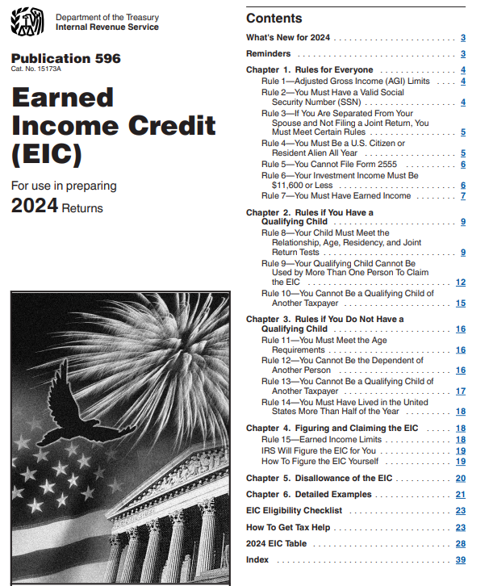
IRS Resources
IRS Resources

Slide 74


Training Questions

Slide 75
Training Question # 1
As a paid preparer, you must ask additional questions if a reasonable and well-informed paid preparer, knowledgeable in the law, would conclude the information given to you seems incorrect, inconsistent or incomplete.
True
False

Slide 76
Training Question # 1 – Answer
True - The knowledge requirement in the regulation provides a standard for when paid return preparers must ask more questions.

Slide 77
Training Question # 2
Which of the following is NOT a due diligence requirement that you as a paid preparer must meet?
Computing the credit
Keeping records
Completing and submitting the Form 8867
Reviewing prior year tax returns
Following the knowledge requirement

Slide 78
Training Question # 2 – Answer
D. Reviewing prior year tax returns - The four due diligence requirements include:
Completing and submitting the Form 8867
Computing the credit
Following the knowledge requirement
Keeping records

Slide 79
Training Question # 3
Which of the following is not true about the due diligence requirements?
Paid preparers must keep records showing due diligence requirements were met for at least 3 years from the due date of the return
Paid preparers must always ask for documents to prove the relationship and residency of a qualifying person before completing a claim for the EIC, CTC/ACTC/ODC, AOTC or HOH filing status
Paid preparers must complete and submit Form 8867 to the IRS with each return or claim for refund claiming the EIC, CTC/ACTC/ODC, AOTC or HOH filing status
Paid preparers must keep a copy of any document provided by a client on which the paid preparer relies to determine eligibility for the EIC, CTC/ACTC/ODC, AOTC or HOH filing status
Paid preparers should make additional inquiries if the client's response seems incorrect, inconsistent, or incomplete, and record any additional questions asked and the client's answers

Slide 80
Training Question # 3 – Answer
Paid preparers must always ask for documents to prove the relationship and residency of a qualifying person before completing a claim for the EIC, CTC/ACTC/ODC, AOTC or HOH filing status. FALSE.
Paid preparers are not required to ask for client documents to prove relationship and residency of a qualifying person before completing a claim for the EIC, CTC/ACTC/ODC, AOTC or HOH filing status. However, a paid preparer must ask questions and may request documents if the information provided by the client appears to be incorrect, inconsistent or incomplete.

Slide 81
Training Question # 4
Which of the following is a qualifying child requirement for both the EIC and the CTC/ACTC?
Relationship test
Residency test
Support test
All the above
Both A and B

Slide 82
Training Question # 4 – Answer
E. Both A and B.
Remember :
Relationship
Residency
Age
Joint return
Support

Slide 83
Training Question # 5
Thomas wants to have his taxes prepared. He informs you:
He is 51 years old
He lives in South Dakota
Both Thomas and his 19-year-old son have an ITIN issued by the due date of the return
Thomas's Form W-2 reflects earnings of $19,000

Slide 84
Training Question # 5 – Answer
Does Thomas’s son qualify Thomas for ODC?
Yes
No
Need more information
Let’s discuss…………………

Slide 85
Training Question # 6
Mary wants to have her tax return prepared. She informs you:
She is 22 years old and has an SSN that is valid for employment and issued by the due date of the return
She lives in Iowa (always a bonus)
Her 16-year-old sister lived with her
Her sister has an ITIN issued by the due date of the return
Her 14-year-old niece lived with her
Her niece has SSN and is valid and issued timely
Mary’s W-2 reflects earnings of $27,000

Slide 86
Training Question # 6 – Answer
Does May qualify to claim the EIC with a qualifying child or claim the CTC/ACTC or ODC?
Yes
No
Need more information
Let’s discuss…………………

Slide 87
Training Question # 6 (continued)
Which question(s) would you ask Mary to determine if she can claim CTC/ACTC or ODC for these people?
Is your niece a full-time student?
How long did your sister and niece live with you in the U.S. during the tax year
Did your sister or niece provide more than half of their own support?
Is there a parent or anyone else who my claim your sister or niece as a dependent or qualifying child/relative?
B, C and D

Slide 88
Training Question # 6 (continue) – Answer
In response to your questions, May informs you:
Q: How long did your sister and niece live with you in the United States during the year? A: They both lived with me in the U.S. all year.
Q: Did your sister or niece provide more than half their own support? A: No, they both were attending school. My sister had a part-time job, but she only earned about $1,500. We had no support except my paycheck.
Q: Is there a parent or anyone else who may claim your sister or your niece as a dependent or qualifying child? A: No, our mother died more than a year ago, and we don't know where our father is. My niece's parents don't live in the U.S. No one else lived with us during the year.

Slide 89
Training Question # 6 (continue) – Answer
Does Mary qualify to claim EIC, CTC/ACTC or ODC?
Yes
No
Let’s discuss…………………

Slide 90
Training Question # 7
Linda wants to have her tax return prepared. She tells you:
She is 18 years old
She has a 2-year-old daughter
She wants to claim the EIC and the CTC/ACTC for her daughter
She and her daughter have valid SSNs
Her W-2 reflects earnings of $3,000

Slide 91
Training Question # 7
Would you ask Linda additional questions to satisfy due diligence requirements in this situation?
Yes
No

Slide 92
Training Question # 7
Which question(s) would you ask Linda to determine if she and/or child are the qualifying child or dependent of another person?
With whom did you and your daughter live during the year?
Who provided support for both you and your daughter?
Both A & B
None of the above

Slide 93
Training Question # 7
In response to your questions, Linda provides the following:
Q: With whom did you and your daughter live during the year? A: My daughter lived with my parents all year and I moved into my parent's house in September.
Q: Who provided support for you and your daughter? A: My parents provided most of the support for both of us. I moved back into my parent's house in September because they stopped paying my rent.

Slide 94
Training Question # 7 – Answer
Does Linda qualify to claim the EIC with a qualifying child or claim the CTC/ACTC?
Yes
No
Let’s discuss…………………

Slide 95
Training Question # 8
Steven wants to have his tax return prepared. He tell you:
He is 32 years old
He has stepsons, ages, 10 and 11, and both stepsons have valid SSNs
He can provide documentation that the boys lived with him all year in the U.S.
He divorced the boys’ mother two years ago
The boys’ mother moved back in with them in August
His W-2 reflects earnings are $20,000

Slide 96
Training Question # 8 – Answer
Would you ask Steven additional questions to satisfy due diligence requirements for EIC or CTC/ACTC in this situation?
Yes
No
Let’s discuss…………………

Slide 97
Training Question # 9
Sam wants to have his tax return prepared. He tells you:
He is 29 years old
He has a nephew, age 2
Sam shows you SS cards for himself, nephew, and child’s mother, his widowed (unmarried) sister-in-law, that are valid
Sam’s sister-in-law is 33 years old
His nephew and sister-in-law lived with him all year in U.S.
There were no other adults living in the home
He wishes to claim EIC and the CTC/ACTC and ODC
His W-2 reflects earnings of $33,000

Slide 98
Training Question # 9
Would ask Sam additional questions to satisfy due diligence requirements for EIC, CTC/ACTC or ODC in this situation?
Yes
No

Slide 99
Training Question # 9
Which questions would you ask Sam to determine if his nephew is a qualifying child for EIC and CTC/ACTC and if sister-in-law is a qualifying relative for whom Sam can claim ODC?
Does anyone else live in your household?
Why is the child’s mother not claiming him?
Who paid towards sister-in-law support and did Sam provide more than one-half?
Both A & C
Both B & C

Slide 100
Training Question # 9
In answer to your questions, Sam informs you:
Q: Why is the child's mother not claiming him? A: My sister-in-law said I can claim her son since I have been supporting the two of them all year. Her husband passed away almost two years ago.
Q: Who paid toward your sister-in-law's support, and did you provide more than half her support? A: My sister-in-law works a part-time job and earned $3,500. Other than money from her part-time job, I was the only one supporting all of us.

Slide 101
Training Question # 9 – Answer
Does Sam qualify to claim the EIC and the CTC/ACTC and ODC?
Yes
No
Let’s discuss…………………

Slide 102
Training Question # 10
Ellen is a returning client. In the previous two years, she claimed one qualifying child on her tax return. Ellen informs you:
This year she wants to claim two children, ages 13 and 14, for the EIC and the CTC/ACTS
One child is her daughter and the other child is her niece
She and her daughter have valid SSNs
Her niece has an ITIN issued by the due date of tax return
Her W-2 reflects earnings of $12,000

Slide 103
Training Question # 10 – Answer
Would you ask Ellen additional questions to satisfy due diligence requirements in this situation?
Yes
No
Discussion points…………………

Slide 104
Training Question # 10
Which question(s) would you ask Ellen to determine if the children meet the requirements to be her qualifying children?
With whom did the children live during the year and for how long?
How many bedrooms are in your home?
Where are the niece’s parents and why aren’t they claiming her?
Who provided support for the children and in what amounts?
Only A, C and D

Slide 105
Training Question # 10
In response to your questions, Ellen replies:
Q: Where are the niece's parents and why aren't they claiming her? A: My niece's mother passed away in June. Her father was in jail.
Q: Who provided support for the children and in what amounts? A: I provided all the support for both my daughter and my niece.

Slide 106
Training Question # 10 – Answer
Does Ellen qualify to claim EIC and CTC/ACTC for her daughter?
Yes
No
Let’s discuss…………
What about the niece?

Slide 107

Q&A

Slide 108


Slide 109

Disclaimers:
Opinions expressed by A.J. Reynolds are solely A.J. Reynolds' own and do not necessarily express the views or opinions of TaxAct Professional.
TaxAct is not responsible for, and expressly disclaims all liability and damages, of any kind arising out of use, reference to, or reliance on any third-party information contained on this site.
EIC Eligibility and Due Diligence

