Slide 1

Understanding Your Obligations & Adopting Appropriate Policies

Slide 2

Meet the Speaker
Jared Ballew VP, Government Relations
| 2

Slide 3
Objectives
Understand your data-security responsibilities as a tax professional – Safeguarding vs WISP Learn how to build and maintain a WISP
Learn how to build and maintain a WISP
Practical applications of tax professional data security
Q&A

Slide 4
Your Obligation
Protecting Taxpayer Data is the Law

Slide 5
1999 Gramm Leach Bliley Act
U.S. law requires financial institutions to protect consumer data
• Tax and accounting professionals are considered financial institutions, regardless of size
• The Federal Trade Commission (FTC) is responsible for the GLBA’s implementation
• FTC issued the Safeguards Rule to outline data safety measures

Slide 6
Safeguards Rule
Expanding the definition of a “financial institution”
…An accountant or other tax preparation service that is in the business of completing income tax returns is a financial institution because tax preparation services is a financial activity listed in 12 CFR 225.28(b)(6)(vi) and referenced in section 4(k)(4)(G) of the Bank Holding Company Act, 12 U.S.C. 1843(k)(4)(G).
Final Rules effective June 9, 2023

Slide 7
FTC §314.6 Exceptions – USE CAUTION
Section 314.4(b)(1), (d)(2), (h), and (i) do not apply to financial institutions that maintain customer information concerning fewer than five thousand consumers.
[86 FR 70308, Dec. 9, 2021]

Slide 8
What is PII? (Personally Identifiable Information)
SSN
Date of birth
Employment data
State-issued ID info
Income data
Account numbers
Credit and debit card numbers
Access codes
Personal identification numbers
Passwords associated with a tax client’s financial accounts
Taxpayer’s contact information

Slide 9
The Cost of Non-compliance
FTC
The Federal Trade Commission (FTC) can impose fines of up to $100,000 per violation for non-compliance with the FTC Safeguards Rule. The FTC may also impose additional penalties, including:
• Fines for individuals: Up to $10,000 per violation for individuals, such as corporate officers
• Consent violation damages: Up to $43,000 per day for each consent violation
• Restitution payments: To affected consumers
• Legal fees: To defend against the FTC's enforcement actions
• Corrective measures: To implement to fix any violations
• Long-term consent decrees: Extensive injunctive relief
IRS
A data breach is a violation of §7216 if proper WISP is not implemented
• Not maintaining a WISP could be considered willful and reckless
• Substantial penalties, including criminal penalties for unauthorized disclosures of tax information
• A violation of section 7216 is a misdemeanor, with a maximum penalty of up to one-year imprisonment or a fine of not more than $1,000, or both, together with the costs of prosecution.

Slide 10
The FTC Safeguard Rule Buckets
Physical
Technical
Administrative

Slide 11

Physical Safeguards
Keep Your Data Safe From Physical Threats
Examples of physical safeguards include limiting access to computers that store client data or creating a backup and storing it in a secure location offsite

Slide 12

Technical Safeguards
Ensure That Your Network Is Not Compromised
Technical safeguards include updated antimalware and antivirus software on office devices

Slide 13

Administrative Safeguards
Manage and Train Your Staff Employees are the leading cause of data breaches. Ensure that they can recognize phishing emails and other attempts by malicious actors to compromise data.

Slide 14
FTC Safeguards Rule New Requirements
Implement multi-factor authentication for any individual accessing any information system, unless your Qualified Individual has approved in writing the use of reasonably equivalent or more secure access controls
Protect by encryption all customer information held or transmitted by you both in transit over external networks and at rest.

Slide 15
Additional FTC Safeguards Rules 5k+ Customers
01
Create a Written Risk Assessment
Implement continuous monitoring or periodic penetration testing and vulnerability assessments
Establish a Written Incident Response Plan
Require your Qualified Individual to report in writing, regularly and at least annually, to your board of directors or equivalent governing body
02
03
04

Slide 16
Creating Your Written Information Security Plan

Slide 17
Your Security Plan (WISP)
Ensure that your security plan and policies are appropriate for your company’s:
• Size
• Complexity
• Scope of activities
• Sensitivity of customer data

Slide 18
Pubs 4557 and 5708
❑ Use Publication 4557 to:
▪ Understand FTC Safeguards Rule
▪ Understand basic security steps
▪ Recognize signs of data theft
▪ Respond & recover from data loss
❑ The Security Summit created Pub 5708 to help you create your WISP. It includes:
▪ An outline of required elements
▪ Sample template
▪ Sample policy attachments

Slide 19
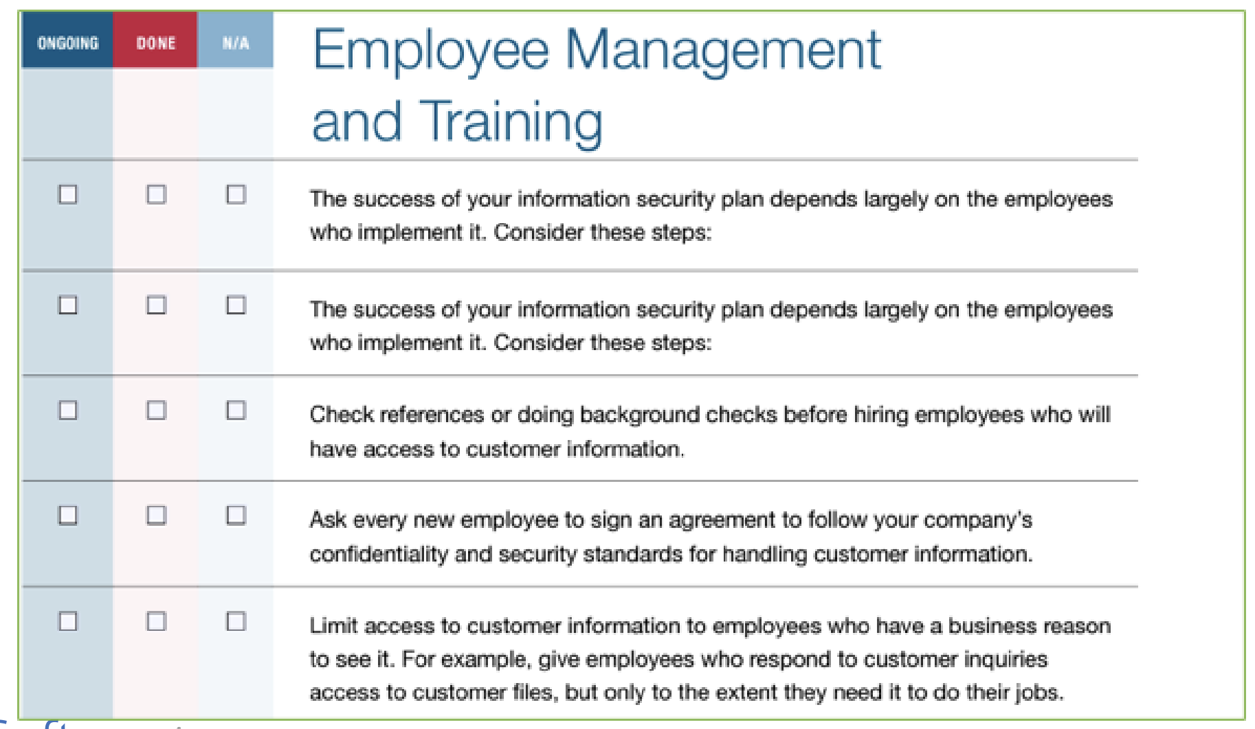
Pub 4557

Slide 20
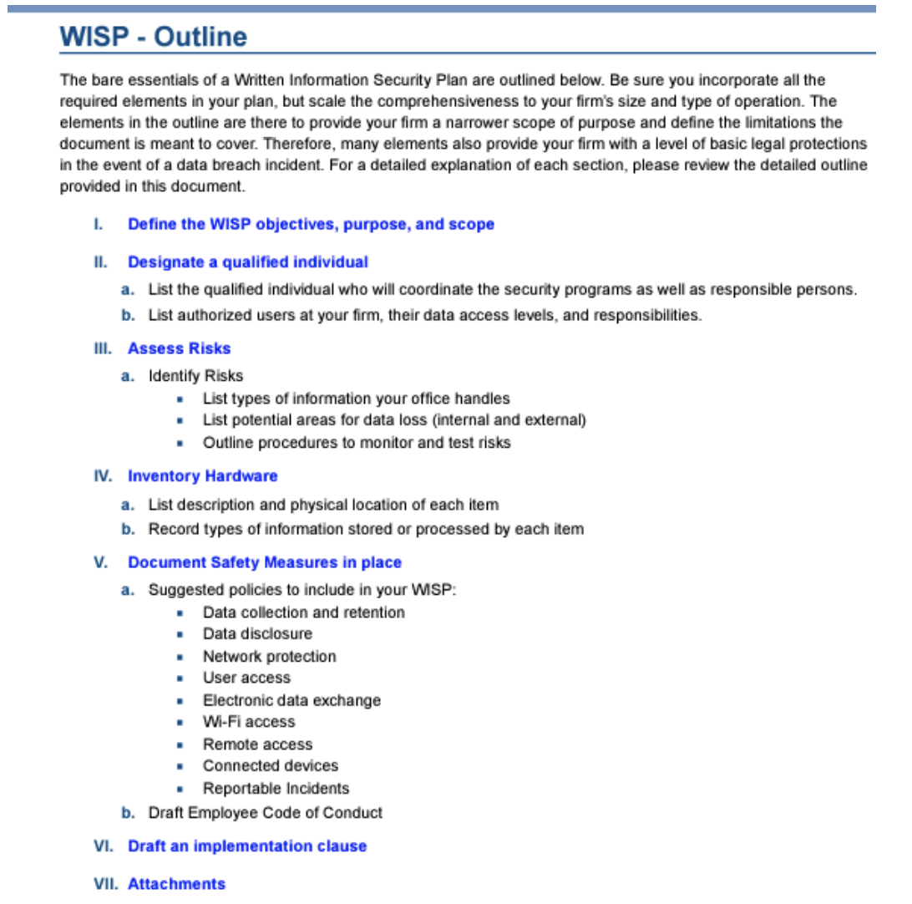
Pub 5708 WISP Development Page 2-4
Begin with your plan’s objectives, purpose, and scope
Identify responsible individuals
Assess risks
Inventory hardware
Document safety measures
Draft an implementation clause
Ancillary attachments

Slide 21
WISP Required Elements
The Safeguards Rule requires the following elements to be included in your WISP. Publication 5708 contains templates that cover each element.
1. Designate a qualified person
2. Identify and assess the risks
3. Manage and train staff
4. Design, implement, monitor, and test safeguard controls
5. Select service providers that can maintain appropriate safeguards
6. Evaluate and adjust the program
7. Implement Multi-Factor Authentication

Slide 22
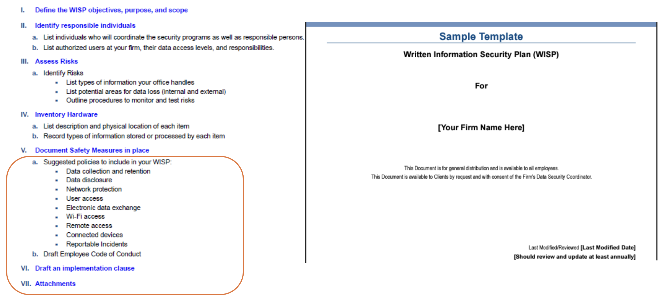
Use The Template on Pages 5-12

Slide 23
Section I. Define Objectives & Scope
❑ Objective Statement:
Defines the reason for the plan and states legal obligations. It should explain why the Firm developed the plan.
❑ Purpose Statement:
The Purpose Statement should explain what and how taxpayer information is being protected by security process and procedures.
❑ Scope Statement:
The scope statement sets the limits on the intent and purpose of the WISP.

Slide 24
Section II Identify Qualified Person
Identify by name and position of persons responsible for overseeing your security programs.
Explain who will act in the roles of Data Security Coordinator (DSC) and Public Information Officer (PIO).
In most firms of two or more practitioners, these should be different individuals. These roles will have concurrent duties in the event of a data security incident.
Be sure to define the duties of each responsible individual.

Slide 25
Section III. Assess Risk
Identify Risks: While building your WISP, take a close look at your business to identify risks of unauthorized access, use, or disclosure of information. Carefully consider your firm’s vulnerabilities.
▪ List types of information your office handles
▪ List all potential types of loss (internal and external)
▪ Outline procedures to monitor your processes and test for new risks that may arise

Slide 26
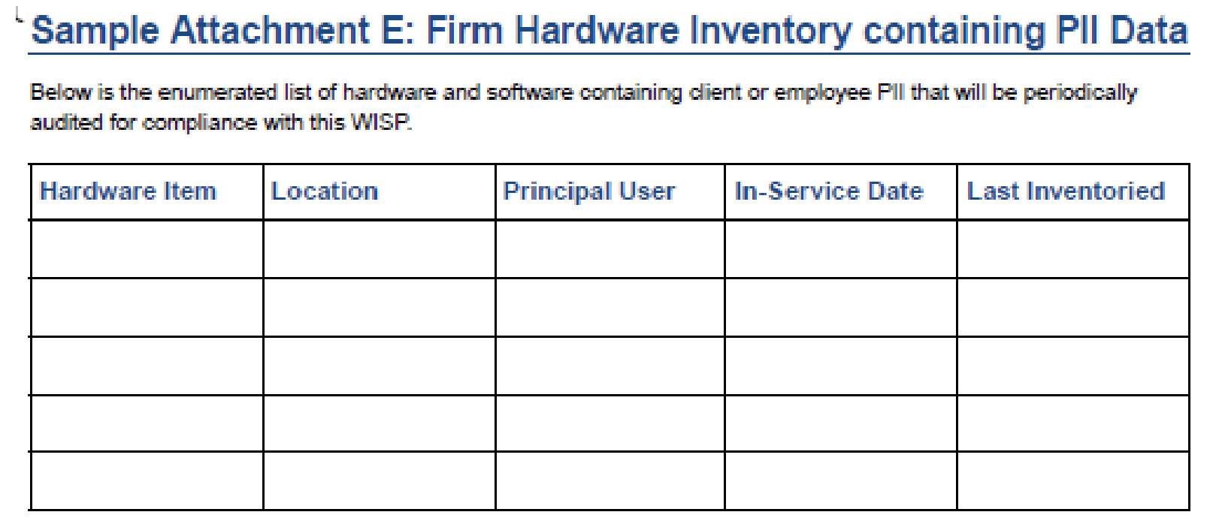
Section IV. Inventory Hardware
Catalog all devices used in your practice that touch taxpayer data
▪ List description and physical location of each item
▪ Record types of information stored or processed by each item

Slide 27
Section V. Document Safety Measures
Suggested Policies & Procedures to include in your WISP:
▪ Inventory Containing PII
▪ Data collection and retention
▪ Data disclosure
▪ Network protection
▪ Electronic data exchange
▪ User Access
▪ Wi-Fi Access
▪ Remote Access
▪ Connected Devices
▪ Reportable Incidents

Slide 28
Section V. Document Safety Measures
Pub 5708 Contains Sample Policy Attachments
▪ Record Retention Policy
▪ Rules of Behavior & Conduct Safeguarding Client PII
▪ Security Breach Procedures & Notification
▪ Employee Code of Conduct
▪ Employee / Contractor Acknowledgement
▪ Firm Hardware Inventory Containing PII
▪ Firm Employee Authorization to Access PII

Slide 29
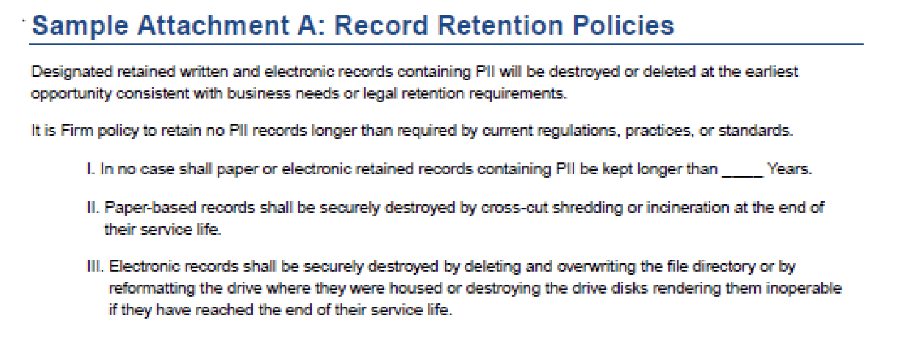
How Should I Document Policies?
▪ Use the pre-populated templates and policy attachments sample templates in Pub 5708!
▪ Checklists of items to consider can be found in Publication 4557

Slide 30
Section VI. Implement Your WISP!
An Implementation clause is included in Publication 5708 and should show the following elements:
Date of implementation & Firm Name
Affirmation that the plan complies with GLBA requirements
Affirmation that the plan complies the Federal Trade Commission Financial Privacy and Safeguards Rule
Reference to applicable state regulatory requirements
Signatures of the principal operating officer or owner, and the DSC and dated with the date of implementation

Slide 31
Poll Question #3

Slide 32
Practical Applications of Tax
Professional Data Security
Question Everything – Trust Nothing

Slide 33
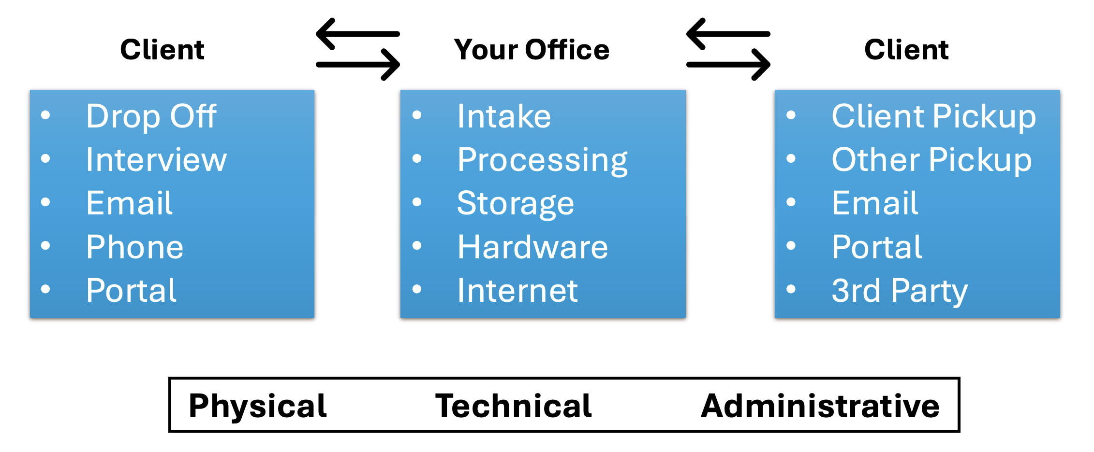
Map Out How You Communicate, Use & Store Data

Slide 34
FTC Data Breach Response Guide
Guides practitioners through the steps to take in the event of a breach
Secure operations, fix vulnerabilities, notify appropriate parties, and inform clients
Template breach notifications and response letters available
Implementing and monitoring a Written Information Security Plan is an effective tool against breaches

Slide 35
Worst Case Scenario
• Prepare – have a plan NOW (WISP)
• Contact IRS Stakeholder Liaison and State DOR
• Contact law enforcement (Local/FBI)
• Contact insurance carrier
• Contact experts
• FTC : Data Breach Response: A Guide for Businesses

Slide 36
FTC Data Breach Reporting Webpage
OMB APPROVAL NO.: 3084-0171 EXPIRATION DATE: 12/31/2026
The Safeguards Rule requires covered financial institutions to report to the FTC security events affecting 500 or more people. Your report may be made public. Law enforcement can request a delay in making this report public.
After submitting your online data breech report you should receive a reply email within two business days with instructions for the secure electronic submission of encrypted documents.

Slide 37
Questions

Slide 38
Thank you!

